Slide 1
IIT, Kanpur eMasters – Communication Systems EE910 – Digital Communication Systems-I
Notes, References, Questions, Problems, and Solutions
Venkateswar Reddy Melachervu
April 2023

Slide 2
Instructor Details
Name: Adrish Banerjee
E-mail: adrish@iitk.ac.in (preferred mode of communication)
Phone: 0512-259-7991
Teaching Assistants
Tamoghno Nath tamoghno@iitk.ac.in
Kalyan Paul kalyanpaul21@iitk.ac.in

Slide 3
Course Evaluation
Class Participation
Assignment
Weekly assignments
Final grade based on best 6 submissions
Quizzes
Two quizzes – each of one hour duration
Best 2 of 4 for final grade
End-semester exam
Three hours – multiple choice
Negative marking
+4 for right answer and -1 for wrong answer
Grading Weightages
Sr.No |  | Marks
1 | Class Participation in live sessions | 10
2 | Assignments (best six out of eight) | 30
3 | Quizzes (best two out of four) | 20
4 | End-semester exam | 40

Slide 4
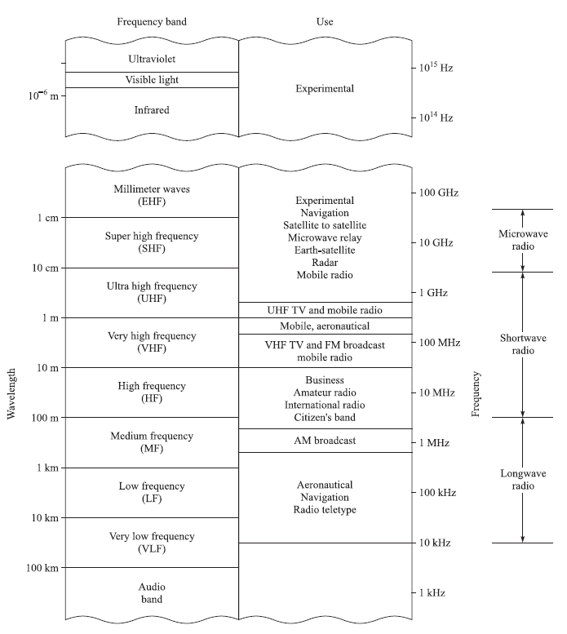
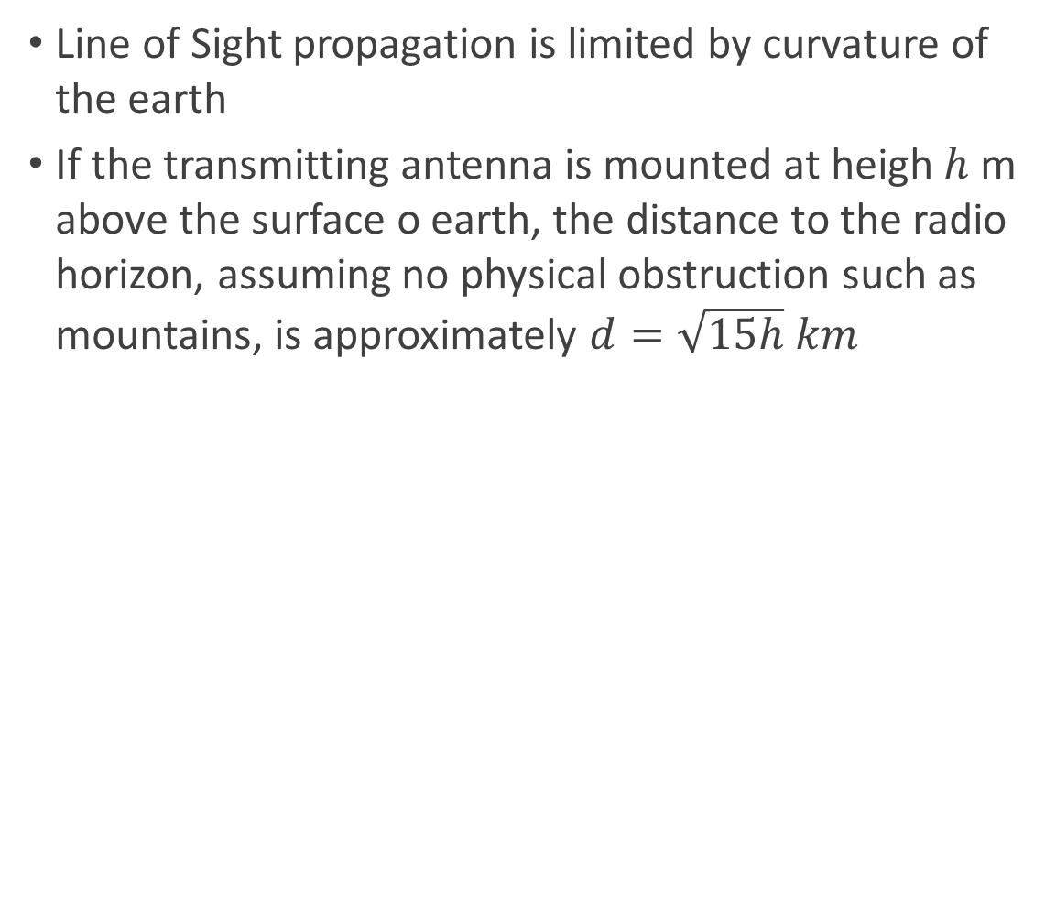
Frequency Range and Wireless Channels
Line of Sight propagation is limited by curvature of the earth
If the transmitting antenna is mounted at heigh $h$ m above the surface o earth, the distance to the radio horizon, assuming no physical obstruction such as mountains, is approximately $d=\sqrt{15h} km$

Slide 5
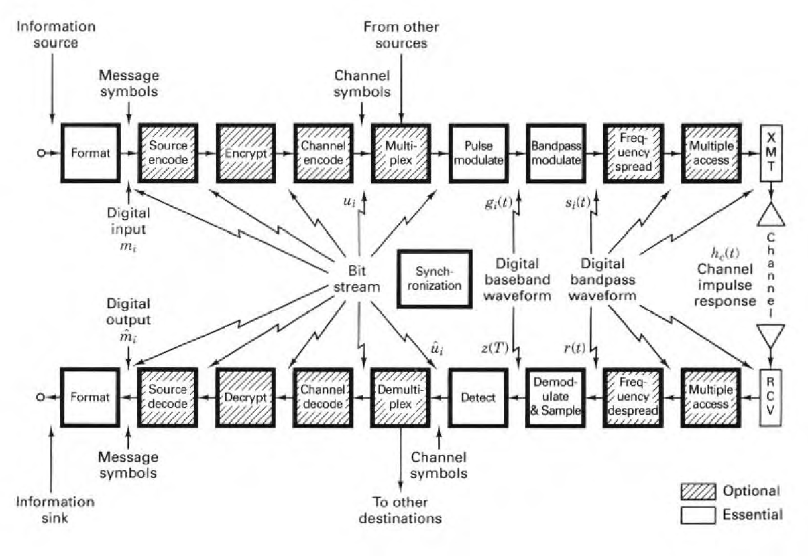
Communication System - Functional Block Diagram

Slide 6
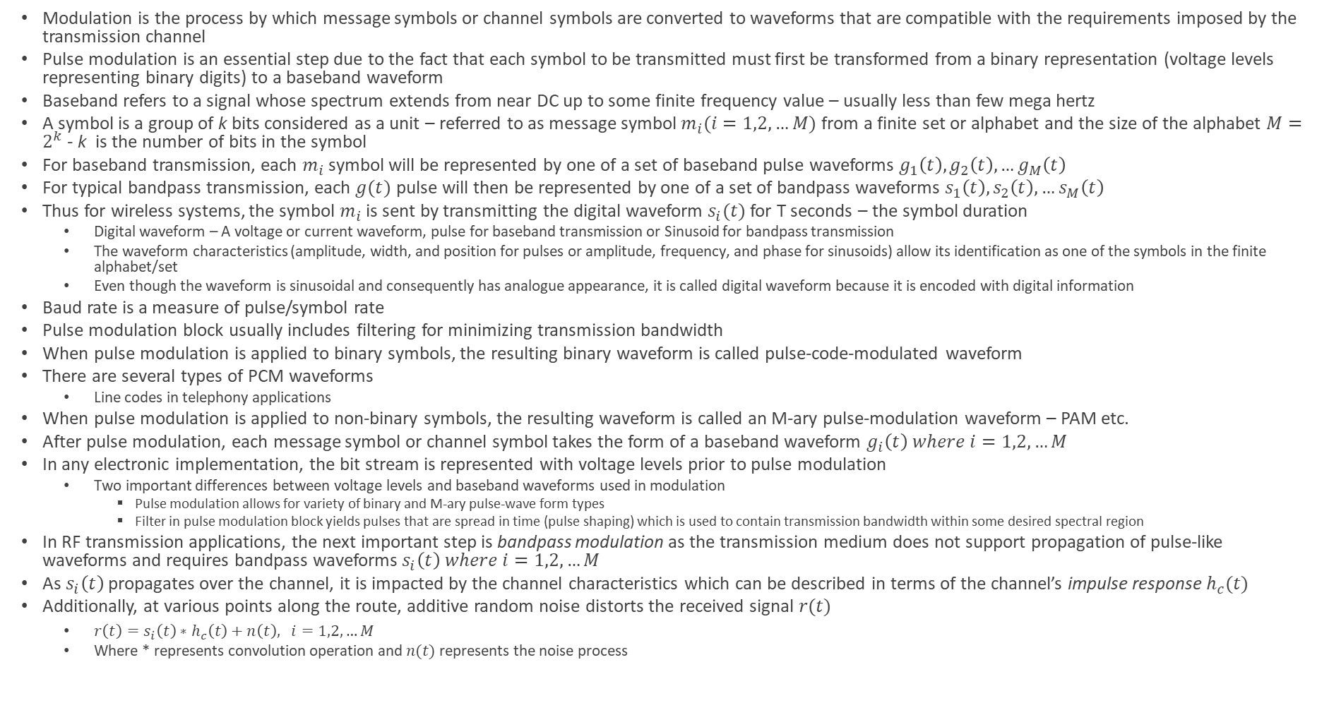
Communication System - Functional Block Diagram
Modulation is the process by which message symbols or channel symbols are converted to waveforms that are compatible with the requirements imposed by the transmission channel
Pulse modulation is an essential step due to the fact that each symbol to be transmitted must first be transformed from a binary representation (voltage levels representing binary digits) to a baseband waveform
Baseband refers to a signal whose spectrum extends from near DC up to some finite frequency value – usually less than few mega hertz
A symbol is a group of k bits considered as a unit – referred to as message symbol $m_{i}(i=1,2,…M)$ from a finite set or alphabet and the size of the alphabet $M=2^{k}$ - k is the number of bits in the symbol
For baseband transmission, each $m_{i}$ symbol will be represented by one of a set of baseband pulse waveforms $g_{1}\left(t\right), g_{2}\left(t\right), …g_{M}\left(t\right)$
For typical bandpass transmission, each $g(t)$ pulse will then be represented by one of a set of bandpass waveforms $s_{1}\left(t\right), s_{2}\left(t\right),…s_{M}\left(t\right)$
Thus for wireless systems, the symbol $m_{i}$ is sent by transmitting the digital waveform $s_{i}(t)$ for T seconds – the symbol duration
Digital waveform – A voltage or current waveform, pulse for baseband transmission or Sinusoid for bandpass transmission
The waveform characteristics (amplitude, width, and position for pulses or amplitude, frequency, and phase for sinusoids) allow its identification as one of the symbols in the finite alphabet/set
Even though the waveform is sinusoidal and consequently has analogue appearance, it is called digital waveform because it is encoded with digital information
Baud rate is a measure of pulse/symbol rate
Pulse modulation block usually includes filtering for minimizing transmission bandwidth
When pulse modulation is applied to binary symbols, the resulting binary waveform is called pulse-code-modulated waveform
There are several types of PCM waveforms
Line codes in telephony applications
When pulse modulation is applied to non-binary symbols, the resulting waveform is called an M-ary pulse-modulation waveform – PAM etc.
After pulse modulation, each message symbol or channel symbol takes the form of a baseband waveform $g_{i}\left(t\right) where i=1,2,…M$
In any electronic implementation, the bit stream is represented with voltage levels prior to pulse modulation
Two important differences between voltage levels and baseband waveforms used in modulation
Pulse modulation allows for variety of binary and M-ary pulse-wave form types
Filter in pulse modulation block yields pulses that are spread in time (pulse shaping) which is used to contain transmission bandwidth within some desired spectral region
In RF transmission applications, the next important step is bandpass modulation as the transmission medium does not support propagation of pulse-like waveforms and requires bandpass waveforms $s_{i}\left(t\right) where i=1,2,…M$
As $s_{i}\left(t\right)$ propagates over the channel, it is impacted by the channel characteristics which can be described in terms of the channel’s impulse response$h_{c}(t)$
Additionally, at various points along the route, additive random noise distorts the received signal $r(t)$
$r\left(t\right)=s_{i}\left(t\right)∗h_{c}\left(t\right)+n\left(t\right), i=1,2,…M$
Where * represents convolution operation and $n(t)$ represents the noise process

Slide 7
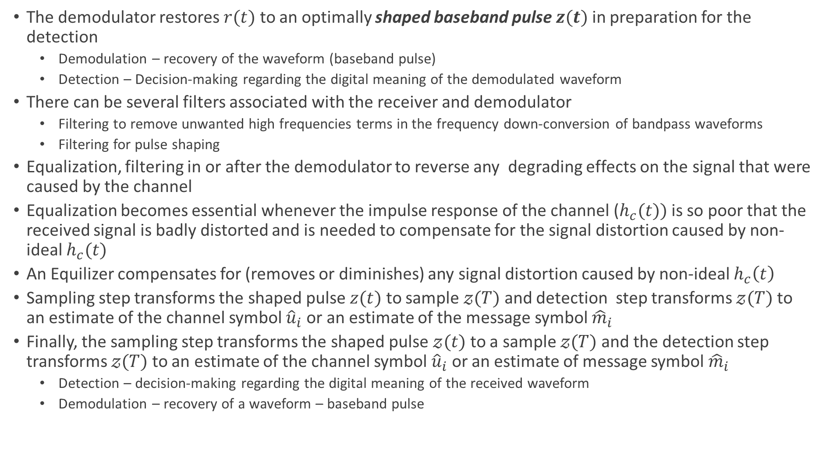
Communication System - Functional Block Diagram
The demodulator restores $r(t)$ to an optimally shaped baseband pulse $z(t)$ in preparation for the detection
Demodulation – recovery of the waveform (baseband pulse)
Detection – Decision-making regarding the digital meaning of the demodulated waveform
There can be several filters associated with the receiver and demodulator
Filtering to remove unwanted high frequencies terms in the frequency down-conversion of bandpass waveforms
Filtering for pulse shaping
Equalization, filtering in or after the demodulator to reverse any degrading effects on the signal that were caused by the channel
Equalization becomes essential whenever the impulse response of the channel ($h_{c}(t))$ is so poor that the received signal is badly distorted and is needed to compensate for the signal distortion caused by non-ideal $h_{c}(t)$
An Equilizer compensates for (removes or diminishes) any signal distortion caused by non-ideal $h_{c}\left(t\right)$
Sampling step transforms the shaped pulse $z(t)$ to sample $𝓏(T)$ and detection step transforms $𝓏(T)$ to an estimate of the channel symbol ${\hat{u}}_{i}$ or an estimate of the message symbol ${\hat{m}}_{i}$
Finally, the sampling step transforms the shaped pulse $𝓏(t)$ to a sample $𝓏(T)$ and the detection step transforms $𝓏(T)$ to an estimate of the channel symbol ${\hat{u}}_{i}$ or an estimate of message symbol ${\hat{m}}_{i}$
Detection – decision-making regarding the digital meaning of the received waveform
Demodulation – recovery of a waveform – baseband pulse

Slide 8
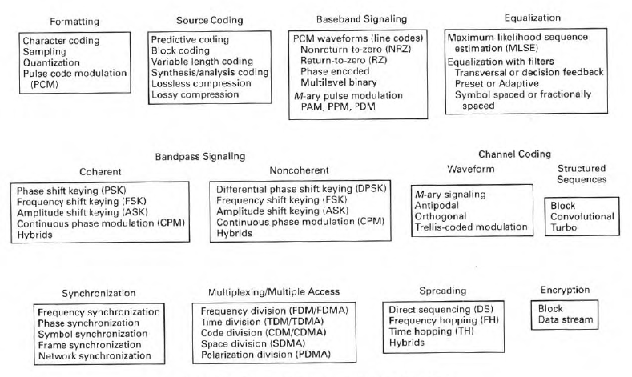
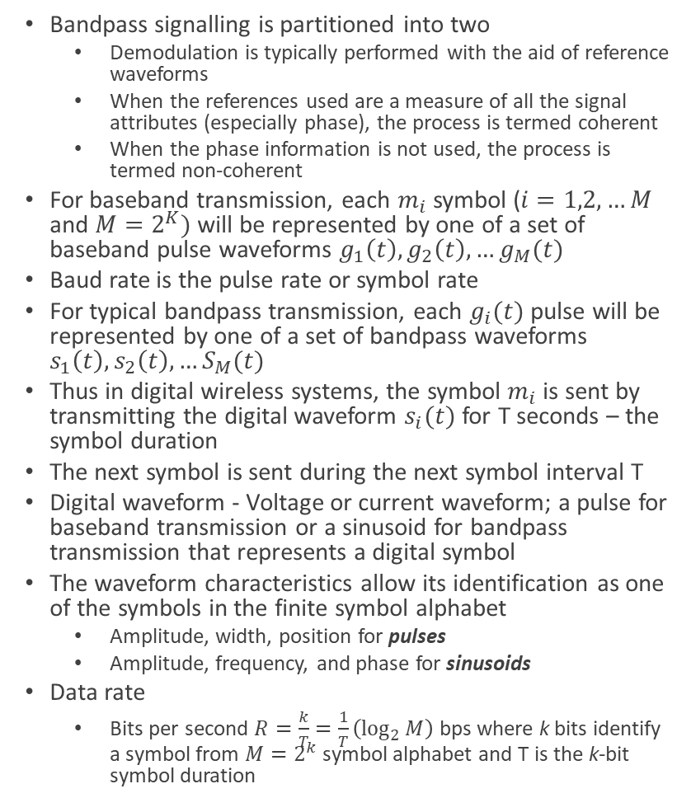
DCS Basic Signal Processing Functions
Bandpass signalling is partitioned into two
Demodulation is typically performed with the aid of reference waveforms
When the references used are a measure of all the signal attributes (especially phase), the process is termed coherent
When the phase information is not used, the process is termed non-coherent
For baseband transmission, each $m_{i}$ symbol ($i=1,2,…M$ and $M=2^{K})$ will be represented by one of a set of baseband pulse waveforms $g_{1}\left(t\right), g_{2}\left(t\right), …g_{M}(t)$
Baud rate is the pulse rate or symbol rate
For typical bandpass transmission, each $g_{i}(t)$ pulse will be represented by one of a set of bandpass waveforms $s_{1}\left(t\right), s_{2}\left(t\right),…S_{M}(t)$
Thus in digital wireless systems, the symbol $m_{i}$ is sent by transmitting the digital waveform $s_{i}(t)$ for T seconds – the symbol duration
The next symbol is sent during the next symbol interval T
Digital waveform - Voltage or current waveform; a pulse for baseband transmission or a sinusoid for bandpass transmission that represents a digital symbol
The waveform characteristics allow its identification as one of the symbols in the finite symbol alphabet
Amplitude, width, position for pulses
Amplitude, frequency, and phase for sinusoids
Data rate
Bits per second $R=\frac{k}{T}=\frac{1}{T}\left(\log_{2}{M}\right)$ bps where k bits identify a symbol from $M=2^{k}$ symbol alphabet and T is the k-bit symbol duration

Slide 9
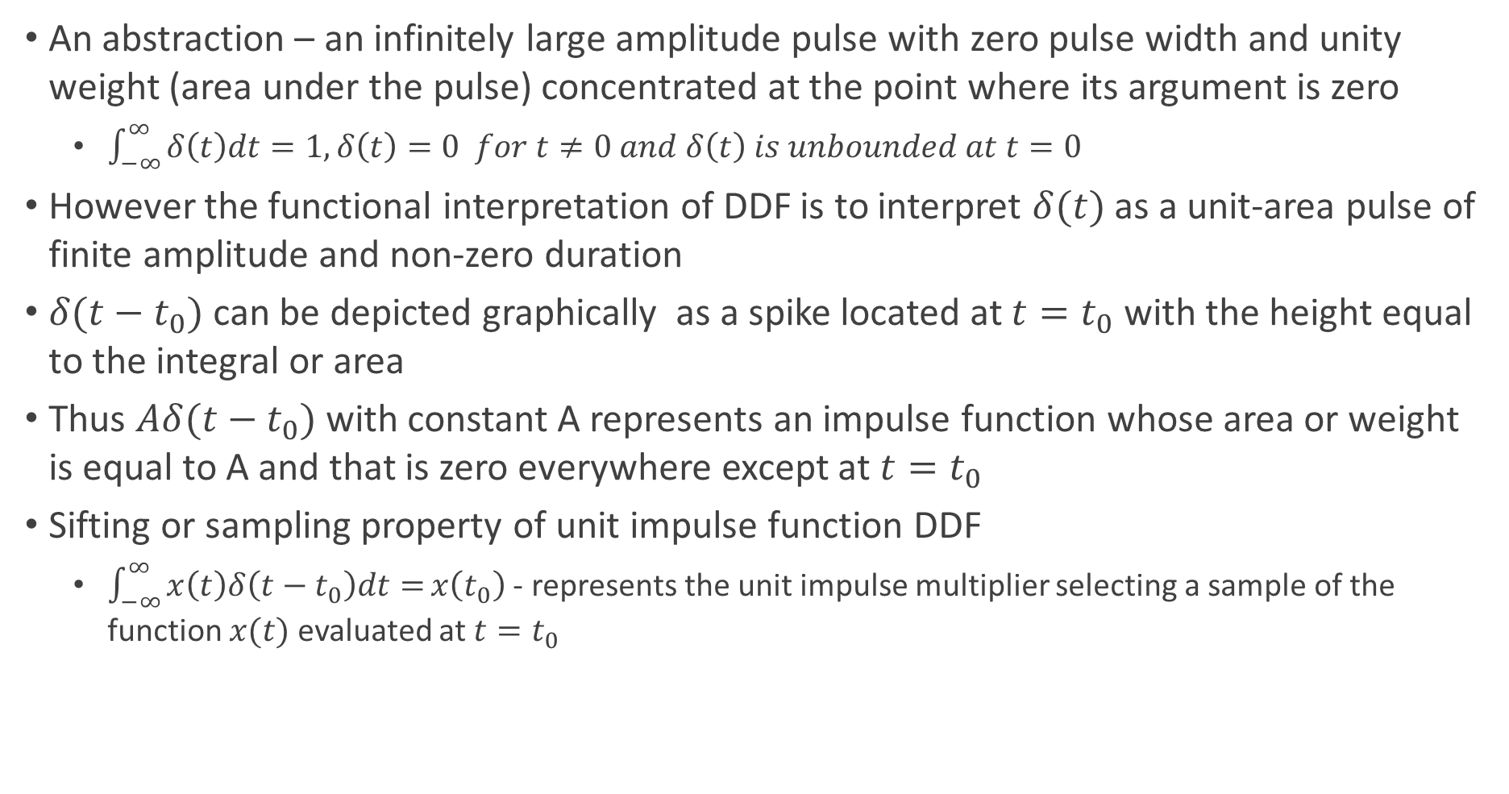
Unit Impulse Function – Dirac Delta Function
An abstraction – an infinitely large amplitude pulse with zero pulse width and unity weight (area under the pulse) concentrated at the point where its argument is zero
$\int_{−∞}^{∞}{δ\left(t\right)dt=1, δ\left(t\right)=0 for t≠0 and δ\left(t\right) is unbounded at t=0}$
However the functional interpretation of DDF is to interpret $δ(t)$ as a unit-area pulse of finite amplitude and non-zero duration
$δ(t−t_{0})$ can be depicted graphically as a spike located at $t=t_{0}$ with the height equal to the integral or area
Thus $Aδ(t−t_{0})$ with constant A represents an impulse function whose area or weight is equal to A and that is zero everywhere except at $t=t_{0}$
Sifting or sampling property of unit impulse function DDF
$\int_{−∞}^{∞}{x\left(t\right)δ\left(t−t_{0}\right)dt=}x\left(t_{0}\right)$ - represents the unit impulse multiplier selecting a sample of the function $x(t)$ evaluated at $t=t_{0}$

Slide 10
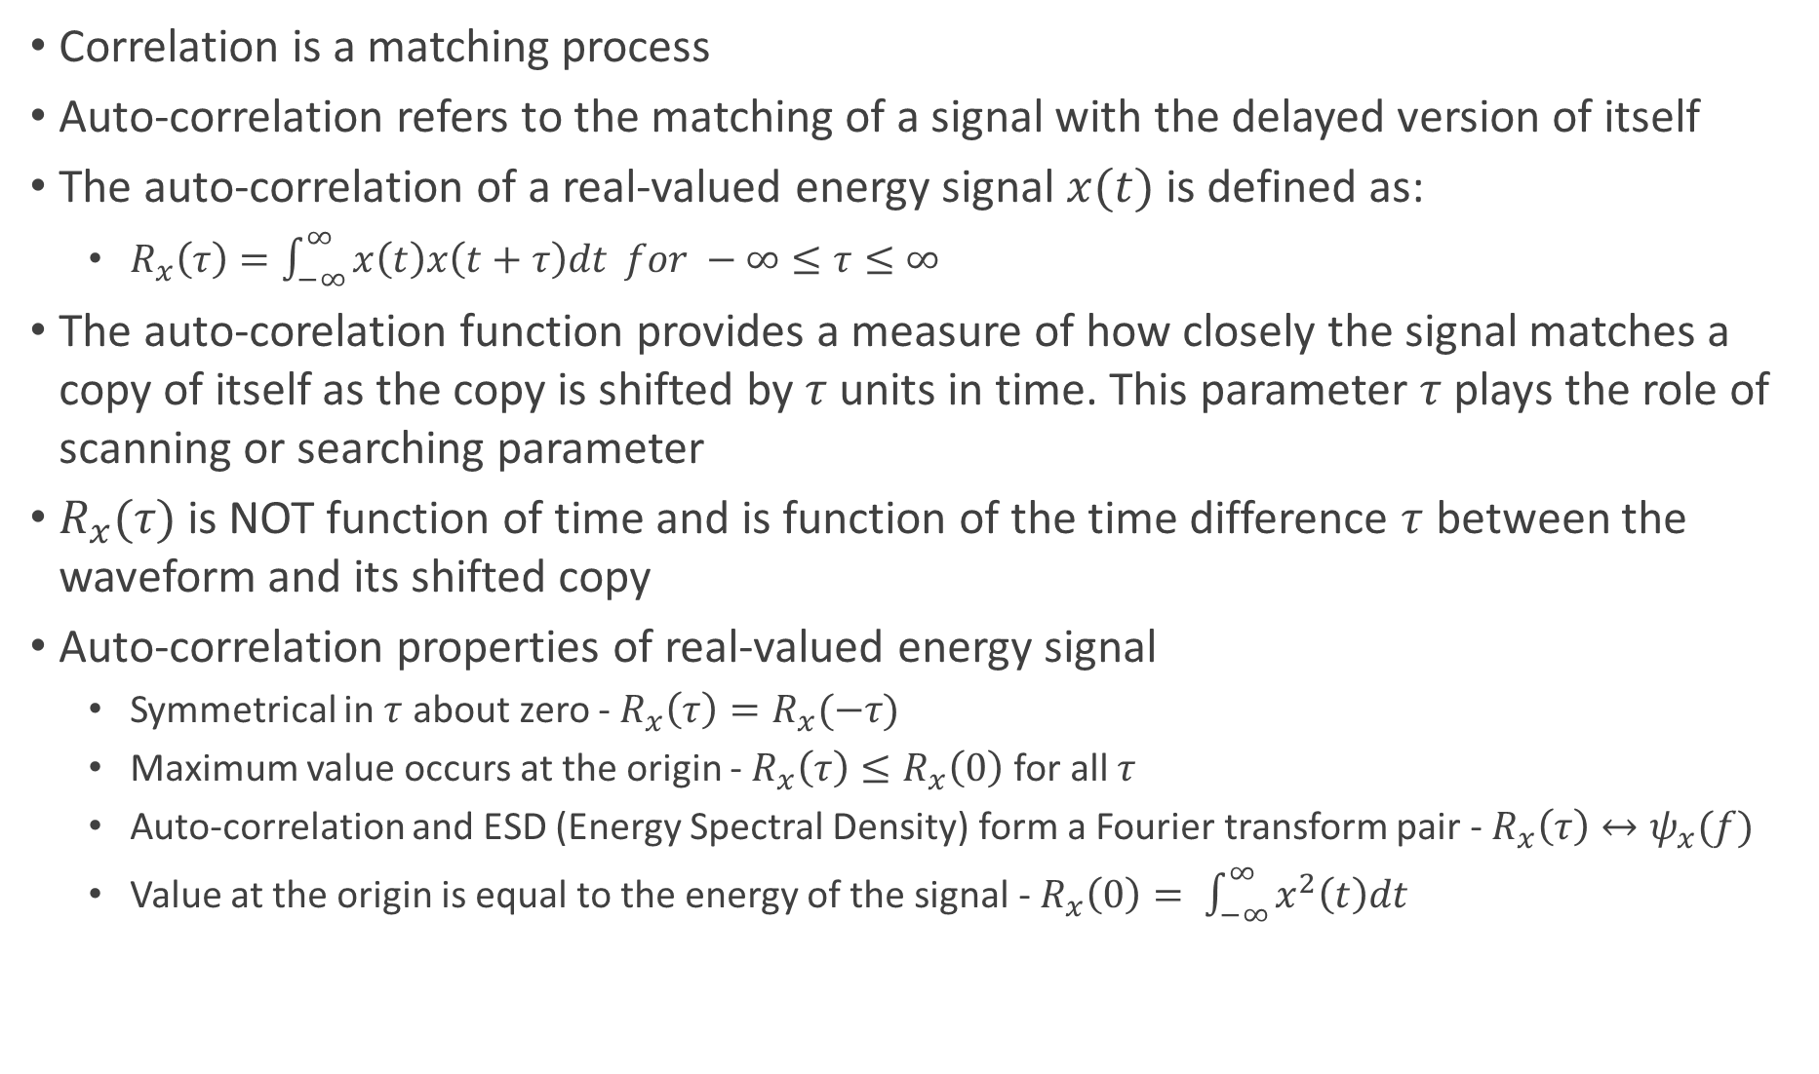
Auto-correlation of Energy Signal
Correlation is a matching process
Auto-correlation refers to the matching of a signal with the delayed version of itself
The auto-correlation of a real-valued energy signal $x(t)$ is defined as:
$R_{x}\left(τ\right)=\int_{−∞}^{∞}{x\left(t\right)x\left(t+τ\right)dt} for −∞≤τ≤∞$
The auto-corelation function provides a measure of how closely the signal matches a copy of itself as the copy is shifted by $τ$ units in time. This parameter $τ$ plays the role of scanning or searching parameter
$R_{x}(τ)$ is NOT function of time and is function of the time difference $τ$ between the waveform and its shifted copy
Auto-correlation properties of real-valued energy signal
Symmetrical in $τ$ about zero - $R_{x}\left(τ\right)=R_{x}(−τ)$
Maximum value occurs at the origin - $R_{x}\left(τ\right)≤R_{x}\left(0\right)$ for all $τ$
Auto-correlation and ESD (Energy Spectral Density) form a Fourier transform pair - $R_{x}\left(τ\right)↔ψ_{x}(f)$
Value at the origin is equal to the energy of the signal - $R_{x}\left(0\right)= \int_{−∞}^{∞}{x^{2}\left(t\right)dt}$

Slide 11
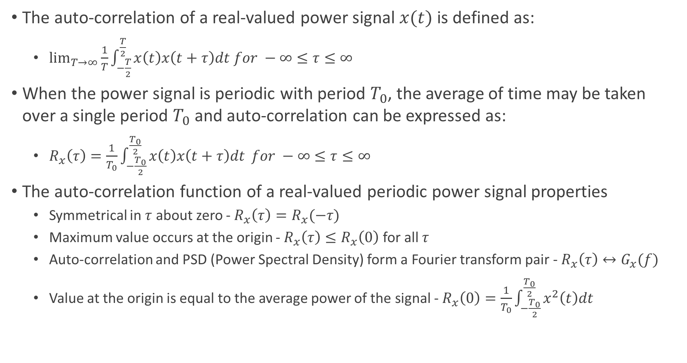
Auto-correlation of Periodic (Power) Signal
The auto-correlation of a real-valued power signal $x(t)$ is defined as:
$\lim_{T→∞}{\frac{1}{T}\int_{−\frac{T}{2}}^{\frac{T}{2}}{x\left(t\right)x\left(t+τ\right)dt for −∞≤τ≤∞}}$
When the power signal is periodic with period $T_{0}$, the average of time may be taken over a single period $T_{0}$ and auto-correlation can be expressed as:
$R_{x}\left(τ\right)=\frac{1}{T_{0}}\int_{−\frac{T_{0}}{2}}^{\frac{T_{0}}{2}}{x\left(t\right)x\left(t+τ\right)dt }for −∞≤τ≤∞$
The auto-correlation function of a real-valued periodic power signal properties
Symmetrical in $τ$ about zero - $R_{x}\left(τ\right)=R_{x}(−τ)$
Maximum value occurs at the origin - $R_{x}\left(τ\right)≤R_{x}\left(0\right)$ for all $τ$
Auto-correlation and PSD (Power Spectral Density) form a Fourier transform pair - $R_{x}\left(τ\right)↔G_{x}(f)$
Value at the origin is equal to the average power of the signal - $R_{x}\left(0\right)=\frac{1}{T_{0}}\int_{−\frac{T_{0}}{2}}^{\frac{T_{0}}{2}}{x^{2}\left(t\right)dt}$

Slide 12
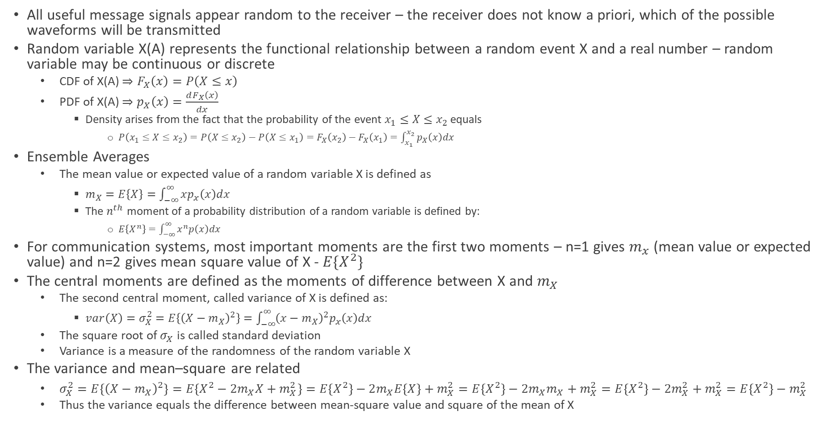
Random Signals
All useful message signals appear random to the receiver – the receiver does not know a priori, which of the possible waveforms will be transmitted
Random variable X(A) represents the functional relationship between a random event X and a real number – random variable may be continuous or discrete
CDF of X(A) $⇒F_{X}\left(x\right)=P\left(X≤x\right)$
PDF of X(A) $⇒p_{X}\left(x\right)=\frac{dF_{X}\left(x\right)}{dx}$
Density arises from the fact that the probability of the event $x_{1}≤X≤x_{2}$ equals
$P\left(x_{1}≤X≤x_{2}\right)=P\left(X≤x_{2}\right)−P\left(X≤x_{1}\right)=F_{X}\left(x_{2}\right)−F_{X}\left(x_{1}\right)=\int_{x_{1}}^{x_{2}}{p_{X}\left(x\right)dx}$
Ensemble Averages
The mean value or expected value of a random variable X is defined as
$m_{X}=E\left\{X\right\}=\int_{−∞}^{∞}{xp_{x}\left(x\right)dx}$
The $n^{th}$ moment of a probability distribution of a random variable is defined by:
$E\left\{X^{n}\right\}=\int_{−∞}^{∞}{x^{n}p\left(x\right)dx}$
For communication systems, most important moments are the first two moments – n=1 gives $m_{x}$ (mean value or expected value) and n=2 gives mean square value of X - $E\{X^{2}\}$
The central moments are defined as the moments of difference between X and $m_{X}$
The second central moment, called variance of X is defined as:
$var\left(X\right)=σ_{X}^{2}=E\left\{{\left(X−m_{X}\right)}^{2}\right\}=\int_{−∞}^{∞}{{\left(x−m_{X}\right)}^{2}p_{x}\left(x\right)dx}$
The square root of $σ_{X}$ is called standard deviation
Variance is a measure of the randomness of the random variable X
The variance and mean–square are related
$σ_{X}^{2}=E\left\{{\left(X−m_{X}\right)}^{2}\right\}=E\left\{X^{2}−2m_{X}X+m_{X}^{2}\right\}=E\left\{X^{2}\right\}−2m_{X}E\left\{X\right\}+m_{X}^{2}=E\left\{X^{2}\right\}−2m_{X}m_{X}+m_{X}^{2}=E\left\{X^{2}\right\}−2m_{X}^{2}+m_{X}^{2}=E\left\{X^{2}\right\}−m_{X}^{2}$
Thus the variance equals the difference between mean-square value and square of the mean of X

Slide 13
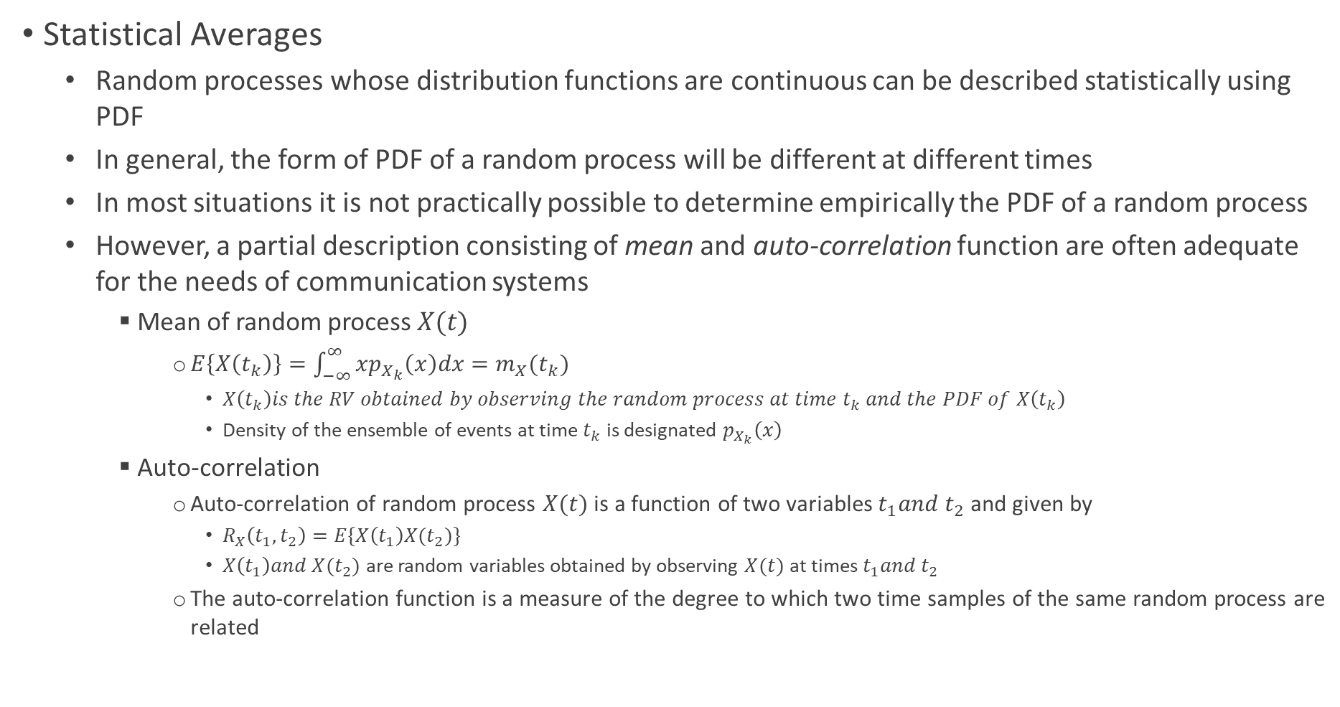
Random Processes
Statistical Averages
Random processes whose distribution functions are continuous can be described statistically using PDF
In general, the form of PDF of a random process will be different at different times
In most situations it is not practically possible to determine empirically the PDF of a random process
However, a partial description consisting of mean and auto-correlation function are often adequate for the needs of communication systems
Mean of random process $X(t)$
$E\left\{X\left(t_{k}\right)\right\}=\int_{−∞}^{∞}{xp_{X_{k}}\left(x\right)dx=m_{X}(t_{k})}$
$X\left(t_{k}\right)is the RV obtained by observing the random process at time t_{k} and the PDF of X\left(t_{k}\right)$
Density of the ensemble of events at time $t_{k}$ is designated $p_{X_{k}}\left(x\right)$
Auto-correlation
Auto-correlation of random process $X(t)$ is a function of two variables $t_{1}and t_{2}$ and given by
$R_{X}\left(t_{1},t_{2}\right)=E\{X\left(t_{1}\right)X(t_{2})\}$
$X\left(t_{1}\right)and X(t_{2})$ are random variables obtained by observing $X(t)$ at times $t_{1}and t_{2}$
The auto-correlation function is a measure of the degree to which two time samples of the same random process are related

Slide 14
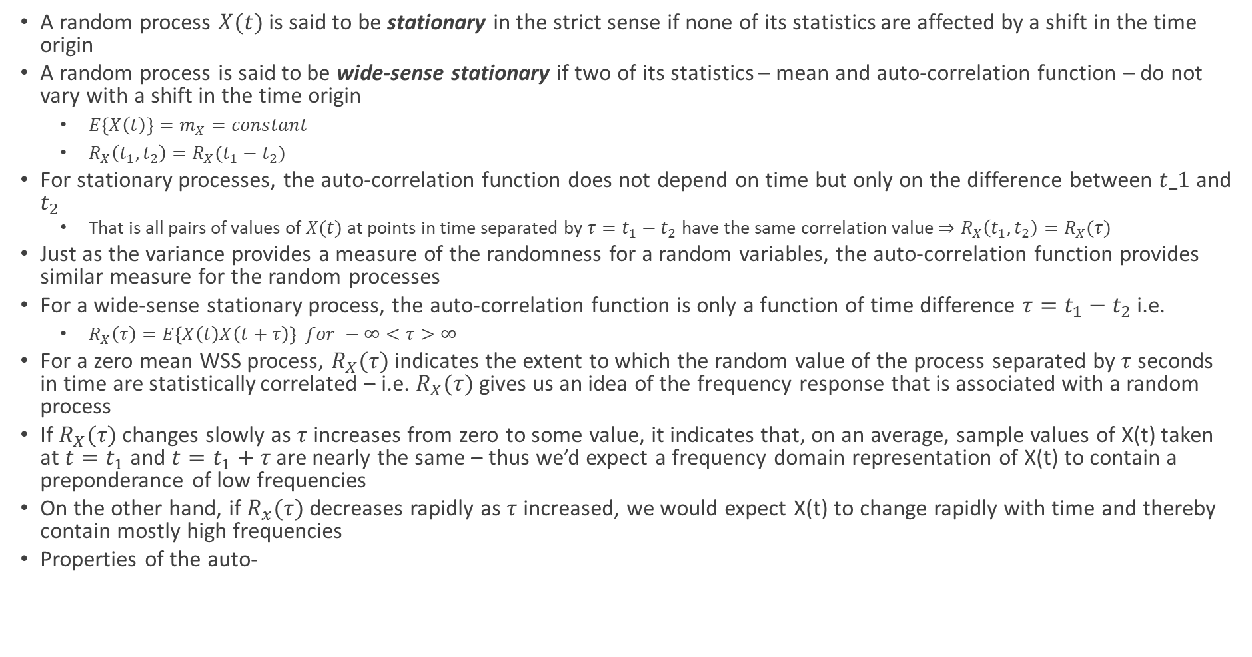
Stationarity
A random process $X(t)$ is said to be stationary in the strict sense if none of its statistics are affected by a shift in the time origin
A random process is said to be wide-sense stationary if two of its statistics – mean and auto-correlation function – do not vary with a shift in the time origin
$E\left\{X\left(t\right)\right\}=m_{X}=constant$
$R_{X}\left(t_{1},t_{2}\right)=R_{X}(t_{1}−t_{2})$
For stationary processes, the auto-correlation function does not depend on time but only on the difference between $t_1$ and $t_{2}$
That is all pairs of values of $X(t)$ at points in time separated by $τ=t_{1}−t_{2}$ have the same correlation value $⇒R_{X}\left(t_{1},t_{2}\right)=R_{X}(τ)$
Just as the variance provides a measure of the randomness for a random variables, the auto-correlation function provides similar measure for the random processes
For a wide-sense stationary process, the auto-correlation function is only a function of time difference $τ=t_{1}−t_{2}$ i.e.
$R_{X}\left(τ\right)=E\left\{X\left(t\right)X\left(t+τ\right)\right\} for −∞<τ>∞$
For a zero mean WSS process, $R_{X}(τ)$ indicates the extent to which the random value of the process separated by $τ$ seconds in time are statistically correlated – i.e. $R_{X}(τ)$ gives us an idea of the frequency response that is associated with a random process
If $R_{X}(τ)$ changes slowly as $τ$ increases from zero to some value, it indicates that, on an average, sample values of X(t) taken at $t=t_{1}$ and $t=t_{1}+τ$ are nearly the same – thus we’d expect a frequency domain representation of X(t) to contain a preponderance of low frequencies
On the other hand, if $R_{x}(τ)$ decreases rapidly as $τ$ increased, we would expect X(t) to change rapidly with time and thereby contain mostly high frequencies
Properties of the auto-

Slide 15
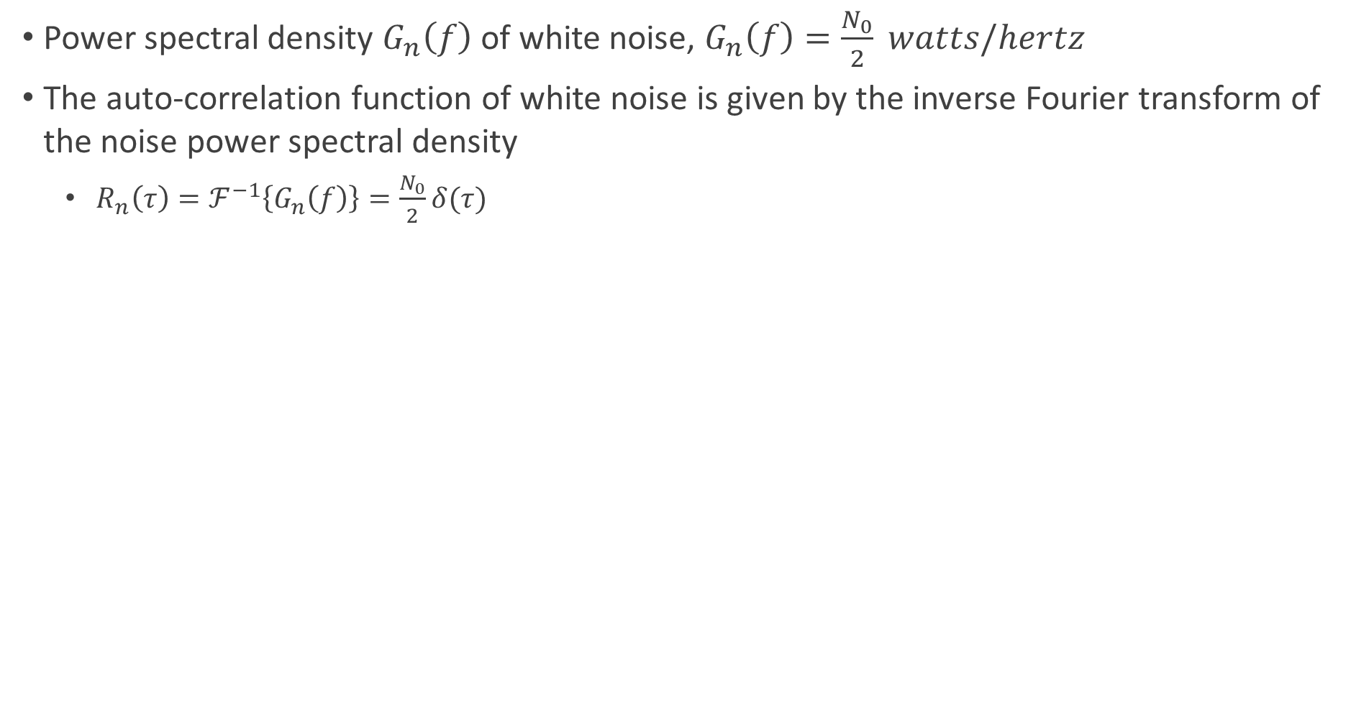
White Noise
Power spectral density $G_{n}\left(f\right)$ of white noise, $G_{n}\left(f\right)=\frac{N_{0}}{2} watts/hertz$
The auto-correlation function of white noise is given by the inverse Fourier transform of the noise power spectral density
$R_{n}\left(τ\right)=ℱ^{−1}\left\{G_{n}\left(f\right)\right\}=\frac{N_{0}}{2}δ(τ)$

Slide 16
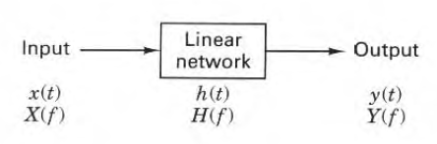
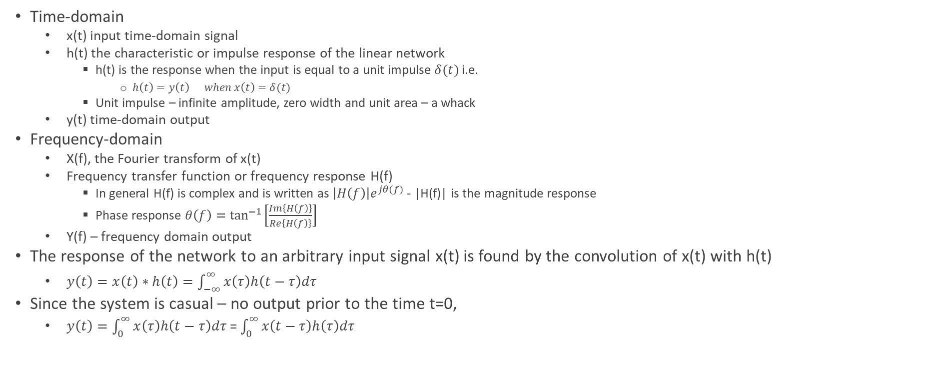
Signal Transmission Through Linear Systems (Time-invariant)
Time-domain
x(t) input time-domain signal
h(t) the characteristic or impulse response of the linear network
h(t) is the response when the input is equal to a unit impulse $δ(t)$ i.e.
$h\left(t\right)=y\left(t\right) when x\left(t\right)=δ(t)$
Unit impulse – infinite amplitude, zero width and unit area – a whack
y(t) time-domain output
Frequency-domain
X(f), the Fourier transform of x(t)
Frequency transfer function or frequency response H(f)
In general H(f) is complex and is written as $\left|H\left(f\right)\right|e^{jθ(f)}$ - |H(f)| is the magnitude response
Phase response $θ\left(f\right)=\tan^{−1}\left[\frac{Im\left\{H\left(f\right)\right\}}{Re\left\{H\left(f\right)\right\}}\right]$
Y(f) – frequency domain output
The response of the network to an arbitrary input signal x(t) is found by the convolution of x(t) with h(t)
$y\left(t\right)=x\left(t\right)∗h\left(t\right)=\int_{−∞}^{∞}{x\left(τ\right)h\left(t−τ\right)dτ}$
Since the system is casual – no output prior to the time t=0,
$y\left(t\right)=\int_{0}^{∞}{x\left(τ\right)h\left(t−τ\right)dτ}$ = $\int_{0}^{∞}{x\left(t−τ\right)h\left(τ\right)dτ}$

Slide 17
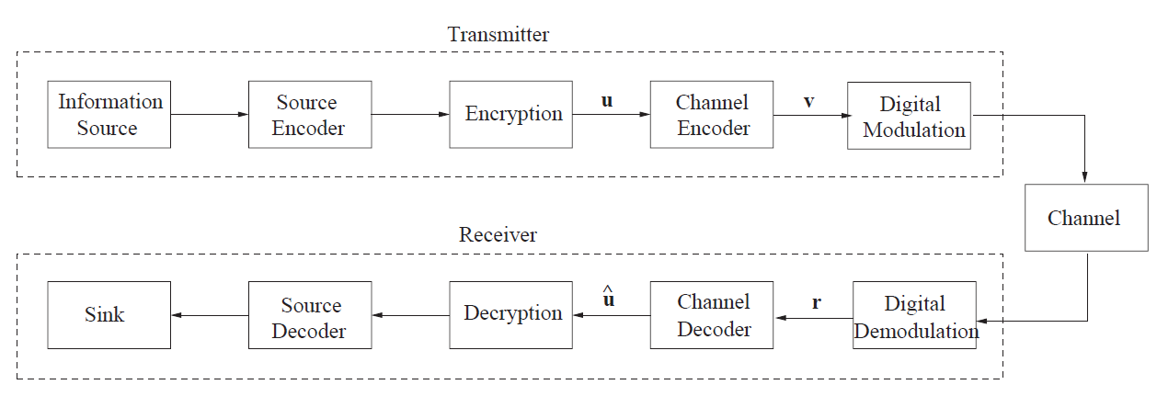
Model of Digital Communication Systems

Slide 18
Source Coding
To minimize the number of bits per unit time required to represent the source output
Also known as source coding or compression
Examples of algos : Huffman coding, LZ – Lempel-Ziv etc.
Leverages the statistical nature of the source data to represent its output efficiently
Main principle of data compression : Only information essential to understand must be transmitted

Slide 19
Encryption
To secure source bits transmission
Example algos : DES, RSA etc.

Slide 20
Channel Coding
To correct/control transmission errors introduced by the channel
Introduces some redundant bits to a sequence of information bits in a controlled manner
Example algos : Repetition code, Reed-Solomon Codes, CRC etc.
The encoded sequence that is the output of the channel encoder is called as code word

Slide 21
Modulation
Mapping code words onto waveforms for transmission over the channel
Example modulation techniques: PSK, BPSK, QPSK, QAM etc.
The transmitted waveforms are corrupted due to the characteristics of the channel
Noise, interference, fading, multipath transmission
Example channel models: BEC – Binary Erasure Channel, AWGN etc.

Slide 22
Demodulation
To convert the noisy waveform to a sequence of bits which is an estimate of the transmitted data bits – hard demodulation
If the demodulator outputs are unquantized – has more than two quantization levels – it is known as soft demodulation
Soft demodulation has significant improvement over hard demodulation

Slide 23
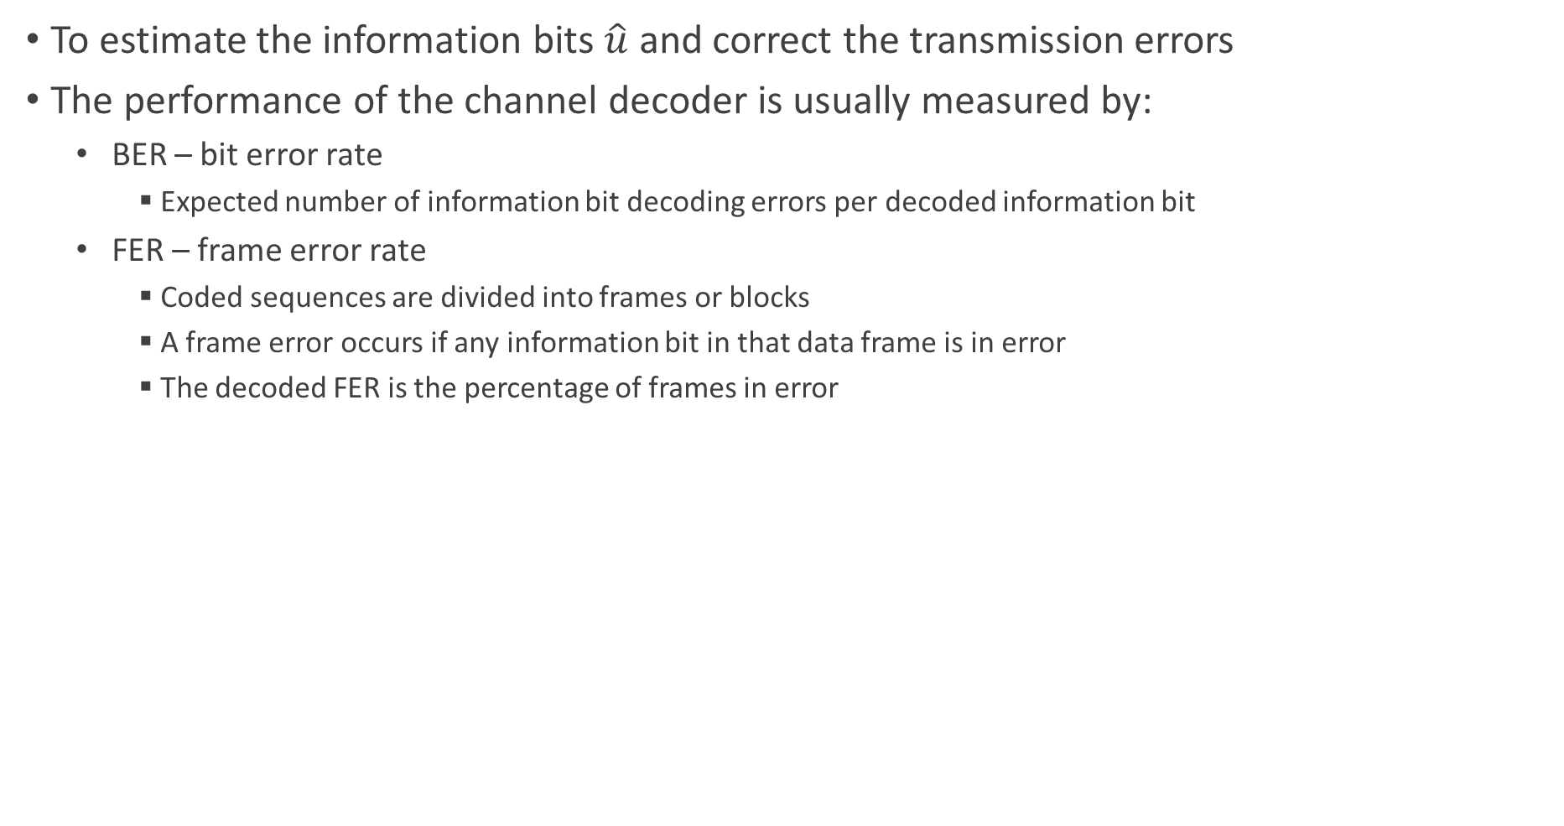
Channel Decoder
To estimate the information bits $\hat{u}$ and correct the transmission errors
The performance of the channel decoder is usually measured by:
BER – bit error rate
Expected number of information bit decoding errors per decoded information bit
FER – frame error rate
Coded sequences are divided into frames or blocks
A frame error occurs if any information bit in that data frame is in error
The decoded FER is the percentage of frames in error

Slide 24
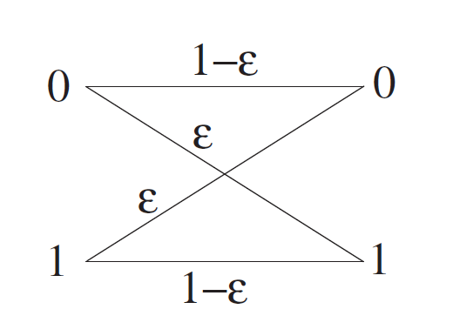
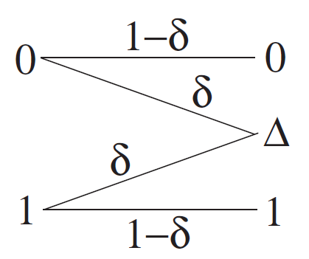
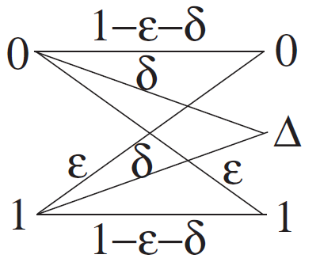
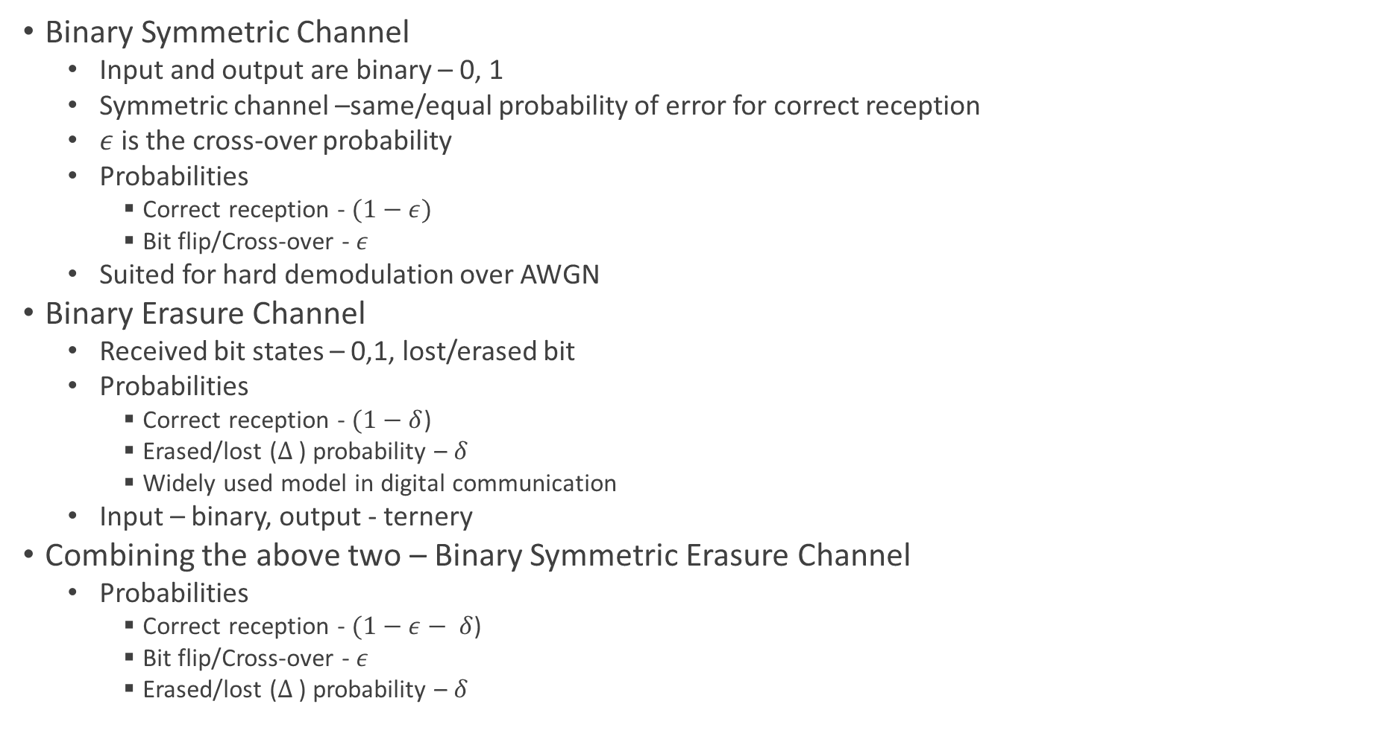
Communication Channels and Models
Binary Symmetric Channel
Input and output are binary – 0, 1
Symmetric channel –same/equal probability of error for correct reception
$ε$ is the cross-over probability
Probabilities
Correct reception - $(1−ε)$
Bit flip/Cross-over - $ε$
Suited for hard demodulation over AWGN
Binary Erasure Channel
Received bit states – 0,1, lost/erased bit
Probabilities
Correct reception - $(1−δ$)
Erased/lost ($Δ$ ) probability – $δ$
Widely used model in digital communication
Input – binary, output - ternery
Combining the above two – Binary Symmetric Erasure Channel
Probabilities
Correct reception - $(1−ε− δ$)
Bit flip/Cross-over - $ε$
Erased/lost ($Δ$ ) probability – $δ$
BSC
BEC
BSEC

Slide 25
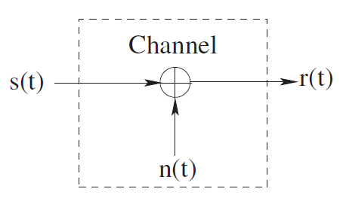
Communication Channels and Models
Additive Noise Channel
Signal s(t) is corrupted by additive noise n(t)
Noise is characterized statistically as a Gaussian noise process
Noise that has constant power spectral density (across all frequencies) is known as white noise
AWGN model is used to model a broadcast class of physical communication channel
ANC

Slide 26
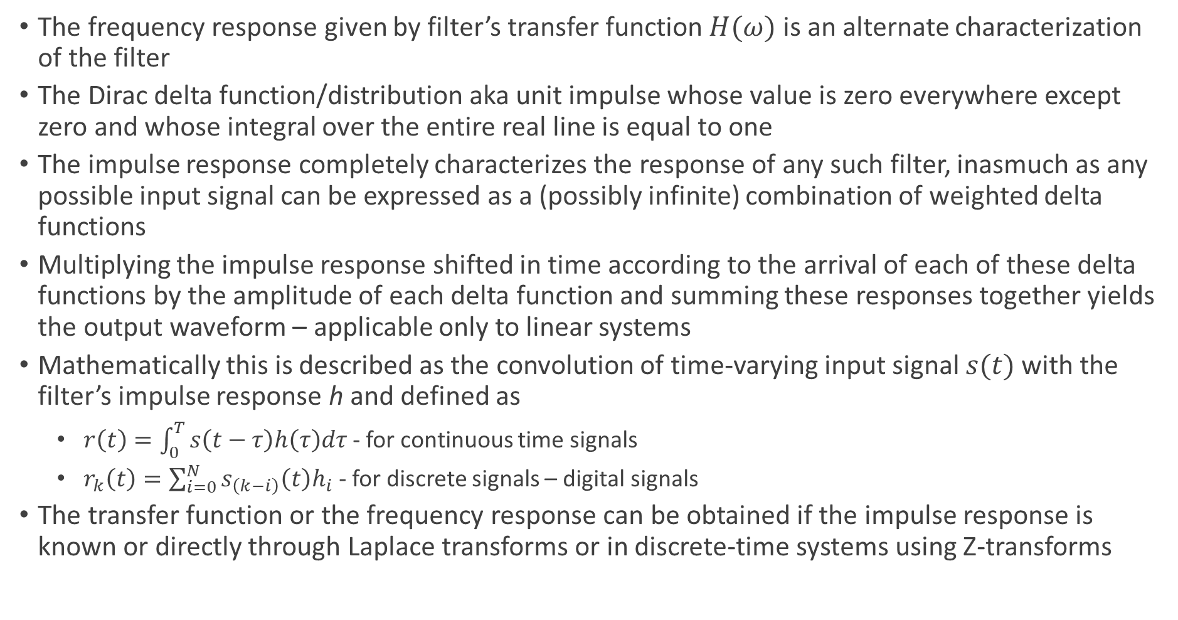
Filters in Signal Processing
The frequency response given by filter’s transfer function $H(ω)$ is an alternate characterization of the filter
The Dirac delta function/distribution aka unit impulse whose value is zero everywhere except zero and whose integral over the entire real line is equal to one
The impulse response completely characterizes the response of any such filter, inasmuch as any possible input signal can be expressed as a (possibly infinite) combination of weighted delta functions
Multiplying the impulse response shifted in time according to the arrival of each of these delta functions by the amplitude of each delta function and summing these responses together yields the output waveform – applicable only to linear systems
Mathematically this is described as the convolution of time-varying input signal $s(t)$ with the filter’s impulse response h and defined as
$r\left(t\right)=\int_{0}^{T}{s\left(t−τ\right)h\left(τ\right)dτ}$ - for continuous time signals
$r_{k}\left(t\right)=\sum_{i=0}^{N}{s_{\left(k−i\right)}\left(t\right)h_{i}}$ - for discrete signals – digital signals
The transfer function or the frequency response can be obtained if the impulse response is known or directly through Laplace transforms or in discrete-time systems using Z-transforms

Slide 27
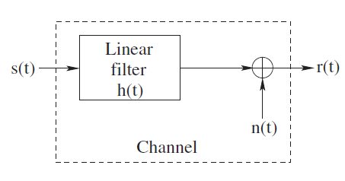
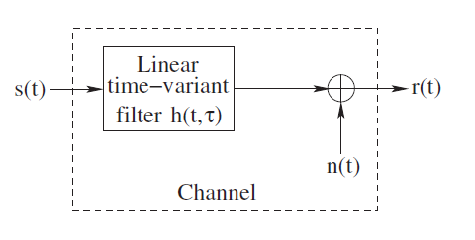
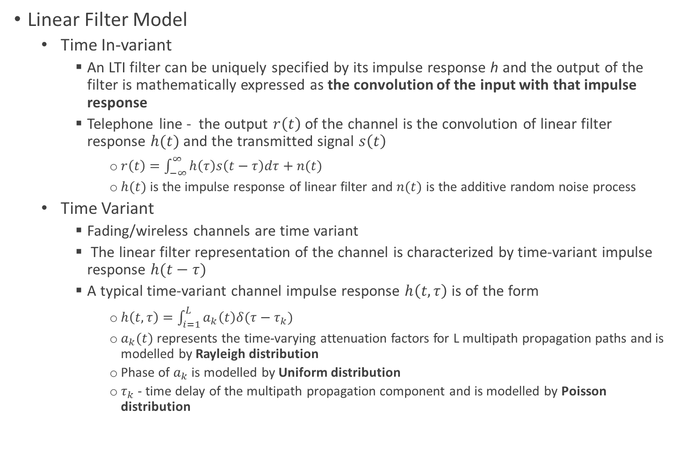
Communication Channels and Models
Linear Filter Model
Time In-variant
An LTI filter can be uniquely specified by its impulse response h and the output of the filter is mathematically expressed as the convolution of the input with that impulse response
Telephone line - the output $r\left(t\right)$of the channel is the convolution of linear filter response $h(t)$ and the transmitted signal $s\left(t\right)$
$r\left(t\right)=\int_{−∞}^{∞}{h\left(τ\right)s\left(t−τ\right)dτ}+n(t)$
$h(t)$ is the impulse response of linear filter and $n(t)$ is the additive random noise process
Time Variant
Fading/wireless channels are time variant
The linear filter representation of the channel is characterized by time-variant impulse response $h(t−τ)$
A typical time-variant channel impulse response $h\left(t,τ\right)$ is of the form
$h\left(t,τ\right)=\int_{i=1}^{L}{a_{k}\left(t\right)δ(τ−τ_{k})}$
$a_{k}(t)$ represents the time-varying attenuation factors for L multipath propagation paths and is modelled by Rayleigh distribution
Phase of $a_{k}$ is modelled by Uniform distribution
$τ_{k}$ - time delay of the multipath propagation component and is modelled by Poisson distribution
LFC – Time In-variant
LFC – Time Variant

Slide 28
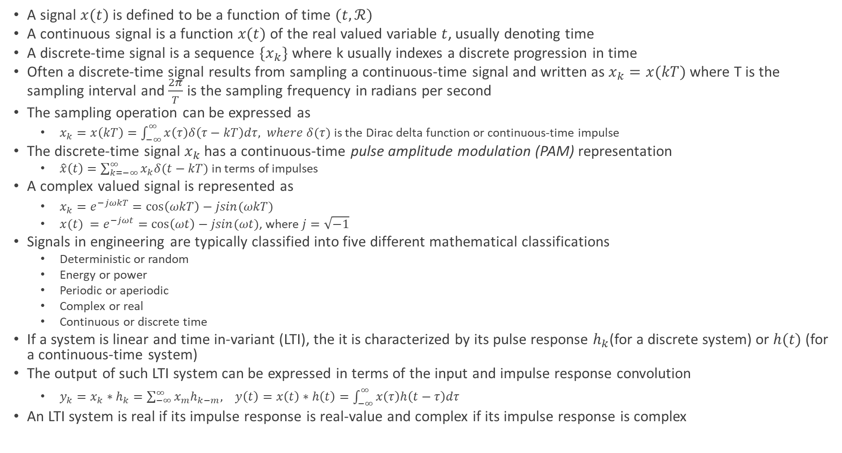
Signals
A signal $x(t)$ is defined to be a function of time $(t, ℛ)$
A continuous signal is a function $x(t)$ of the real valued variable $t$, usually denoting time
A discrete-time signal is a sequence $\{x_{k}\}$ where k usually indexes a discrete progression in time
Often a discrete-time signal results from sampling a continuous-time signal and written as $x_{k}=x(kT)$ where T is the sampling interval and $\frac{2π}{T}$ is the sampling frequency in radians per second
The sampling operation can be expressed as
$x_{k}=x\left(kT\right)=\int_{−∞}^{∞}{x\left(τ\right)δ\left(τ−kT\right)dτ, where δ(τ)}$ is the Dirac delta function or continuous-time impulse
The discrete-time signal $x_{k}$ has a continuous-time pulse amplitude modulation (PAM) representation
$\hat{x}\left(t\right)=\sum_{k=−∞}^{∞}{x_{k}δ(t−kT)}$ in terms of impulses
A complex valued signal is represented as
$x_{k}=e^{−jωkT}=\cos\left(ωkT\right)−jsin(ωkT)$
${x(t)}_{ }=e^{−jωt}=\cos\left(ωt\right)−jsin(ωt)$, where $j=\sqrt{−1}$
Signals in engineering are typically classified into five different mathematical classifications
Deterministic or random
Energy or power
Periodic or aperiodic
Complex or real
Continuous or discrete time
If a system is linear and time in-variant (LTI), the it is characterized by its pulse response $h_{k}$(for a discrete system) or $h(t)$ (for a continuous-time system)
The output of such LTI system can be expressed in terms of the input and impulse response convolution
$y_{k}=x_{k}∗h_{k}=\sum_{−∞}^{∞}{x_{m}h_{k−m}, y\left(t\right)=x\left(t\right)∗h\left(t\right)=\int_{−∞}^{∞}{x\left(τ\right)h\left(t−τ\right)dτ}}$
An LTI system is real if its impulse response is real-value and complex if its impulse response is complex

Slide 29
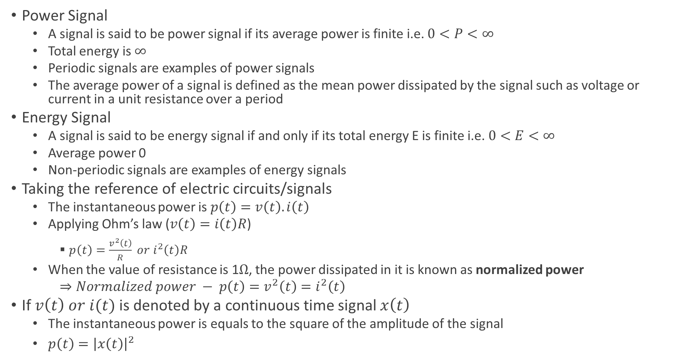
Key Concepts in Signal Processing
Power Signal
A signal is said to be power signal if its average power is finite i.e. $0<P<∞$
Total energy is $∞$
Periodic signals are examples of power signals
The average power of a signal is defined as the mean power dissipated by the signal such as voltage or current in a unit resistance over a period
Energy Signal
A signal is said to be energy signal if and only if its total energy E is finite i.e. $0<E<∞$
Average power 0
Non-periodic signals are examples of energy signals
Taking the reference of electric circuits/signals
The instantaneous power is $p\left(t\right)=v\left(t\right).i\left(t\right)$
Applying Ohm’s law ($v\left(t\right)=i\left(t\right)R$)
$p\left(t\right)=\frac{v^{2}\left(t\right)}{R} or i^{2}\left(t\right)R$
When the value of resistance is 1$Ω$, the power dissipated in it is known as normalized power
$⇒Normalized power − p\left(t\right)=v^{2}\left(t\right)=i^{2}\left(t\right)$
If $v\left(t\right) or i(t)$ is denoted by a continuous time signal $x\left(t\right)$
The instantaneous power is equals to the square of the amplitude of the signal
$p\left(t\right)={\left|x\left(t\right)\right|}^{2}$

Slide 30
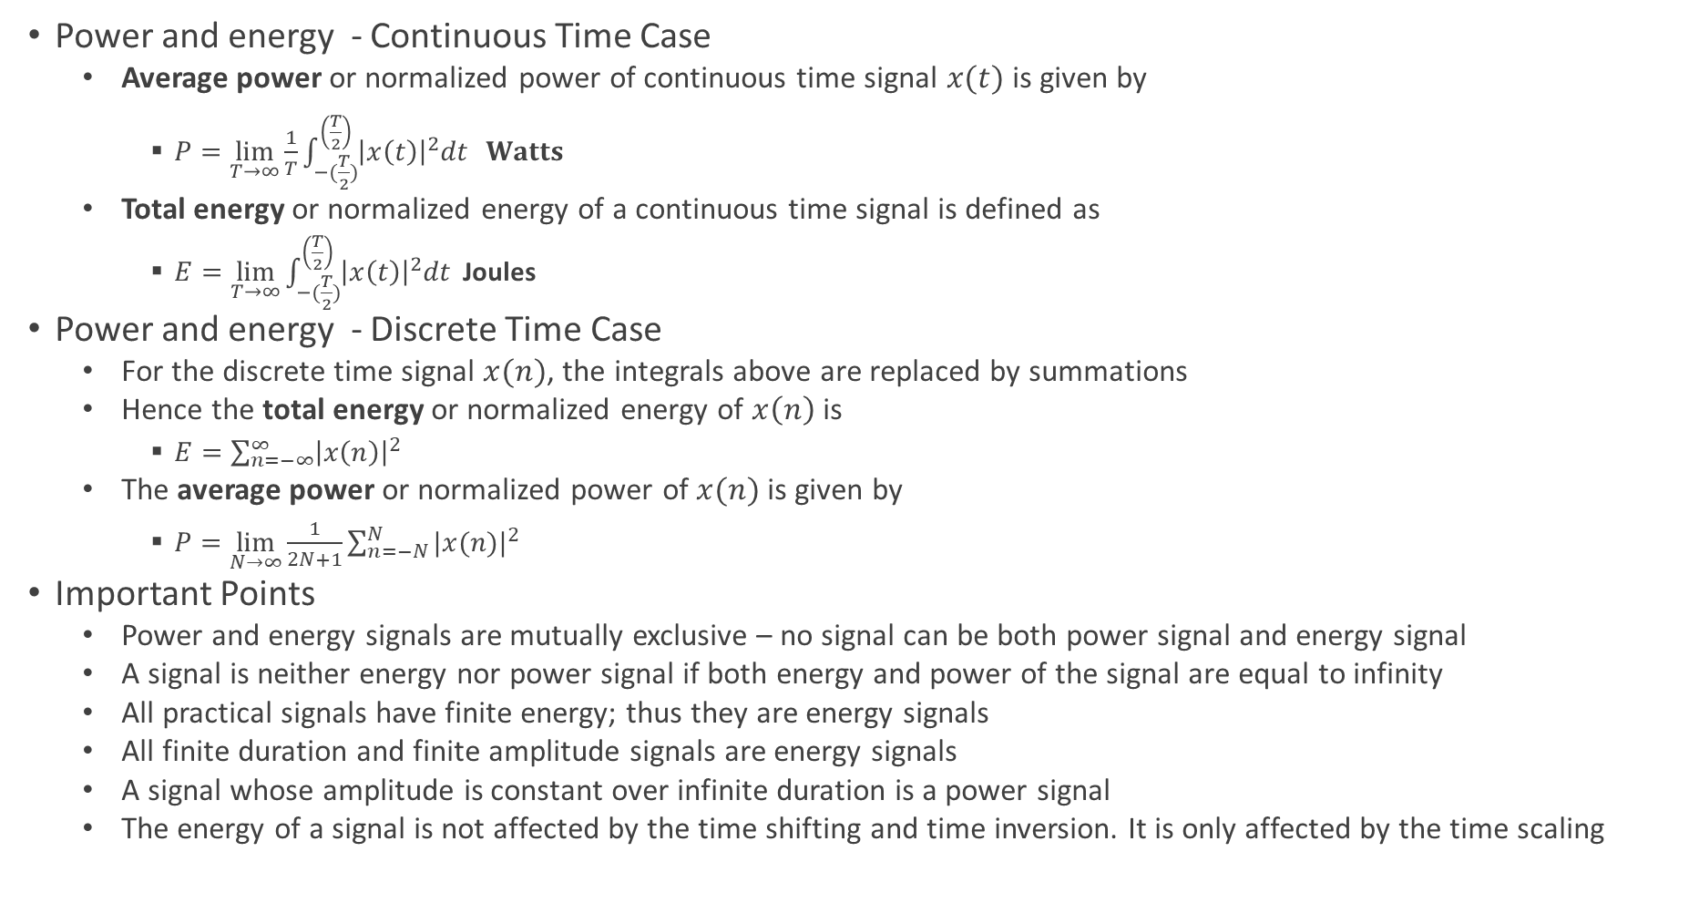
Key Concepts in Signal Processing
Power and energy - Continuous Time Case
Average power or normalized power of continuous time signal $x(t)$ is given by
$P=\lim_{T→∞}{\frac{1}{T}\int_{−(\frac{T}{2})}^{\left(\frac{T}{2}\right)}{{\left|x\left(t\right)\right|}^{2}dt} } Watts$
Total energy or normalized energy of a continuous time signal is defined as
$E=\lim_{T→∞}{\int_{−(\frac{T}{2})}^{\left(\frac{T}{2}\right)}{{\left|x\left(t\right)\right|}^{2}dt} }$Joules
Power and energy - Discrete Time Case
For the discrete time signal $x(n)$, the integrals above are replaced by summations
Hence the total energy or normalized energy of $x\left(n\right)$ is
$E=\sum_{n=−∞}^{∞}{{\left|x\left(n\right)\right|}^{2}}$
The average power or normalized power of $x(n)$ is given by
$P=\lim_{N→∞}{\frac{1}{2N+1}\sum_{n=−N}^{N}{{|x(n)|}^{2}}}$
Important Points
Power and energy signals are mutually exclusive – no signal can be both power signal and energy signal
A signal is neither energy nor power signal if both energy and power of the signal are equal to infinity
All practical signals have finite energy; thus they are energy signals
All finite duration and finite amplitude signals are energy signals
A signal whose amplitude is constant over infinite duration is a power signal
The energy of a signal is not affected by the time shifting and time inversion. It is only affected by the time scaling

Slide 31
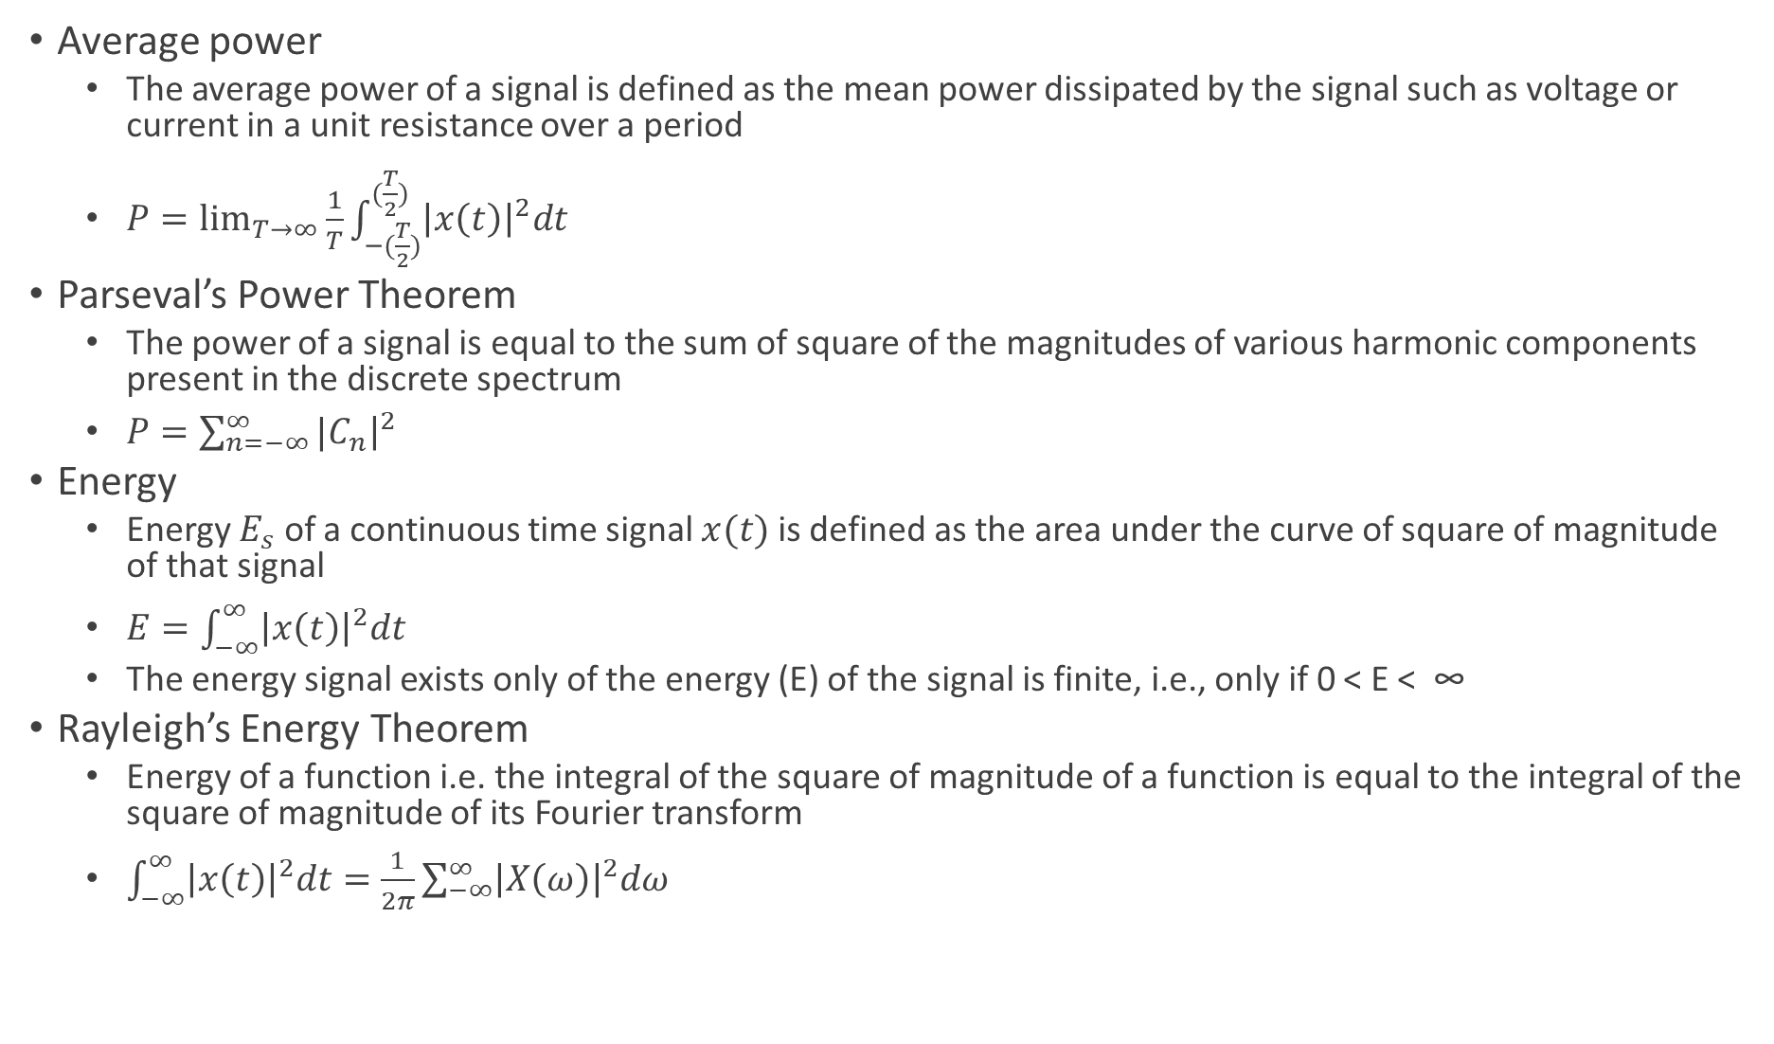
Key Concepts in Signal Processing
Average power
The average power of a signal is defined as the mean power dissipated by the signal such as voltage or current in a unit resistance over a period
$P=\lim_{T→∞}{\frac{1}{T}\int_{−(\frac{T}{2})}^{(\frac{T}{2})}{{\left|x\left(t\right)\right|}^{2}dt}}$
Parseval’s Power Theorem
The power of a signal is equal to the sum of square of the magnitudes of various harmonic components present in the discrete spectrum
$P=\sum_{n=−∞}^{∞}{{|C}_{n}{\left.​\right|}^{2}}$
Energy
Energy $E_{s}$ of a continuous time signal $x(t)$ is defined as the area under the curve of square of magnitude of that signal
$E=\int_{−∞}^{∞}{{\left|x\left(t\right)\right|}^{2}dt}$
The energy signal exists only of the energy (E) of the signal is finite, i.e., only if 0 < E < ∞
Rayleigh’s Energy Theorem
Energy of a function i.e. the integral of the square of magnitude of a function is equal to the integral of the square of magnitude of its Fourier transform
$\int_{−∞}^{∞}{{\left|x\left(t\right)\right|}^{2}dt=\frac{1}{2π}\sum_{−∞}^{∞}{{\left|X\left(ω\right)\right|}^{2}dω}}$

Slide 32
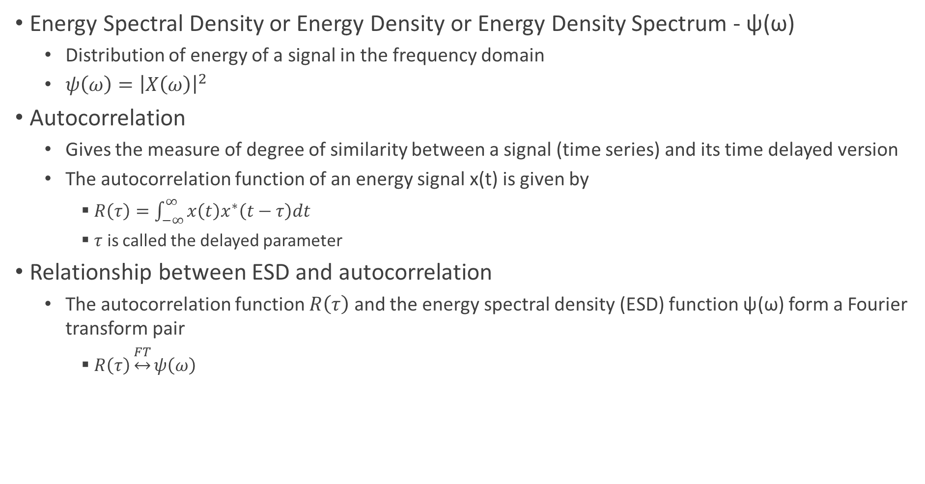
Energy Spectral Density and Autocorrelation
Energy Spectral Density or Energy Density or Energy Density Spectrum - ψ(ω)
Distribution of energy of a signal in the frequency domain
$ψ\left(ω\right)={\left|X\left(ω\right)\right|}^{2}$
Autocorrelation
Gives the measure of degree of similarity between a signal (time series) and its time delayed version
The autocorrelation function of an energy signal x(t) is given by
$R\left(τ\right)=\int_{−∞}^{∞}{x\left(t\right)x^{∗}\left(t−τ\right)dt}$
$τ$ is called the delayed parameter
Relationship between ESD and autocorrelation
The autocorrelation function $R\left(τ\right)$ and the energy spectral density (ESD) function ψ(ω) form a Fourier transform pair
$R\left(τ\right)\underset{↔}{FT}ψ\left(ω\right)$

Slide 33
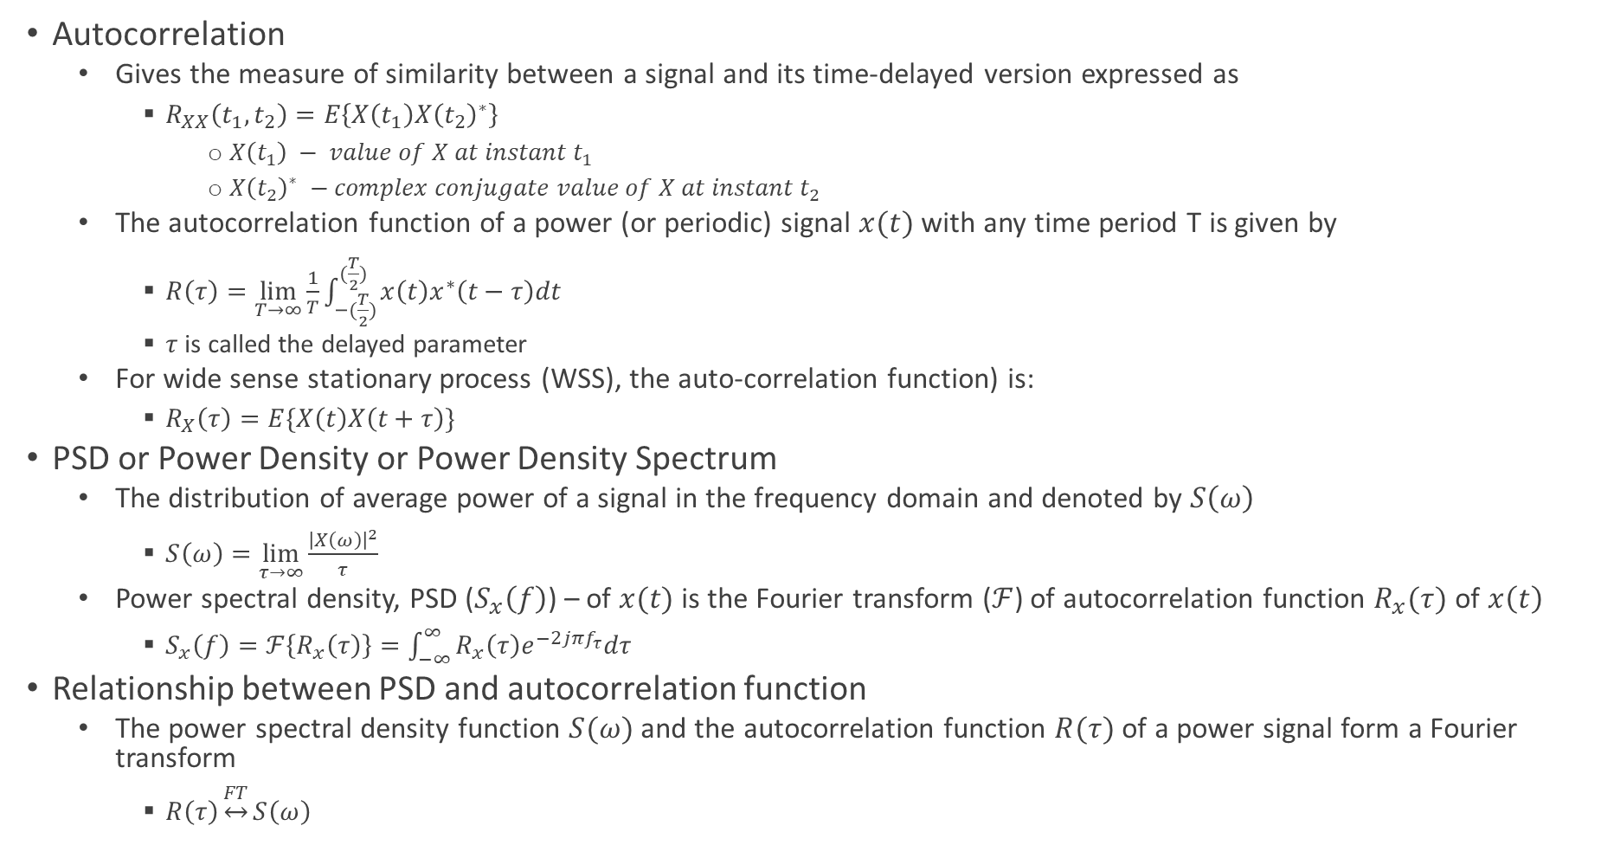
Power Spectral Density and Autocorrelation
Autocorrelation
Gives the measure of similarity between a signal and its time-delayed version expressed as
$R_{XX}\left(t_{1},t_{2}\right)=E\left\{X\left(t_{1}\right)X{\left(t_{2}\right)}^{∗}\right\}$
$X\left(t_{1}\right) − value of X at instant t_{1}$
$X{\left(t_{2}\right)}^{∗} −complex conjugate value of X at instant t_{2}$
The autocorrelation function of a power (or periodic) signal $x(t)$ with any time period T is given by
$R\left(τ\right)=\lim_{T→∞}{\frac{1}{T}\int_{−(\frac{T}{2})}^{(\frac{T}{2})}{x\left(t\right)x^{∗}\left(t−τ\right)dt}}$
$τ$ is called the delayed parameter
For wide sense stationary process (WSS), the auto-correlation function) is:
$R_{X}\left(τ\right)=E\{X\left(t\right)X\left(t+τ\right)\}$
PSD or Power Density or Power Density Spectrum
The distribution of average power of a signal in the frequency domain and denoted by $S\left(ω\right)$
$S\left(ω\right)=\lim_{τ→∞}{\frac{{\left|X\left(ω\right)\right|}^{2}}{τ}}$
Power spectral density, PSD ($S_{x}\left(f\right)$) – of $x(t)$is the Fourier transform ($ℱ$) of autocorrelation function $R_{x}(τ)$ of $x\left(t\right)$
$S_{x}\left(f\right)=ℱ\left\{R_{x}\left(τ\right)\right\}=\int_{−∞}^{∞}{R_{x}\left(τ\right)e^{−2jπf_{τ}}dτ}$
Relationship between PSD and autocorrelation function
The power spectral density function $S(ω)$ and the autocorrelation function $R(τ)$ of a power signal form a Fourier transform
$R\left(τ\right)\underset{↔}{FT}S\left(ω\right)$

Slide 34
Deterministic or Random
Deterministic signals can be defined exactly by a mathematical formula
In contrast, there is uncertainty with respect to the value of a random signal at any instant of time
The random signals are modelled in probabilistic terms

Slide 35
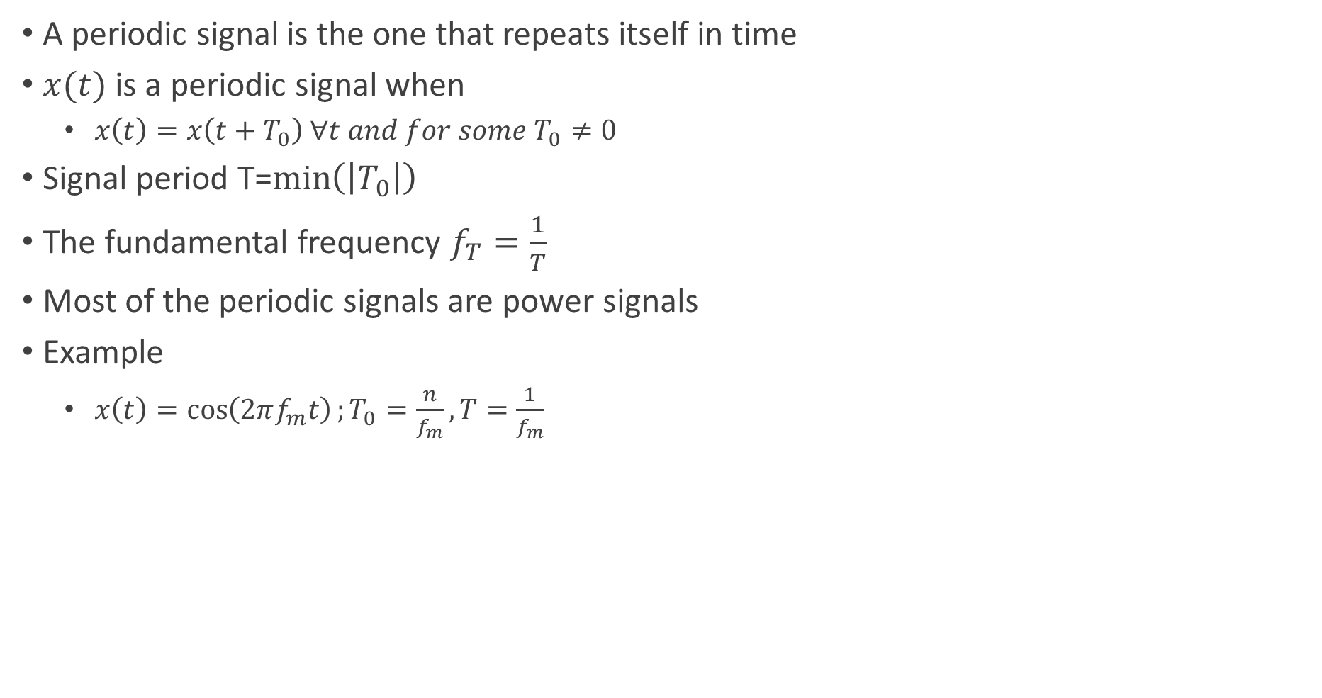
Periodic and Aperiodic
A periodic signal is the one that repeats itself in time
$x(t)$ is a periodic signal when
$x\left(t\right)=x\left(t+T_{0}\right) ∀t and for some T_{0}≠0$
Signal period T=$\min\left(\left|T_{0}\right|\right)$
The fundamental frequency $f_{T}=\frac{1}{T}$
Most of the periodic signals are power signals
Example
$x\left(t\right)=\cos\left(2πf_{m}t\right);T_{0}=\frac{n}{f_{m}}, T=\frac{1}{f_{m}}$

Slide 36
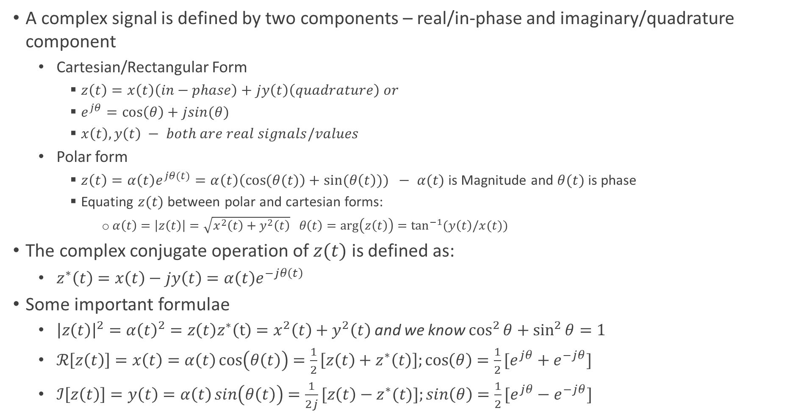
Complex and Real Signals
A complex signal is defined by two components – real/in-phase and imaginary/quadrature component
Cartesian/Rectangular Form
$z\left(t\right)=x\left(t\right)\left(in−phase\right)+jy\left(t\right)\left(quadrature\right) or$
$e^{jθ}=\cos\left(θ\right)+jsin(θ)$
$x\left(t\right), y\left(t\right) − both are real signals/values$
Polar form
$z\left(t\right)=α\left(t\right)e^{jθ(t)}=α\left(t\right)\left(\cos{(θ(t)}\right)+sin⁡(θ\left(t\right))) − α(t)$ is Magnitude and $θ(t)$ is phase
Equating $z(t)$ between polar and cartesian forms:
$α\left(t\right)=\left|z\left(t\right)\right|=\sqrt{x^{2}\left(t\right)+y^{2}\left(t\right)} θ\left(t\right)=\arg\left(z\left(t\right)\right)=\tan^{−1}{(y\left(t\right)/x(t))}$
The complex conjugate operation of $z(t)$ is defined as:
$z^{∗}\left(t\right)=x\left(t\right)−jy\left(t\right)=α\left(t\right)e^{−jθ\left(t\right)}$
Some important formulae
${\left|z\left(t\right)\right|}^{2}=α{\left(t\right)}^{2}=z\left(t\right)z^{∗}\left(t\right)=x^{2}\left(t\right)+y^{2}\left(t\right)$ and we know $\cos^{2}{θ+\sin^{2}{θ=1}}$
$ℛ\left[z\left(t\right)\right]=x\left(t\right)=α\left(t\right)\cos\left(θ\left(t\right)\right)=\frac{1}{2}\left[z\left(t\right)+z^{∗}\left(t\right)\right];\cos\left(θ\right)=\frac{1}{2}[e^{jθ}+e^{−jθ}]$
$ℐ\left[z\left(t\right)\right]=y\left(t\right)=α\left(t\right)\sin\left(θ\left(t\right)\right)=\frac{1}{2j}[z\left(t\right)−z^{∗}(t)];\sin\left(θ\right)=\frac{1}{2}[e^{jθ}−e^{−jθ}]$

Slide 37
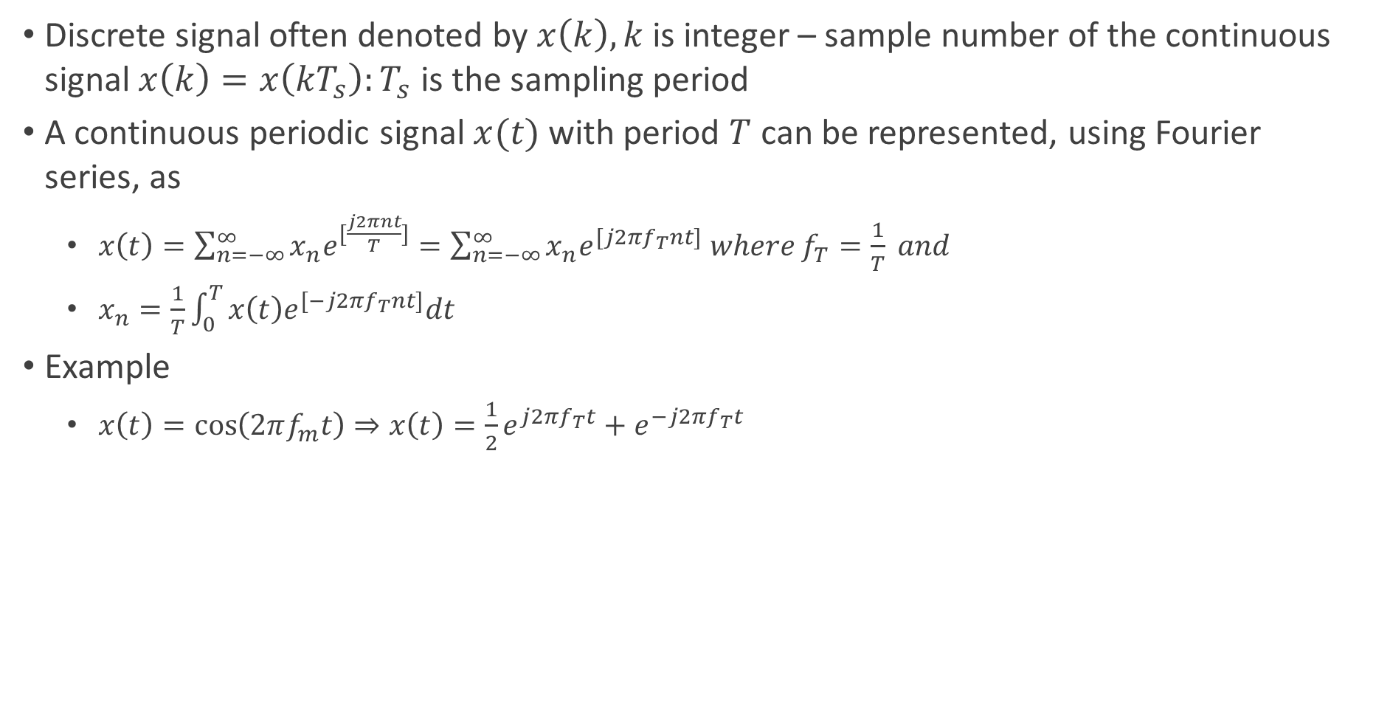
Continuous and Discrete Signal
Discrete signal often denoted by $x\left(k\right), k$is integer – sample number of the continuous signal $x\left(k\right)=x\left(kT_{s}\right):T_{s}$ is the sampling period
A continuous periodic signal $x(t)$ with period $T$ can be represented, using Fourier series, as
$x\left(t\right)=\sum_{n=−∞}^{∞}{x_{n}e^{[\frac{j2πnt}{T}]}}=\sum_{n=−∞}^{∞}{x_{n}e^{[j2πf_{T}nt]} where f_{T}=\frac{1}{T} and}$
$x_{n}=\frac{1}{T}\int_{0}^{T}{x\left(t\right)e^{[−j2πf_{T}nt]}dt}$
Example
$x\left(t\right)=\cos\left(2πf_{m}t\right)⇒x\left(t\right)=\frac{1}{2}e^{j2πf_{T}t}+e^{−j2πf_{T}t }$

Slide 38
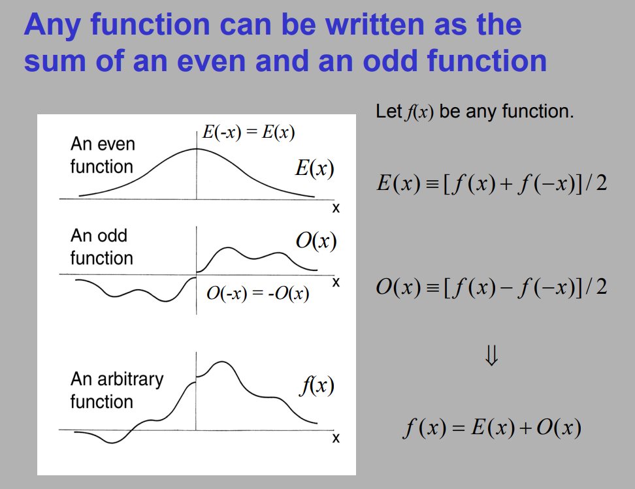
Even and Odd Functions
$\cos\left(−θ\right)=cos\left(θ\right)$ $⇒\cos\left(2π(−{f)t}_{ }+θ\right)=cos\left(−(2πft−θ)\right)=$ $cos\left(−(2πft−θ)\right)=cos\left(2πft−θ\right)$
$\sin\left(−θ\right)=−sin\left(θ\right)=sin\left(θ−π\right)⇒\sin\left(2π(−{f)t}_{ }+θ\right)=\sin\left(−\left(2πft−θ\right)\right)= \text{−}sin\left(2πft−θ\right){ }=sin\left(2πft−θ−π\right){ }$

Slide 39
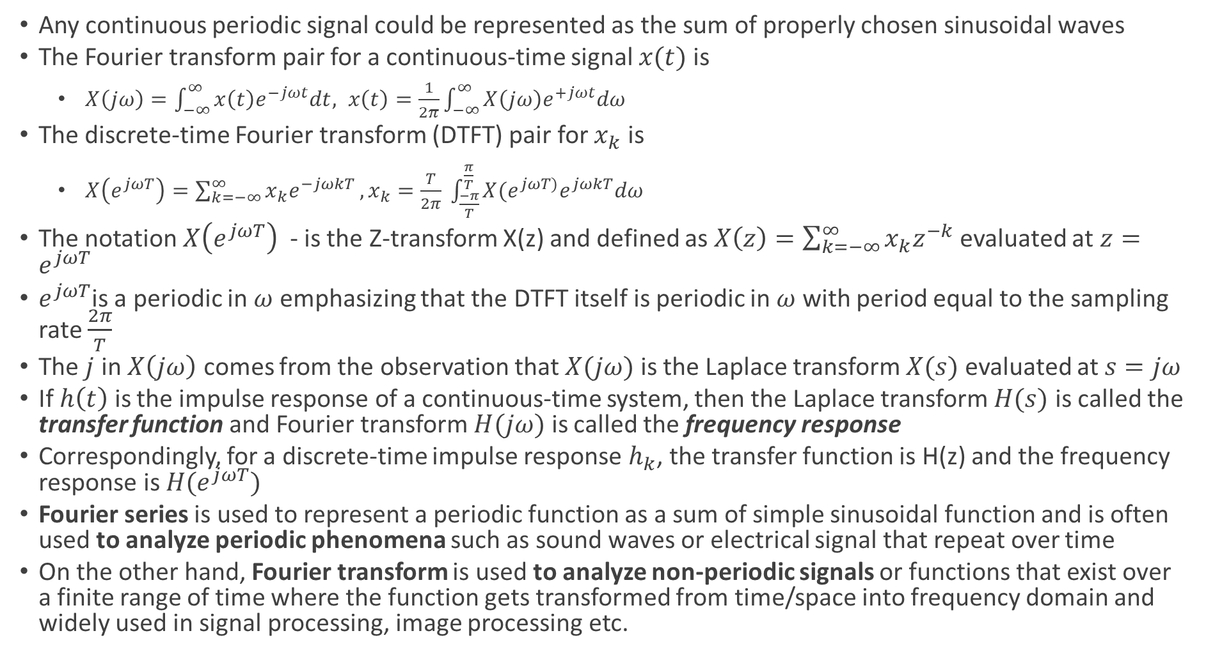
Fourier Analysis and Transform
Any continuous periodic signal could be represented as the sum of properly chosen sinusoidal waves
The Fourier transform pair for a continuous-time signal $x(t)$ is
$X\left(jω\right)=\int_{−∞}^{∞}{x\left(t\right)e^{−jωt}dt, x\left(t\right)=\frac{1}{2π}\int_{−∞}^{∞}{X\left(jω\right)e^{+jωt}dω}}$
The discrete-time Fourier transform (DTFT) pair for $x_{k}$ is
$X\left(e^{jωT}\right)=\sum_{k=−∞}^{∞}{x_{k}e^{−jωkT}}, x_{k}=\frac{T}{2π} \int_{\frac{−π}{T}}^{\frac{π}{T} }{X(e^{jωT)}e^{jωkT}dω}$
The notation $X\left(e^{jωT}\right)$ - is the Z-transform X(z) and defined as $X\left(z\right)=\sum_{k=−∞}^{∞}{x_{k}z^{−k}}$ evaluated at $z=e^{jωT}$
$e^{jωT}$is a periodic in $ω$ emphasizing that the DTFT itself is periodic in $ω$ with period equal to the sampling rate $\frac{2π}{T}$
The $j$ in $X\left(jω\right)$ comes from the observation that $X(jω)$ is the Laplace transform $X(s)$ evaluated at $s=jω$
If $h\left(t\right)$ is the impulse response of a continuous-time system, then the Laplace transform $H(s)$ is called the transfer function and Fourier transform $H(jω)$ is called the frequency response
Correspondingly, for a discrete-time impulse response $h_{k}$, the transfer function is H(z) and the frequency response is $H(e^{jωT})$
Fourier series is used to represent a periodic function as a sum of simple sinusoidal function and is often used to analyze periodic phenomena such as sound waves or electrical signal that repeat over time
On the other hand, Fourier transform is used to analyze non-periodic signals or functions that exist over a finite range of time where the function gets transformed from time/space into frequency domain and widely used in signal processing, image processing etc.

Slide 40
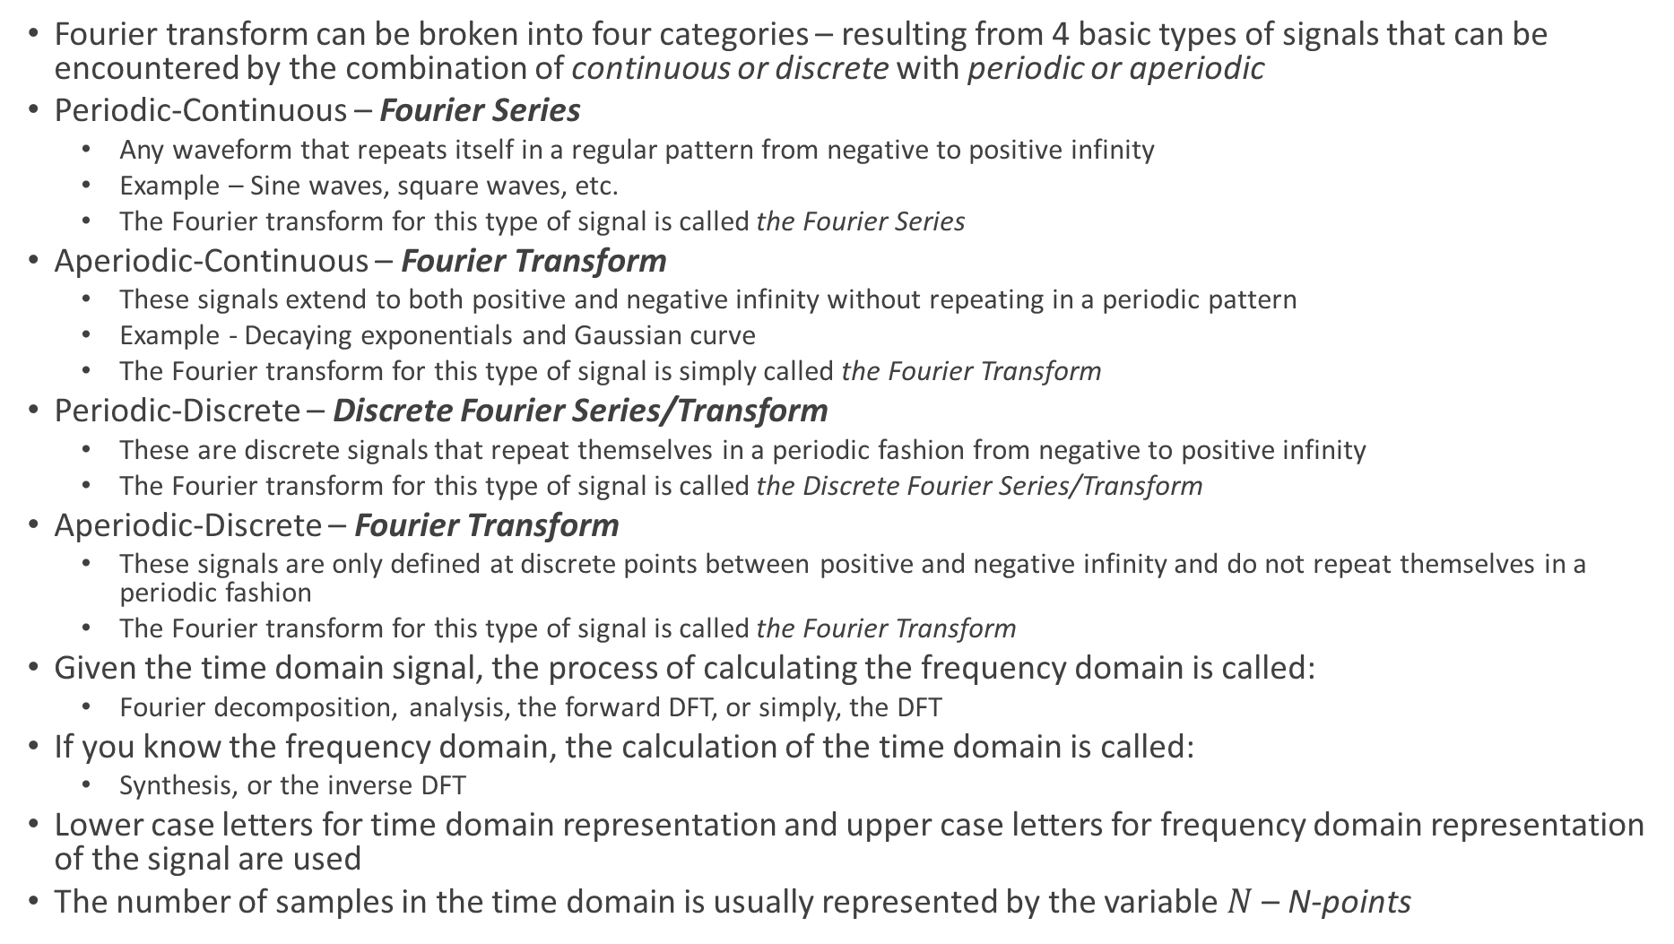
Fourier Analysis and Transform
Fourier transform can be broken into four categories – resulting from 4 basic types of signals that can be encountered by the combination of continuous or discrete with periodic or aperiodic
Periodic-Continuous – Fourier Series
Any waveform that repeats itself in a regular pattern from negative to positive infinity
Example – Sine waves, square waves, etc.
The Fourier transform for this type of signal is called the Fourier Series
Aperiodic-Continuous – Fourier Transform
These signals extend to both positive and negative infinity without repeating in a periodic pattern
Example - Decaying exponentials and Gaussian curve
The Fourier transform for this type of signal is simply called the Fourier Transform
Periodic-Discrete – Discrete Fourier Series/Transform
These are discrete signals that repeat themselves in a periodic fashion from negative to positive infinity
The Fourier transform for this type of signal is called the Discrete Fourier Series/Transform
Aperiodic-Discrete – Fourier Transform
These signals are only defined at discrete points between positive and negative infinity and do not repeat themselves in a periodic fashion
The Fourier transform for this type of signal is called the Fourier Transform
Given the time domain signal, the process of calculating the frequency domain is called:
Fourier decomposition, analysis, the forward DFT, or simply, the DFT
If you know the frequency domain, the calculation of the time domain is called:
Synthesis, or the inverse DFT
Lower case letters for time domain representation and upper case letters for frequency domain representation of the signal are used
The number of samples in the time domain is usually represented by the variable $N$ – N-points

Slide 41
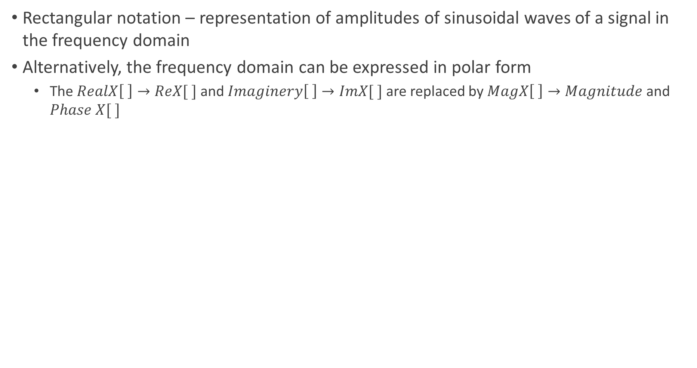
Fourier Analysis – Polar Representation
Rectangular notation – representation of amplitudes of sinusoidal waves of a signal in the frequency domain
Alternatively, the frequency domain can be expressed in polar form
The $RealX\left[ \right]→ReX[ ]$ and $Imaginery\left[ \right]→ImX[ ]$ are replaced by $MagX\left[ \right]→Magnitude$ and $Phase X[ ]$

Slide 42
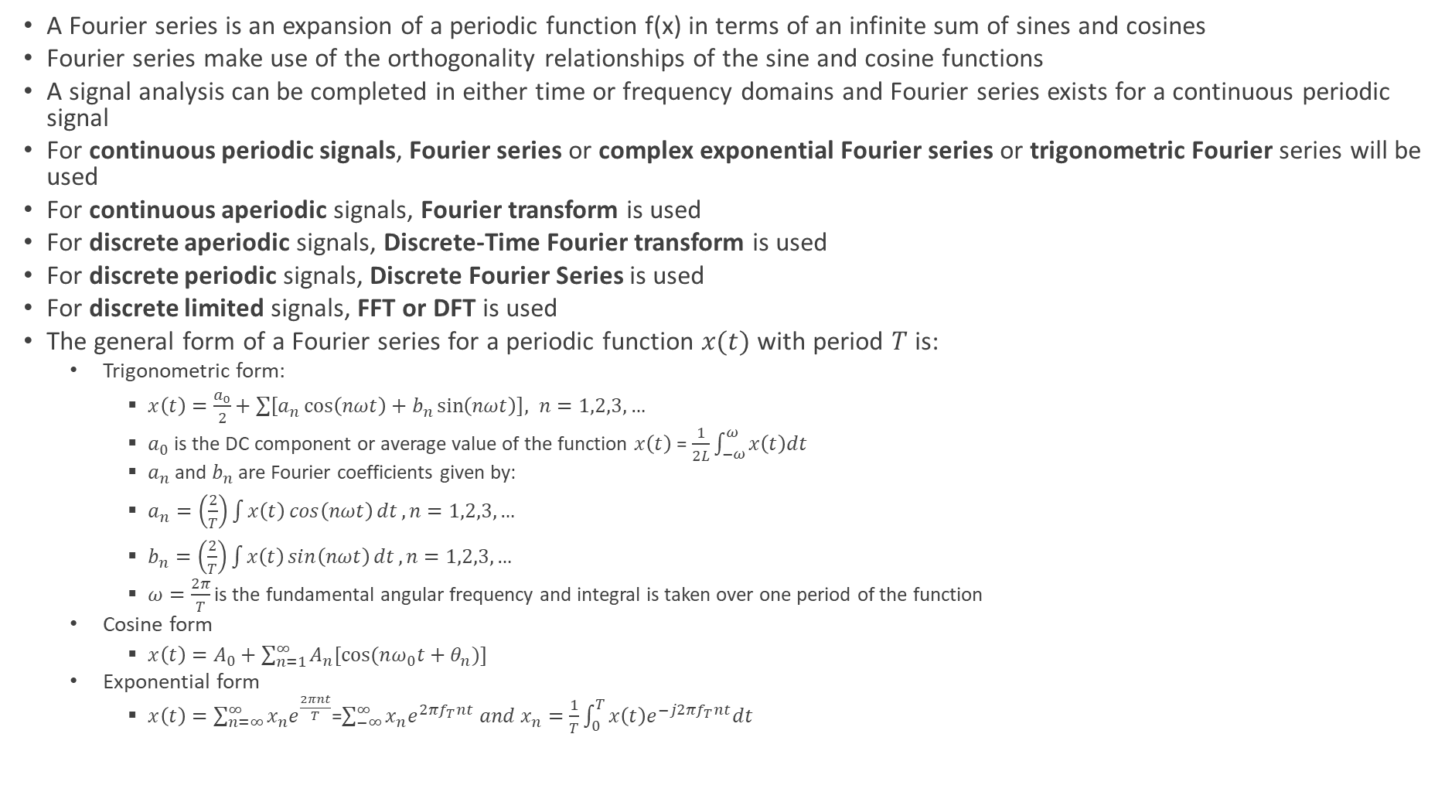
Fourier Series
A Fourier series is an expansion of a periodic function f(x) in terms of an infinite sum of sines and cosines
Fourier series make use of the orthogonality relationships of the sine and cosine functions
A signal analysis can be completed in either time or frequency domains and Fourier series exists for a continuous periodic signal
For continuous periodic signals, Fourier series or complex exponential Fourier series or trigonometric Fourier series will be used
For continuous aperiodic signals, Fourier transform is used
For discrete aperiodic signals, Discrete-Time Fourier transform is used
For discrete periodic signals, Discrete Fourier Series is used
For discrete limited signals, FFT or DFT is used
The general form of a Fourier series for a periodic function $x(t)$ with period $T$ is:
Trigonometric form:
$x\left(t\right)=\frac{a_{0}}{2}+\sum{\left[a_{n}\cos\left(nωt\right)+b_{n}\sin\left(nωt\right)\right], n=1,2,3,…}$
$a_{0}$is the DC component or average value of the function $x\left(t\right)$ = $\frac{1}{2L}\int_{−ω}^{ω}{x\left(t\right)dt}$
$a_{n}$ and $b_{n}$ are Fourier coefficients given by:
$a_{n}=\left(\frac{2}{T}\right)\int{x\left(t\right)\cos\left(nωt\right)dt}, n=1,2,3,…$
$b_{n}=\left(\frac{2}{T}\right)\int{x\left(t\right)\sin\left(nωt\right)dt}, n=1,2,3,…$
$ω=\frac{2π}{T}$ is the fundamental angular frequency and integral is taken over one period of the function
Cosine form
$x\left(t\right)=A_{0}+\sum_{n=1}^{∞}{A_{n}[cos⁡(nω_{0}t+θ_{n})]}$
Exponential form
$x\left(t\right)=\sum_{n=∞}^{∞}{x_{n}e^{\frac{2πnt}{T}}}$=$\sum_{−∞}^{∞}{x_{n}e^{2πf_{T}nt} and x_{n}=\frac{1}{T}\int_{0}^{T}{x\left(t\right)e^{−j2πf_{T}nt}dt }}$

Slide 43
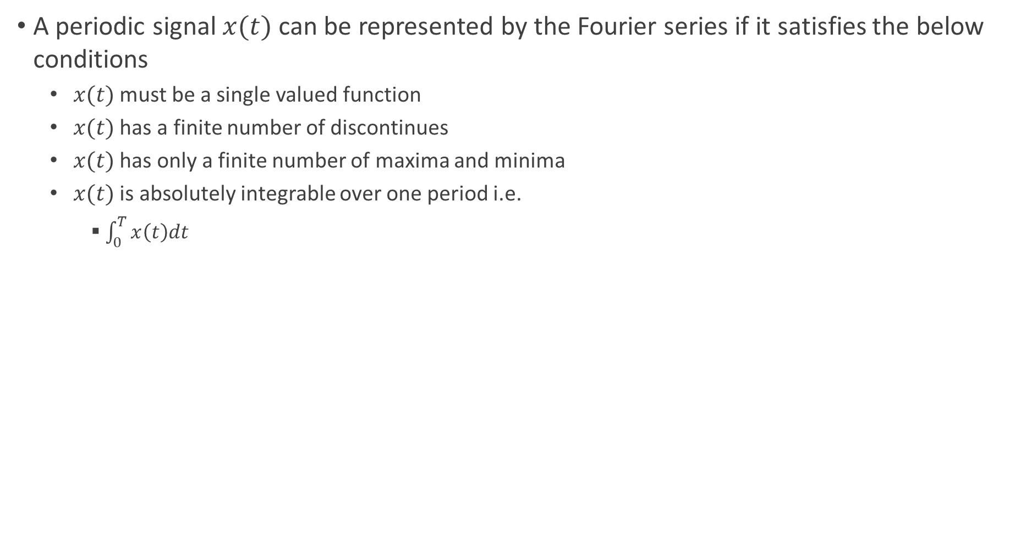
Dirichlet’s Condition for Existence of Fourier Series
A periodic signal $x(t)$ can be represented by the Fourier series if it satisfies the below conditions
$x(t)$ must be a single valued function
$x(t)$ has a finite number of discontinues
$x(t)$ has only a finite number of maxima and minima
$x(t)$ is absolutely integrable over one period i.e.
$\int_{0}^{T}{x\left(t\right)dt}$

Slide 44
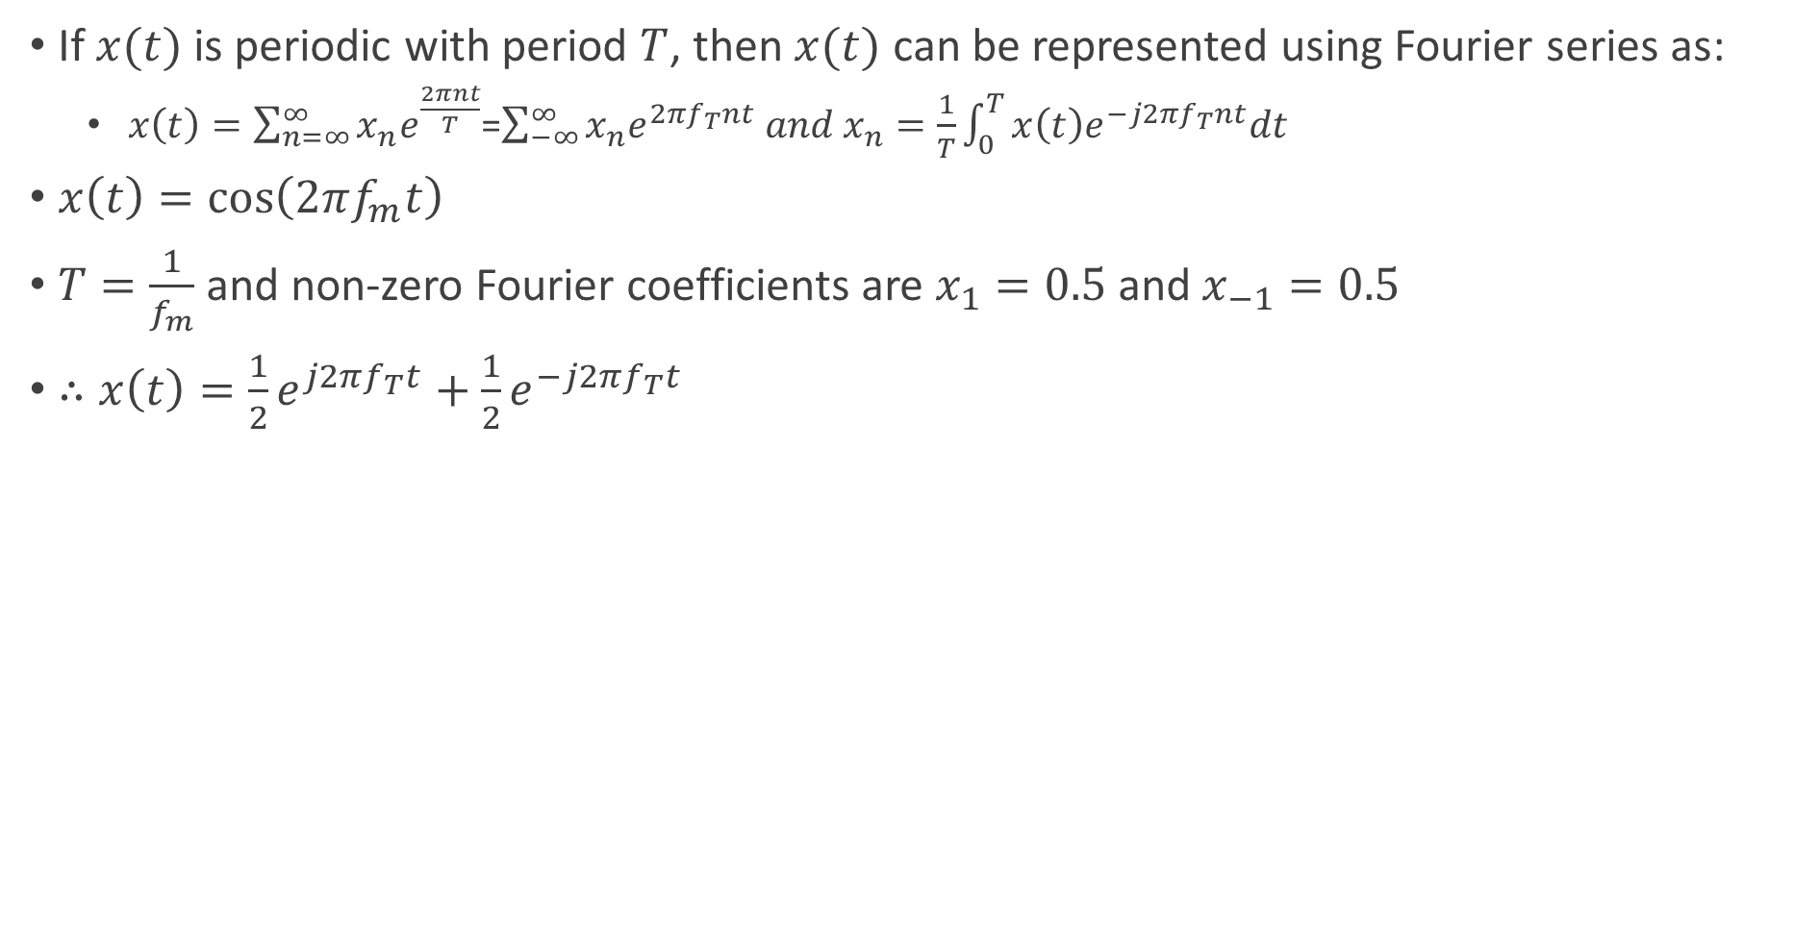
Fourier Series Example
If $x(t)$ is periodic with period $T$, then $x(t)$ can be represented using Fourier series as:
$x\left(t\right)=\sum_{n=∞}^{∞}{x_{n}e^{\frac{2πnt}{T}}}$=$\sum_{−∞}^{∞}{x_{n}e^{2πf_{T}nt} and x_{n}=\frac{1}{T}\int_{0}^{T}{x\left(t\right)e^{−j2πf_{T}nt}dt }}$
$x\left(t\right)=\cos\left(2πf_{m}t\right)$
$T=\frac{1}{f_{m}}$ and non-zero Fourier coefficients are $x_{1}=0.5$ and $x_{−1}=0.5$
$∴x\left(t\right)=\frac{1}{2}e^{j2πf_{T}t}+\frac{1}{2}e^{−j2πf_{T}t}$

Slide 45
Fourier Transform
A periodic signal can be represented as linear combination of complex exponentials which are harmonically related
An aperiodic signal can be represented as linear combination of complex exponentials which are infinitesimally close in frequency – representation is of the form integral rather than sum/sigma
As period increases the fundamental frequency decreases and harmonics become closer in frequency
As the period becomes infinite, the frequency components form a continuum and Fourier series becomes and integral

Slide 46
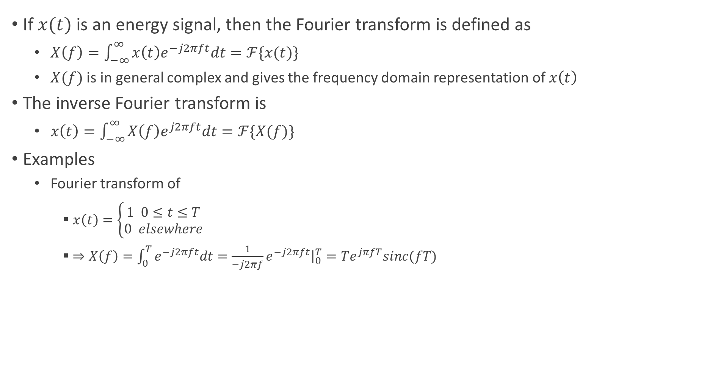
Fourier Transform
If $x(t)$ is an energy signal, then the Fourier transform is defined as
$X\left(f\right)=\int_{−∞}^{∞}{x\left(t\right)e^{−j2πft}dt=ℱ\{x(t)\}}$
$X(f)$ is in general complex and gives the frequency domain representation of $x\left(t\right)$
The inverse Fourier transform is
$x\left(t\right)=\int_{−∞}^{∞}{X\left(f\right)e^{j2πft}dt=ℱ\{X(f)\}}$
Examples
Fourier transform of
$x\left(t\right)=\left\{\begin{aligned}1 0≤t≤T \\ 0 elsewhere\end{aligned}\right.$
$⇒X\left(f\right)=\int_{0}^{T}{e^{−j2πft}dt=\frac{1}{−j2πf}e^{−j2πft}{\left.​\right|}_{0}^{T}=Te^{jπfT}sinc(fT) }$

Slide 47
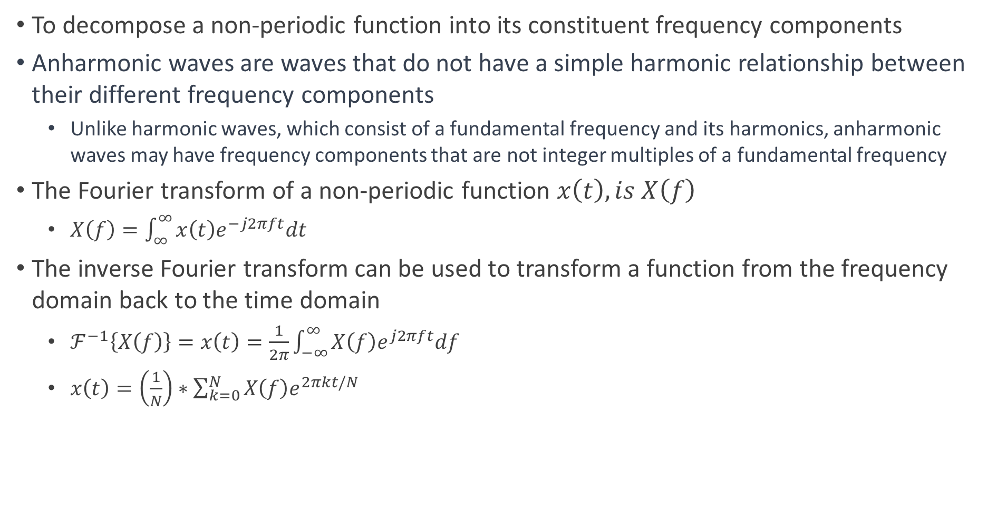
Fourier Transform and Inverse Fourier Transform
To decompose a non-periodic function into its constituent frequency components
Anharmonic waves are waves that do not have a simple harmonic relationship between their different frequency components
Unlike harmonic waves, which consist of a fundamental frequency and its harmonics, anharmonic waves may have frequency components that are not integer multiples of a fundamental frequency
The Fourier transform of a non-periodic function $x\left(t\right), is X\left(f\right)$
$X\left(f\right)=\int_{∞}^{∞}{x\left(t\right)e^{−j2πft}dt}$
The inverse Fourier transform can be used to transform a function from the frequency domain back to the time domain
$ℱ^{−1}\left\{X\left(f\right)\right\}=x\left(t\right)=\frac{1}{2π}\int_{−∞}^{∞}{X\left(f\right)e^{j2πft}df}$
$x\left(t\right)=\left(\frac{1}{N}\right)∗\sum_{k=0}^{N}{X\left(f\right)e^{2πkt/N}}$

Slide 48
Time and Frequency Duality
The synthesis (inverse DFT) and analysis (DFT) of signals/equations are strikingly similar
To move from one domain o the other, the known values are multiplied by the basis functions and the resulting products added
This symmetry between the time and frequency domain is called time and frequency duality and gives rise to many interesting properties
A single point in the frequency domain corresponds to a sinusoidal in the time domain. By duality, the inverse is also true – a single point in the time domain corresponds to a sinusoidal in the frequency domain
A convolution in the time domain corresponds to multiplication in the frequency domain. By duality, the reverse is also true – convolution in the frequency domain corresponds to multiplication in the time domain

Slide 49
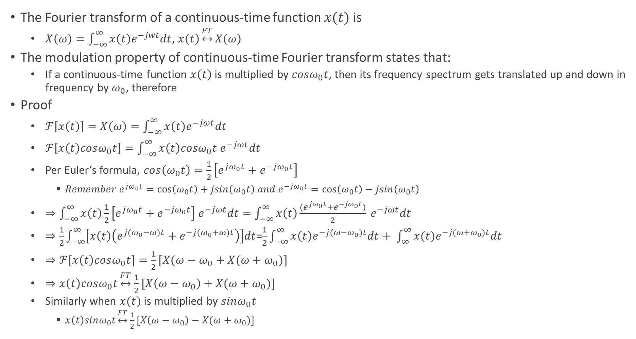
Modulation Property of Fourier Transform
The Fourier transform of a continuous-time function $x(t)$ is
$X\left(ω\right)=\int_{−∞}^{∞}{x\left(t\right)e^{−jwt}dt}$, $x\left(t\right)\underset{↔}{FT}X\left(ω\right)$
The modulation property of continuous-time Fourier transform states that:
If a continuous-time function $x\left(t\right)$ is multiplied by $cosω_{0}t$, then its frequency spectrum gets translated up and down in frequency by $ω_{0}$, therefore
Proof
$ℱ\left[x\left(t\right)\right]=X\left(ω\right)=\int_{−∞}^{∞}{x\left(t\right)e^{−jωt}dt}$
$ℱ\left[x\left(t\right)cosω_{0}t\right]=\int_{−∞}^{∞}{x\left(t\right)cosω_{0}t e^{−jωt}dt}$
Per Euler’s formula, $\cos\left(ω_{0}t\right)=\frac{1}{2}\left[e^{jω_{0}t}+e^{−jω_{0}t}\right]$
$Remember e^{jω_{0}t}=\cos\left(ω_{0}t\right)+jsin\left(ω_{0}t\right) and e^{−jω_{0}t}=\cos\left(ω_{0}t\right)−jsin\left(ω_{0}t\right)$
$⇒\int_{−∞}^{∞}{x\left(t\right)\frac{1}{2}\left[e^{jω_{0}t}+e^{−jω_{0}t}\right] e^{−jωt}dt}=\int_{−∞}^{∞}{x\left(t\right)\frac{(e^{jω_{0}t}+e^{−jω_{0}t})}{2} e^{−jωt}dt}$
$⇒\frac{1}{2}\int_{−∞}^{∞}{\left[x\left(t\right)\left(e^{j(ω_{0}−ω)t}+e^{−j(ω_{0}+ω)t}\right)\right]dt}$=$\frac{1}{2}\int_{−∞}^{∞}{x\left(t\right)e^{−j({ω−ω}_{0})t}dt+ \int_{∞}^{∞}{{x(t)e}^{−j({ω+ω}_{0})t}dt}}$
$⇒ℱ[x\left(t\right)cosω_{0}t]=\frac{1}{2}[X(ω−ω_{0}+X(ω+ω_{0})]$
$⇒x\left(t\right)cosω_{0}t\underset{↔}{FT}$ $\frac{1}{2}[X\left(ω−ω_{0}\right)+X(ω+ω_{0})]$
Similarly when $x(t)$ is multiplied by $sinω_{0}t$
$x\left(t\right)sinω_{0}t\underset{↔}{FT}$ $\frac{1}{2}[X\left(ω−ω_{0}\right)−X(ω+ω_{0})]$

Slide 50
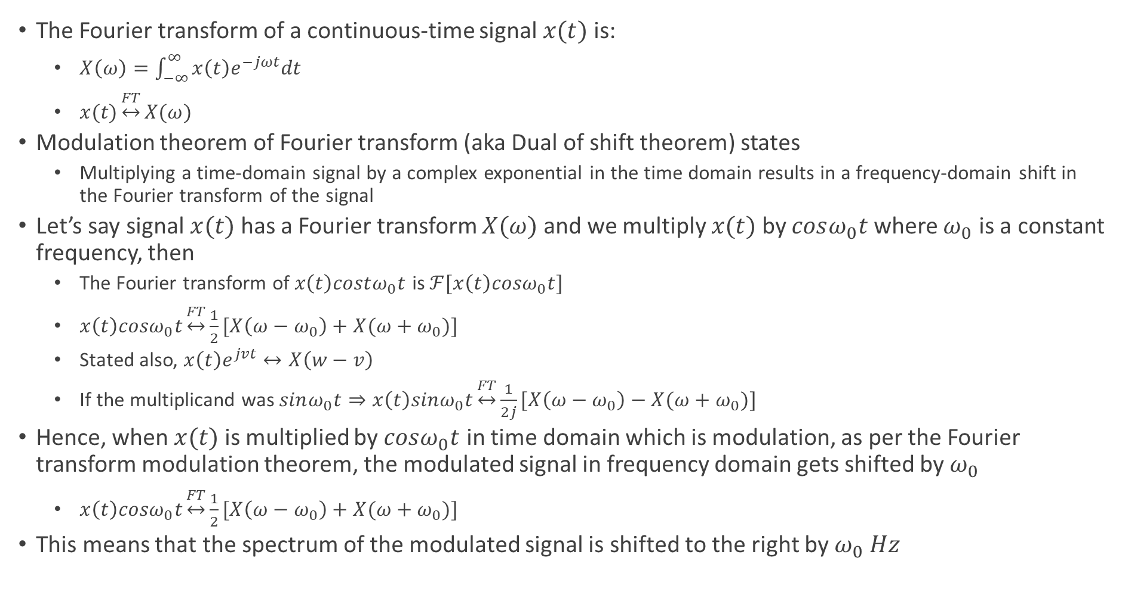
Modulation Theorem of Fourier Transform
The Fourier transform of a continuous-time signal $x(t)$ is:
$X\left(ω\right)=\int_{−∞}^{∞}{x\left(t\right)e^{−jωt}dt}$
$x(t)\underset{↔}{FT}X(ω)$
Modulation theorem of Fourier transform (aka Dual of shift theorem) states
Multiplying a time-domain signal by a complex exponential in the time domain results in a frequency-domain shift in the Fourier transform of the signal
Let’s say signal $x(t)$ has a Fourier transform $X(ω)$ and we multiply $x(t)$ by $cosω_{0}t$where $ω_{0}$ is a constant frequency, then
The Fourier transform of $x\left(t\right)costω_{0}t$ is $ℱ[x\left(t\right)cosω_{0}t]$
$x\left(t\right)cosω_{0}t\underset{↔}{FT}\frac{1}{2}[X\left(ω−ω_{0}\right)+X(ω+ω_{0})]$
Stated also, $x\left(t\right)e^{jvt}↔X\left(w−v\right)$
If the multiplicand was $sinω_{0}t⇒x\left(t\right)sinω_{0}t\underset{↔}{FT}\frac{1}{2j}[X\left(ω−ω_{0}\right)−X(ω+ω_{0})]$
Hence, when $x(t)$ is multiplied by $cosω_{0}t$ in time domain which is modulation, as per the Fourier transform modulation theorem, the modulated signal in frequency domain gets shifted by $ω_{0}$
$x\left(t\right)cosω_{0}t\underset{↔}{FT}\frac{1}{2}[X\left(ω−ω_{0}\right)+X(ω+ω_{0})]$
This means that the spectrum of the modulated signal is shifted to the right by $ω_{0} Hz$

Slide 51
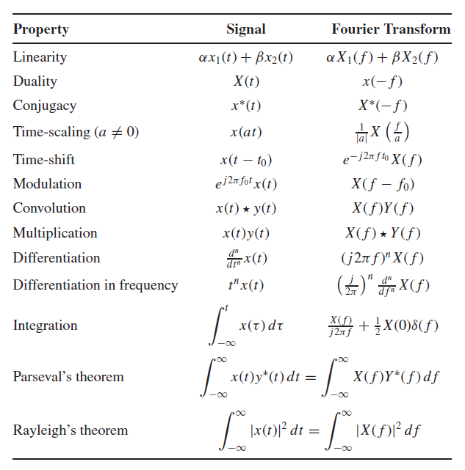
Fourier Transform Properties

Slide 52
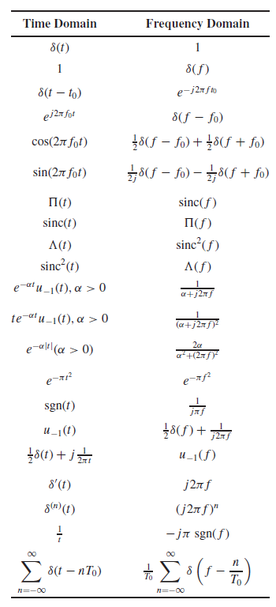
Fourier Transform Pairs

Slide 53
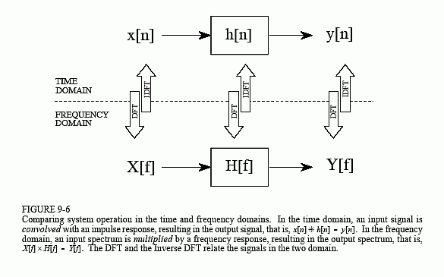
Application of DFT
Any linear system can be completely described by how it changes the amplitude and the phase of cosine waves passing through it – called the system’s frequency response
Since system’s impulse response and frequency response contain complete information about the system – there must be a one-to-one correspondence between the two and given one, the other can be calculated
The relationship between the impulse response and frequency response is one of the foundations of signal processing
A system’s frequency response is the Fourier Transform of its impulse response

Slide 54
FFT
There are several ways to calculate the DFT – solving simultaneous linear equations or correlation method etc.
FFT is another method for calculating the DFT
While it produces the same result as the other approaches, it is incredibly more efficient, often reducing the computation time by hundreds

Slide 55



Energy or Power Signal
Energy signal
The energy $E_{x}$ of a signal $x(t)$ is given by
$E_{x}=\lim_{T→∞}{\int_{−\frac{T}{2}}^{\frac{T}{2}}{{\left|x\left(t\right)\right|}^{2}dt}}$
$x(t)$ is called an energy signal when $E_{x}$ is bounded i.e. $E_{x}<∞$
Typically energy signals are normally associated with finite duration waveforms
Power signal
A signal is called power signal if it does not have finite energy i.e. power signal does not have bounded energy but have bounded power
The signal power $P_{x}$ is given by
$P_{x}= \lim_{T→∞}{ \frac{1}{T}\int_{−\frac{T}{2}}^{\frac{T}{2}}{{\left|x\left(t\right)\right|}^{2}dt}}$
If $E_{x}<∞$, then $P_{x}=0$ and $P_{x}>0$, then $E_{x}=∞$

Slide 56

Parseval Theorem
Power of a signal can be calculated using either time or frequency domain representation of the signal and the two results are identical
$P_{x}=\frac{1}{T}\int_{0}^{T}{{\left|x\left(t\right)\right|}^{2}dt=\sum_{n=−∞}^{∞}{{\left|x_{n}\right|}^{2}}}$

Slide 57


Fourier Transform of Pulse
$x\left(t\right)=\left\{\begin{aligned}1, 0≤t≤T \\ 0 , elsewhere\end{aligned}\right.$
$X\left(f\right)=\int_{0}^{T}{1.e^{−j2πft}dt=\frac{1}{−j2πf}e^{−j2πft}{\left.​\right|}_{0}^{T}=Te^{jπfT}sinc(fT) }$

Slide 58

Rayleigh Energy Theorem
According to Rayleigh’s energy theorem
The signal energy computed in time domain and in frequency domain are same
$E_{x}=\int_{−∞}^{∞}{{\left|x\left(t\right)\right|}^{2}dt=\int_{−∞}^{∞}{{\left|X\left(f\right)\right|}^{2}df}}$
Example
Let’s take $x\left(t\right)=\left\{\begin{aligned}1 0≤t≤T \\ 0 elsewhere\end{aligned}\right.$
$⇒X\left(f\right)=\int_{0}^{T}{e^{−j2πft}dt=\frac{1}{−j2πf}e^{−j2πft}{\left.​\right|}_{0}^{T}=Te^{jπfT}sinc(fT) }$
The energy is mostly computed in time domain
$E_{x}=\int_{0}^{T}{{\left|x\left(t\right)\right|}^{2}dt=T}$

Slide 59

Correlation Function
Correlation function of a signal $x(t)$ is defined as:
$V_{x}\left(τ\right)=\int_{−∞}^{∞}{x\left(t\right)x^{∗}\left(t−τ\right)dt}$
The important characteristics of correlation function are:
At $τ=0⇒V_{x}\left(0\right)=\int_{−∞}^{∞}{{\left|x\left(t\right)\right|}^{2}dt=E_{x}}$ - nothing but the energy of the signal!
$V_{x}\left(τ\right)=V_{x}^{∗}\left(−τ\right)$
$\left|V_{x}\left(τ\right)\right|<V_{x}(0)$
Example: For the pulse
$x\left(t\right)=\left\{\begin{aligned}1 0≤t≤T \\ 0 Otherwise\end{aligned}\right.$
The correlation function is
$V_{x\left(τ\right)}=\left\{\begin{aligned}T\left(1−\frac{\left|τ\right|}{T}\right) \left|τ\right|≤T \\ 0 Elsewhere\end{aligned}\right.$

Slide 60

Energy Spectrum
The energy spectrum of a signal is defined by the Fourier transform of the signal
$G_{x}\left(f\right)=X\left(f\right)X^{∗}\left(f\right)={\left|X\left(f\right)\right|}^{2}$
The energy spectral density of a function is the Fourier transform of the correlation function
$G_{x}\left(f\right)=ℱ\{V_{x}(τ)\}$
The energy spectrum is a functional description of how the signal $x(t)$’s energy is distributed as a function of frequency
Properties of the energy spectral density
$G_{x}\left(f\right)≥0 ∀f$ – energy in a signal cannot be negative valued
$E_{x}=\int_{−∞}^{∞}{{\left|x\left(t\right)\right|}^{2}dt=\int_{−∞}^{∞}{G_{x}\left(f\right)df}}$
Example
For the pulse
$x\left(t\right)=\left\{\begin{aligned}1 0≤t≤T \\ 0 Otherwise\end{aligned}\right.$ $X\left(f\right)=Te^{−jπfT}sinc(fT)$
The energy spectrum is $G_{x}\left(f\right)=T^{2}{\left(sinc\left(fT\right)\right)}^{2}$

Slide 61

Bandwidth of A Signal
Refers to the amount of positive frequency spectrum that a signal occupies
If a signal $x(t)$ has an energy spectrum $G_{x}(f)$, then the bandwidth $B_{x}$ is determined as
$10log⁡(\max_{f}{G_{x}(f)) }=X+10log⁡(G_{x}\left(B_{x}\right))$ where $G_{x}\left(B_{x}\right)>G_{x}\left(f\right)for \left|f\right|>B_{x}$
A signal has a relative bandwidth $B_{x}$, if the energy spectrum is at least X dB down from the peak at all frequencies at or above $B_{x}Hz$
Often used values for X are - 3-dB BW and 40-dB BW
The energy packed in the bandwidth of the signal
$P=\frac{\int_{−B_{P}}^{B_{P}}{G_{x}\left(f\right)df}}{E_{x}}$
Meaning – a signal has an integral bandwidth $B_{P}$ if the percent of the total energy in the interval $[−B_{P}, B_{P}]$ is equal to P% - usually P% is around 98/99%

Slide 62
Digital Filters
Digital filters can be implemented in two ways
Convolution – aka Finite Impulse Response – FIR
Recursion – aka Infinite Impulse Response - IIR

Slide 63






Commonly Used Signals
Rectangular Signal
$⨅(t)=\left\{\begin{aligned}1 ,\left|t\right|<\frac{1}{2} \\ \frac{1}{2} ,t=±\frac{1}{2} \\ 0 ,Otherwise\end{aligned}\right.$
Sinc signal
$sinc\left(t\right)=\left\{\begin{aligned}\frac{\sin\left(πt\right)}{πt} t≠0 \\ 1 t=0\end{aligned}\right.$
$E=\int_{−∞}^{∞}{\left|X{\left(f\right)}^{2}\right|df=\int_{−1}^{1}{df=2}}$
Signum signal
$sgn\left(t\right)=\left\{\begin{aligned}1 t>0 \\ −1 t<0 \\ 0 t=0\end{aligned}\right.$
Unit step signal
$U_{−1}\left(t\right)=\left\{\begin{aligned}1 t>0 \\ \frac{1}{2} t=0 \\ 0 t<0\end{aligned}\right.$
T3:14 in Representation of Lowpass and Bandpass Signals

Slide 64


Commonly Used Signals
Traingular Signal
$∧\left(t\right)=⊓\left(t\right)∗⊓\left(t\right)=\left\{\begin{aligned}t+1 −1≤t≤0 \\ −t+1 0≤t≤1 \\ 0 otherwise \end{aligned}\right.$

Slide 65

Lowpass Equivalent of Bandpass Signals
$x(t)$ is a bandpass signal
Let’s denote lowpass equivalent by $x_{l}(t)$ and is a complex envelop of $x(t)$
The Fourier transform of lowpass equivalent is defined as
$X_{l}\left(f\right)=ℱ\left[x_{l}\left(t\right)\right]=2X_{+}\left(f+f_{0}\right)=2X\left(f+f_{0}\right)u_{−1}(f+f_{0})$
Applying the modulation theorem of Fourier transform

Slide 66

Signals and Frequency Spectrum and Hermitian Symmetry
Hermitian symmetry refers to the property of the Fourier transform of a real-valued signal that has conjugate symmetry about the origin
Hermitian symmetry or Conjugate symmetry
If a complex function or signal is equal to its complex conjugate mirrored about the real axis, it has Hermitian symmetry
$⇒f\left(x\right)=f^{∗}\left(−x\right) where f^{∗}\left(−x\right) is the complex conjugate of f(−x)$
The Fourier transform of a real-value function is a complex function that has Hermitian symmetry
Meaning the Fourier transform of a the function evaluated at a certain frequency is equal to the complex conjugate of the Fourier transform evaluated at the negative of that frequency
Fourier transform of a real signal $x(t)$ has Hermitian Symmetry
$X\left(−f\right)=X^{∗}\left(f\right)$
Magnitude - $\left|X\left(−f\right)\right|=|X(f)|$ and Phase - $∠X\left(−f\right)=−∠X(f)$
The positive and negative spectrum of a signal
$X_{+}\left(f\right)=\left\{\begin{aligned}X\left(f\right), f>0 \\ \frac{1}{2}X\left(0\right), f=0 \\ 0, f<0\end{aligned}\right. ⇒X_{+}\left(f\right)=X\left(f\right)u_{−1}\left(f\right), u_{−1}\left(f\right) is a unit step function$
$X_{_}\left(f\right)=\left\{\begin{aligned}X\left(f\right), f<0 \\ \frac{1}{2}X\left(0\right), f=0 \\ 0, f>0\end{aligned}⇒X_{−}\left(f\right)=X\left(f\right)u_{−1}\left(−f\right), u_{−1}\left(−f\right) is a unit step function \right.$
$∴X\left(f\right)=X_{+}\left(f\right)+X_{−}(f)$
For real signal in time domain, we know it has Hermitian symmetry $X\left(−f\right)=X^{∗}\left(f\right)$
$∴X\left(f\right)=X_{+}\left(f\right)+X_{+}^{∗}(−f)$
Which means knowledge of $X_{+}(f)$ is sufficient to reconstruct $X(f)$
Page 7 of slides2B.pdf

Slide 67

Analytic Signals and Hilbert Transform
An analytic signal is a complex valued signal that carries only positive frequency components (no negative frequency components) and is known as complex envelop
The real and imaginary parts of an analytic signal are real-valued functions related to each other by the Hilbert transform
This helps in achieving single-side band modulation technique
Mathematically, an analytic signal is the result of applying Hilbert transform to a real-valued signal
The basic idea – the negative frequency components of the Fourier transform (or spectrum) of a real-valued function are superfluous due to Hermitian symmetry of such spectrum
The negative frequency components can be discarded with no loss of information provided the complex-valued function is dealt with, instead
When a manipulated function has no negative frequency components i.e. it is still analytic, the conversion from complex back to real is just a matter of discarding the imaginary part
Hilbert transform
Shifts the phase of the Fourier transform of the input signal as below
By $−{90}^{o}$ for positive frequencies
By $+{90}^{o}$ for negative frequencies
The above operation removes, effectively, negative frequency components
A linear operator that produces a complex-valued output signal
Magnitude of the analytical signal represents the envelop of the original signal
Phase of the analytical signal represents the instantaneous phase of the original signal
Hilbert transform can be applied to obtain the analytic signal from the original and vice versa

Slide 68



Hilbert Transform
Mathematical tool used to create a complex-valued representation of a real-valued signal
Hilbert transform is a specific singular integral that takes a function $u(t)$ of a real variable and produces another function of real variable $H(u)(t)$
The Hilbert transform can be thought of as the convolution of $u(t)$ with the function $h\left(t\right)=\frac{1}{πt}$, known as Cauchy kernel
Because $\frac{1}{t}$ is not integrable across $t=0$, the integral defining the convolution does not always converge, instead, Hilbert transform is defined using Cauchy principal value P.V
Explicitly, Hilbert transform is given by,
$H\left\{u\left(t\right)\right\}=H\left(u\right)\left(t\right)=\hat{u}\left(t\right)=\frac{1}{π}P.V.\int_{−∞}^{∞}{\frac{u\left(τ\right)}{t−τ}dτ}$
In frequency domain, Hilbert transform represents a phase shift of $±{90}^{o}(\frac{π}{2}radians)$ to every frequency component of a function
This is done by applying a linear time-invariant filter to the signal that shifts the phase of the signal by $±{90}^{0}$– a quarter of a cycle
If Fourier transform exists, then Hilbert transform also exists for energy and power signals
The analytic signal or the pre-envelop corresponding to $x(t)$ denoted by $x_{+}\left(t\right).$
Say $x_{+}\left(t\right)$ has Fourier transform $X_{+}\left(f\right)$
$x_{+}\left(t\right)=ℱ^{−1}\left[X_{+}\left(f\right)\right]$
$=ℱ^{−1}\left[X\left(f\right)u_{−1}(f)\right]$
This is multiplication of two spectra and inverse Fourier transform in time domain would have convolution operation
$$⇒x_{+}\left(t\right)=x\left(t\right)∗\left(\frac{1}{2}δ\left(t\right)+j\frac{1}{2πt}\right)$$
$=\frac{1}{2}x\left(t\right)+\frac{j}{2}\hat{x}\left(t\right) where \hat{x}\left(t\right)=x\left(t\right)∗\frac{1}{πt} and \hat{x}\left(t\right)is Hilbert transform of x(t)$
Hilbert transform of $x\left(t\right)$
$\hat{x}\left(t\right)=x\left(t\right)∗\frac{1}{πt}$
Fourier transform of $\hat{x}(t)$
$ℱ\left[\hat{x}\left(t\right)\right]=−jsgn\left(f\right)X\left(f\right)$
$where\operatorname{sgn}\left(f\right)=\left\{\begin{aligned}−1, f<0 \\ 1, f>0\end{aligned}\right.$
T10:48/29:21 in the Representation of Lowpass and bandpass signals
Convolution of x(t) with $δ(t)$ is not clear

Slide 69
Lowpass, Baseband, Bandpass Signals and Modulation
In almost all cases, the spectral characteristics of the information sequence to be transmitted do not directly match the spectral characteristics of the channel and hence the information signal cannot be directly transmitted over the channel
In many cases the information signal to be transmitted is a low-frequency signal aka baseband signal and the available spectrum for transmission is at higher frequencies
Therefore at the transmitter the information signal is translated to a higher frequency signal that matches the properties of the channel
This process is called modulation – baseband information signal is turned into a bandpass modulated signal
Any real, narrow-band, and high-frequency signal – called bandpass signal – can be represented in terms of a complex low-frequency signal, called “the lowpass equivalent of the original bandpass signal”
This makes the handling of bandpass signals simplified – so because applying signal processing algorithms to lowpass signals is much easier due to lower required sampling rates which in turn result in lower rates of sampled data

Slide 70

Lowpass, Baseband, Bandpass Signals and Modulation
Bandpass
The bandpass signal is a real-valued signal whose frequency spectrum is located around some frequency $±f_{0}$ which is far from zero
More formally, bandpass signal is a real-valued signal $x(t)$ for which there exists positive $f_{0}$ and $W$ such that the positive spectrum of $X(f)$ i.e. $X_{+}\left(f\right)$ is non-zero in the interval $[f_{0}−\frac{W}{2},f_{0}+\frac{W}{2}]$ where $\frac{W}{2}<f_{0}$. The frequency $f_{0}$ is called the central frequency, though it may not necessarily be the mid-band frequency of the bandpass signal
The Fourier transform of a signal provides information about the frequency content or spectrum of the signal
The Fourier transform of a real valued signal $x(t$ has Hermitian symmetry $i.e. X\left(−f\right)=X^{∗}\left(f\right)⇒\left|X\left(−f\right)\right|=\left|X\left(f\right)\right| and ∠X^{∗}\left(f\right)=−∠X(f)$
In other words, for real-valued function $x(t)$, the magnitude $X(f)$ is even and its phase is odd
Because of this symmetry, all information about the signal is in the positive (or negative) frequency and $x(t)$ can be perfectly reconstructed by specifying $X\left(f\right)$ for $f≥0$
Based on this observation we define the bandwidth as the smallest range of positive frequencies such that $X\left(f\right)=0$ when $|f|$ is outside this range
It is clear that the bandwidth of real-valued signal $x\left(t\right),$per Hermitian symmetry, is one-half of its frequency support set
Lowpass or Baseband
Spectrum is located around zero frequency with different spectral characteristics
Examples – speech, music, video etc.
Usually, lowpass signals are low frequency signals and are slowly varying signals with no jumps or sudden variations
For a complex signal $x(t)$, the spectrum $X(f)$ is not symmetric and hence signal cannot be reconstructed from the information in the positive frequencies alone
When the baseband signal is modulated, the spectrum of lowpass/baseband signal is translated to higher frequencies and the resulting modulated signal is called bandpass signal

Slide 71

Lowpass Equivalent of Bandpass Signals
$x_{l}(t)$ denotes the lowpass equivalent or complex envelop of $x(t)$ whose Fourier transform is
$X_{l}\left(f\right)=ℱ\left\{x_{l}\left(t\right)\right\}=2X_{+}\left(f+f_{0}\right)=2X\left(f+f_{0}\right)u_{−1}\left(f+f_{0}\right)$
Applying Fourier transform modulation property
$x_{l}\left(t\right)=ℱ^{−1}\left\{X_{l}\left(f\right)\right\}=2x_{+}\left(t\right)e^{−j2πf_{0}t}=\left(x\left(t\right)+j\hat{x}\left(t\right)\right)e^{−j2πf_{0}t}$
$=\left(x\left(t\right)+j\hat{x}\left(t\right)\right)\left(cosj2πf_{0}t −jsin2πf_{0}t\right)$
$=\left(x\left(t\right)cos2πf_{0}t+\hat{x}\left(t\right)sin2πf_{0}t \right)+j\left(\hat{x}\left(t\right)cosj2πf_{0}t−x\left(t\right)sin2πf_{0}t\right)−demodulation$
We can write
$x_{l}\left(t\right)=\left(x\left(t\right)+j\hat{x}\left(t\right)\right)e^{−j2πf_{0}t}$
Multiply both side with $e^{j2πf_{0}t}$
$⇒x_{l}\left(t\right)e^{j2πf_{0}t}=x\left(t\right)+j\hat{x}\left(t\right)$
Hence, the real part of [$x_{l}\left(t\right)e^{j2πf_{0}t}]$is $x\left(t\right)$ and imaginary part is $\hat{x}(t)$
$∴x\left(t\right)=Re\left[x_{l}\left(t\right)e^{j2πf_{0}t}\right]− Modulation$
$⇒X\left(f\right)=\frac{1}{2}[X_{l}\left(f−f_{0}\right)+X_{l}^{∗}(−f−f_{0})]$

Slide 72

Lowpass Equivalent of Bandpass Signals
$x_{l}\left(t\right)=\left(x\left(t\right)cos2πf_{0}t+\hat{x}\left(t\right)sin2πf_{0}t \right)+j\left(\hat{x}\left(t\right)cosj2πf_{0}t−x\left(t\right)sin2πf_{0}t\right)$
In-phase component and quadrature components of representation of $x_{l}\left(t\right)$
$x_{l}\left(t\right)=x_{i}\left(t\right)+jx_{q}\left(t\right)$
So, the in-phase and quadrature phase components of $x_{l}\left(t\right)$ are:
$x_{i}\left(t\right)=x\left(t\right)\cos{2πf_{0}t+\hat{x}\left(t\right)\sin{2πf_{0}t}}$
$x_{q}\left(t\right)=\hat{x}\left(t\right)cos2πf_{0}t−x\left(t\right)sin2πf_{0}t$
If we solve the above two equations for $x(t)$ and $\hat{x}(t)$ in terms of $x_{i}(t)$ and $x_{q}(t)$
$x\left(t\right)=x_{i}\left(t\right)cos2πf_{0}t−x_{q}\left(t\right)sin2πf_{0}t$
$\hat{x}\left(t\right)=x_{q}\left(t\right)\cos{2πf_{0}t+x_{i}\left(t\right)sin2πf_{0}t}$
$x_{l}\left(t\right)$ in polar form
Envelop of $x\left(t\right)⇒r_{x}\left(t\right)=\sqrt{x_{i}^{2}\left(t\right)+x_{q}^{2}(t)}$
Phase of $x\left(t\right)⇒θ_{x}\left(t\right)=\arctan{(\frac{x_{q}\left(t\right)}{x_{i}\left(t\right)})}$
Hence $x_{l}\left(t\right)=r_{x}\left(t\right)e^{jθ_{x}\left(t\right)}$
$x\left(t\right)=Re\left[r_{x}\left(t\right)e^{\left(j2πf_{0}t+θ_{x}\left(t\right)\right)}\right]=r_{x}\left(t\right)\cos\left(2πf_{0}t+θ_{x}\left(t\right)\right)$

Slide 73

Energies Consideration of Lowpass and Bandpass
$ℰ_{x}=\int_{−∞}^{∞}{{\left|x\left(t\right)\right|}^{2}dt}$
$=\int_{−∞}^{∞}{{\left|X(f)\right|}^{2}df}−(by Rayleigh^{′}s energy theorem$
$=\int_{−∞}^{∞}{{\left|X_{+}\left(f\right)+X_{−}(f)\right|}^{2}df}$
$=\int_{−∞}^{∞}{{\left|X_{+}(f)\right|}^{2}df}$+ $\int_{−∞}^{∞}{{\left|X_{−}(f)\right|}^{2}df} \left(X_{+}\left(f\right)X_{−}\left(f\right)=0\right)$
$=2\int_{−∞}^{∞}{{\left|X_{+}(f)\right|}^{2}df}$ - for real signals
$=2ℰ_{x+}$ - 2 times the energy of positive spectrum
Recall $X_{l}\left(f\right)=2X_{+}(f+f_{0})$
$⇒\int_{−∞}^{∞}{{\left|\frac{X_{l}\left(f\right)}{2}\right|}^{2}df=\int_{−∞}^{∞}{{\left|X_{+}\left(f\right)\right|}^{2}df}}$
$ℰ_{x}=2ℰ_{x+}=2\int_{−∞}^{∞}{{\left|X_{+}\left(f\right)\right|}^{2}df}=2\int_{−∞}^{∞}{{\left|\frac{X_{l}\left(f\right)}{2}\right|}^{2}df}=\frac{1}{2}ℰ_{x_{l}}⇒ℰ_{x_{l}}={2ℰ}_{x}$
So the energy of the low pass equivalent signal of bandpass is twice that of bandpass signal’s energy

Slide 74

Energies Consideration of Lowpass and Bandpass
Inner product of two signals $x(t)$ and $y\left(t\right)$
$\left\langle x\left(t\right),y(t)\right\rangle ≜\int_{−∞}^{∞}{x\left(t\right)y^{∗}\left(t\right)dt}$
$=\int_{−∞}^{∞}{X\left(f\right)Y^{∗}\left(f\right)df (by Parseval^{′}s theorem)}$
If $x(t)$ and $y(t)$ are two bandpass signals with lowpass equivalents $x_{l}\left(t\right), y_{l}(t)$ with respect to the same center frequency $f_{0}$, then
$\left\langle x\left(t\right),y(t)\right\rangle =\frac{1}{2}Re[\left\langle x_{l}\left(t\right),y_{l}(t)\right\rangle ]$

Slide 75

Bandpass System
A system whose transfer function is located around a frequency $f_{0}$ (far from origin) or a system whose impulse response $h(t)$ is a bandpass signal, then
$h\left(t\right)=Re\left[h_{l}\left(t\right)e^{j2πf_{0}t}\right]−Since h\left(t\right) is bandpass$
If a bandpass signal $x(t)$ passes through a bandpass system with the impulse response $h(t)$ then its output $y(t)$ is also a bandpass signal
$y\left(t\right)=x\left(t\right)∗h\left(t\right)−convolution, and Y\left(f\right)=X\left(f\right)H\left(f\right)$
Spectrum of lowpass equivalent $Y_{l}\left(f\right)$
$Y_{l}\left(f\right)=2Y\left(f+f_{0}\right)u_{−1}\left(f+f_{0}\right)$
$=2H\left(f+f_{0}\right)X\left(f+f_{0}\right)u_{−1}\left(f+f_{0}\right)$
$=\frac{1}{2}\left[2X\left(f+f_{0}\right)u_{−1}\left(f+f_{0}\right)\right]\left[2H\left(f+f_{0}\right)u_{−1}\left(f+f_{0}\right)\right]\left(true if f>f_{0}\right)$
$=\frac{1}{2}X_{l}\left(f\right)H_{l}(f)$

Slide 76

Signal Space Concepts
The inner product of two generally complex valued signals $x_{1}\left(t\right),x_{2}(t)$ is defined as
$\left\langle x_{1}\left(t\right), x_{2}(t)\right\rangle ≜\int_{−∞}^{∞}{x_{1}\left(t\right)x_{2}^{∗}\left(t\right)dt}$
$\left\langle x_{1}\left(t\right), x_{2}(t)\right\rangle =0 −if both signals are orthogonal$
The norm of a signal
$\left|\left|x\left(t\right)\right|\right|=\sqrt{\int_{−∞}^{∞}{{\left|x\left(t\right)\right|}^{2}dt}}=\sqrt{ℰ_{x}}$
A set of m signals are orthonormal if
Those are orthogonal and
They have unit norm
A set of m signals are linearly independent if no signal can be represented as a linear combination of the remaining signals
Signal properties
Triangular inequality $⇒||x_{1}\left(t\right)+x_{2}\left(t\right)≤\left|\left|x_{1}\left(t\right)\right|\right|+|\left|x_{2}\left(t\right)\right||$
Cauchy-Schwartz inequality $⇒\left|\left\langle x_{1}\left(t\right), x_{2}\left(t\right)\right\rangle \right|≤\left|\left|x_{1}\left(t\right)\right|\right|.\left|\left|x_{2}\left(t\right)\right|\right|=\sqrt{{ℰ_{x}}_{1}{ℰ_{x}}_{2}}$
$\left|\int_{−∞}^{∞}{x_{1}\left(t\right)x_{2}^{∗}\left(t\right)dt}\right|≤{\left|\int_{−∞}^{∞}{{|x}_{1}\left(t\right){\left.​\right|}^{2}dt}\right|}^{\frac{1}{2}}{\left|\int_{−∞}^{∞}{{\left|x_{2}^{∗}\left(t\right)\right|}^{2}dt}\right|}^{\frac{1}{2}}$ with equality $x_{2}\left(t\right)=αx_{1}(t)$ for some complex number $α$

Slide 77

Orthogonal Expansions of Signals
When we trying to do an orthogonal expansion of a signal what we are actually doing is:
We are trying to represent the signal as sum of orthonormal functions
A set of orthonormal functions $\left\{φ_{n}\left(t\right), n=1,2,…K\right\}$
$\left\langle φ_{n}\left(t\right), φ_{m}(t)\right\rangle =\int_{−∞}^{∞}{φ_{n}\left(t\right)φ_{m}^{∗}\left(t\right)dt=\left\{\begin{aligned}1, m=n \\ 0, m≠n\end{aligned}\right.}$
The represented/expanded function should be equivalent to the original signal
Approximation of signal $s\left(t\right)$ by $\hat{s}(t)$ is
$\hat{s}\left(t\right)=\sum_{k=1}^{k}{s_{k}φ_{k}(t)}$
Approximation error
$e\left(t\right)=s\left(t\right)−\hat{s}\left(t\right)$
Goal is to minimize mean square error
$ℰ_{e}=\int_{−∞}^{∞}{{\left|s\left(t\right)−\hat{s}\left(t\right)\right|}^{2}dt}=\int_{−∞}^{∞}{{\left|s\left(t\right)−\sum_{k=1}^{k}{s_{k}φ_{k}(t)}\right|}^{2}dt}$
The coefficients $\{s_{k}\}$ are selected such that the error energy $ℰ_{e}$ is minimized (in mean square sense) and are given by
$s_{n}=\left\langle s\left(t\right),φ_{n}(t)\right\rangle =\int_{−∞}^{∞}{s\left(t\right)φ_{n}^{∗}\left(t\right)dt, n=1,2,…K}$

Slide 78

Gram Schmidt Procedure
A procedure to represent a given set of orthogonal signals using the orthonormal functions
Let’s say the set of orthogonal signals from the set of finite energy waveforms $\{s_{m}\left(t\right), m=1,2…M\}$
Choose a signal waveform randomly from the set - $s_{k}\left(t\right)$
Create an normal signal of $s_{k}\left(t\right)$ by dividing $s_{k}\left(t\right)$ with its norm
$φ_{k}\left(t\right)=\frac{s_{k}\left(t\right)}{\sqrt{\int_{−∞}^{∞}{|{\left.​s_{k}(t)\right|}^{2}dt}}}=\frac{s_{k}\left(t\right)}{\sqrt{ℰ_{k}}}$ only for k=1
Subsequently, $γ_{k}\left(t\right)=s_{k}\left(t\right)−\sum_{i=1}^{k−1}{c_{ki}φ_{i}\left(t\right)}$
$c_{ki}$ is the projection of $s_{k}\left(t\right)$ in the direction of $φ_{i}\left(t\right)$ - $c_{ki}=\left\langle s_{k}\left(t\right), φ_{i}\left(t\right)\right\rangle =\int_{−∞}^{∞}{s_{k}\left(t\right)φ_{i}^{∗}\left(t\right)dt}$
$φ_{k}\left(t\right)=\frac{γ_{k}\left(t\right)}{\sqrt{ℰ_{k}}}$ for k>1
$ℰ_{k}= \int_{−∞}^{∞}{γ_{k}^{2}\left(t\right)dt}$
The signal $s_{m}\left(t\right)$ in terms of N orthonormal functions, hence, is
$s_{m}\left(t\right)=\sum_{n=1}^{N}{s_{mn}φ_{n}\left(t\right) for m=1,2,…M}$

Slide 79

Gram Schmidt Procedure
Series expansion of the signal represents orthogonal projection of $s_{i}\left(t\right)$ onto the space spanned by the N basis functions
Expansion coefficients $s_{ik}$ can be interpreted as the projection of the $i^{th}$ signal onto $k^{th}$ basis function
Each signal is represented as a point in N-dimensional signal space
The basis set for the signal set are the orthonormal functions
For a fixed orthonormal basis functions/waveforms $φ_{n}(t)$, signals $\{s_{m}(t)\}$ can be written equivalently as vectors
$s_{m}= {\left[\begin{matrix}s_{m1} & s_{m2} & s_{m3}\end{matrix} \begin{matrix}s_{m4} & … & s_{mN}\end{matrix}\right]}^{T} for m=1,2,…M$
By virtue of orthogonality of the basis
$\left\langle s_{k}\left(t\right),s_{l}(t)\right\rangle =\left\langle s_{k}, s_{l}\right\rangle$
The orthonormal functions $\{φ_{n}(t)\}$ obtained from Gram Schmidt procedure are NOT unique
For different order of orthonormalization process of $\{s_{m}(t)\}$, the orthonomal waveforms $\{φ_{n}\left(t\right)\}$ will be different and the corresponding vector representation of the signal $s_{m}\left(t\right)$ , $s_{m}$ will be different
The dimensionality of the signal space N will not change
The vectors $\{s_{m}\}$ will retain the geometric configuration – their lengths and their inner product will be invariant to the choice of the orthonormal functions $\{φ_{n}(t)\}$

Slide 80

Orthonormal Basis Sets
Signal Constellation
Signal Constellation

Slide 81

Gram Schmidt Procedure
Let the set of M signals be denoted by $s_{1}\left(t\right), s_{2}\left(t\right),…,s_{M}(t)$ defined over the interval [0,T]
Fist basis function is defined by
$φ_{1}\left(t\right)=\frac{s_{1}\left(t\right)}{\sqrt{E_{1}}}$ where $E_{1}$ is the energy of the signal $s_{1}\left(t\right)$ chosen arbitrarily from the set
Then write/represent $s_{1}(t)$ as
$s_{1}\left(t\right)=\sqrt{E_{1}}φ_{1}\left(t\right)=s_{11}φ_{1}\left(t\right)$ where the coefficients $s_{11}=and φ_{1}\left(t\right)$ have unit energy
Next
$s_{21}\left(t\right)=\int_{0}^{T}{s_{2}\left(t\right)φ_{1}\left(t\right)dt}$
Let $g_{2}(t)$ is a function orthogonal to $φ_{1}(t)$ over the interval [0, T] be defined as
$g_{2}\left(t\right)=s_{2}\left(t\right)−s_{21}\left(t\right)φ_{1}\left(t\right)$
Second orthonormal basis function can be defined as
$φ_{2}\left(t\right)=\frac{g_{2}\left(t\right)}{\sqrt{\int_{0}^{T}{g_{2}^{2}\left(t\right)dt}}}=\frac{s_{2}\left(t\right)−s_{21}\left(t\right)φ_{1}\left(t\right)}{\sqrt{E_{2}−S_{21}^{2}}}$
For $i^{th}$ case
$g_{i}\left(t\right)=s_{i}\left(t\right)− \sum_{j=1}^{i−1}{s_{ij}\left(t\right)φ_{j}\left(t\right)}$
where the coefficients $s_{ij}$ are defined as
$s_{ij}\left(t\right)= \int_{0}^{T}{s_{i}\left(t\right)φ_{j}\left(t\right)dt , j=1,2,…,(i−1)}$
Set of basis functions that form the orthonormal set can be defined as
$φ_{i}\left(t\right)=\frac{g_{i}\left(t\right)}{\sqrt{\int_{0}^{T}{g_{i}^{2}\left(t\right)dt}}} , i=1,2,…N$
If the signals $s_{1}\left(t\right), s_{2}\left(t\right), …,s_{M}(t)$ form a linearly independent set, then N=M otherwise N<M

Slide 82

Useful Random Variables – Discrete RVs
Bernoulli RV
Binary valued
${{pmf −F}_{X}\left(x\right)}_{ }=\left\{\begin{aligned}1, P\left[X=1\right]=p \\ 0, P\left[X=0\right]=(1−p)\end{aligned}\right.$
Mean $E\left\{X\right\}=P$
Variance $Var\left\{X\right\}=p(1−p)$
Binomial RV
A binomial random variable counts how often a particular event occurs (success) in a fixed number of tries or trials
Conditions
There are a fixed number of trials (a fixed sample size)
On each trial, the event of interest either occurs or does not
The probability of occurrence (or not) is the same on each trial
Trials are independent of one another
Notations
$n$ – number of trials (sample size)
$p$ – probability that the event of interest occurs on any one trial
${{pmf −F}_{X}\left(x\right)}_{ }=\left\{\begin{aligned}1, P\left[X=1\right]={ ^{n}C}_{x}p^{x}{\left(1−p\right)}^{n−x} \\ 0 \end{aligned}\right.$
Mean $E\left\{x\right\}=np$
Variance $Var\left\{X\right\}=np(1−p)$

Slide 83

Useful Random Variables – Continuous RVs
Uniform RV – Rectangular RV
$R_{X}=\left[l,u\right]−interval of lower and upper$
PDF $f_{X}\left(x\right)=\left\{\begin{aligned}\frac{1}{u−l}, if x∈R_{x} \\ 0, if x∉R_{x}\end{aligned}\right.$
Expected Value / Mean
$E\left[X\right]=\int_{−∞}^{∞}{xf_{X}\left(x\right)dx=}$ $\int_{l}^{u}{x\frac{1}{(u−l)}dx=\frac{1}{(u−l)}}$ $\int_{l}^{u}{xdx}=\frac{1}{(u−l)}{\left[\frac{1}{2}x^{2 }\right]}_{l}^{u}=\frac{1}{(u−l)}{\left[\frac{1}{2}(u^{2}−l^{2})\right]}_{ }^{ }=\frac{u+l}{2}$
Variance
$Var\left[X\right]=E\left[X^{2}\right]−E{\left[X\right]}^{2}$
$⇒E\left[X^{2}\right]=\int_{−∞}^{∞}{x^{2}f_{X}\left(x\right)dx }=\int_{l}^{u}{x^{2}\frac{1}{u−l}dx }=\frac{1}{u−l}\int_{l}^{u}{x^{2}dx }=\frac{1}{u−l}{\left[\frac{1}{3}x^{3}\right]}_{l}^{u}=\frac{1}{u−l}∗\frac{1}{3}\left[u^{3}−l^{3}\right]=\frac{u^{2}+ul+l^{2}}{3}$
$E{\left[X\right]}^{2}={\left[\frac{u+l}{2}\right]}^{2}$
$Var\left[X\right]=E\left[X^{2}\right]−E{\left[X\right]}^{2}=$ $\frac{u^{2}+ul+l^{2}}{3}$ - ${\left[\frac{u+l}{2}\right]}^{2}=\frac{{\left(u−l\right)}^{2}}{12}$

Slide 84

Useful Random Variables – Continuous RVs
Gaussian Normal RV - $𝒩\left(m,σ^{2}\right)$
PDF $f_{X}\left(x\right)=\frac{1}{\sqrt{2πσ^{2}}}e^{−\left(\frac{{\left(x−μ\right)}^{2}}{2σ^{2}}\right)}$
$Q\left(x\right)=P_{ }\left[𝒩(0,1)>x\right]=\frac{1}{\sqrt{2π}}\int_{x}^{∞}{e^{−(\frac{t^{2}}{2})}dt}$
CDF of Gaussian normal variable
$F\left(x\right)=\int_{−∞}^{∞}{\frac{1}{\sqrt{2πσ^{2}}}e^{−\left(\frac{{\left(t−m\right)}^{2}}{2σ^{2}}\right)} dt}=1−\int_{x}^{∞}{\frac{1}{\sqrt{2πσ^{2}}}e^{−\left(\frac{{\left(t−m\right)}^{2}}{2σ^{2}}\right)} dt}=\int_{\frac{x−m}{σ}}^{∞}{\frac{1}{\sqrt{2π}}e^{−\left(\frac{u^{2}}{2}\right)} du}=1−Q(\frac{x−m}{σ})$
Rayleigh RV
Used for describing fading phenomenon
If $x_{1},x_{2}$ are two independent identically distributed Gaussian RVs distributed according to $𝒩\left(0,σ^{2}\right)$, then Rayleigh RV $X$ is
$x=\sqrt{x_{1}^{2}+x_{2}^{2}}$
PDF
$f_{X}\left(x\right)=\left\{\begin{aligned}\frac{x}{σ^{2}}e^{−\frac{x^{2}}{2σ^{2}}}, x>0 \\ 0, Otherwise \end{aligned}\right.$
Mean - $E\left[X\right]=σ\sqrt{\frac{π}{2} }$
Variance - $Var\left[X\right]=\left(2−\frac{π}{2}\right)σ^{2}$

Slide 85

Useful Random Variables – Continuous RVs
Ricean RV
Used for describing line of sight channel phenomenon – LOS – for wireless signal
If $x_{1}$ and $x_{2}$ are two independent Gaussian RVs distributed according to $𝒩(m_{1},σ^{2})$ and $𝒩(m_{2},σ^{2})$ i.e. same variance but with differing means, then
The Ricean RV $x=\sqrt{x_{1}^{2}+x_{2}^{2} }$
Ricean RV PDF
$f_{X}\left(x\right)=\left\{\begin{aligned}\frac{x}{σ^{2}}l_{0}\left(\frac{sx}{σ^{2}}\right)e^{−(\frac{x^{2}+s^{2}}{2σ^{2}})}, x>0 \\ 0, Otherwise \end{aligned}\right.$
Where $s=\sqrt{m_{1}^{2}+m_{2}^{2}}$ and $l_{0}(x)$ is the modified Bessel function of the first kind and order zero
If $s=0$, Ricean distribution becomes Rayleigh distribution
If $s$ is very large, Ricean RV can be well approximated by Gaussian RV
CDF
$F_{X}\left(x\right)=\left\{\begin{aligned}1−Q_{1}\left(\frac{s}{σ},\frac{x}{σ} \right), x>0 \\ 0, Otherwise \end{aligned}\right. where Q_{1}\left(a,b\right)=\int_{b}^{∞}{xe^{−\left(\frac{a^{2}+x^{2}}{2}\right)}l_{0}\left(ax\right)dx}$ is known as Marcom Q function

Slide 86


Useful Random Variables – Continuous RVs
Nakagami-m RV
It relates to gamma distribution and used a lot for modelling multipath fading channels
Rayleigh RV is a special case of Nakagami-m distribution
PDF
$f_{X}\left(x\right)=\left\{\begin{aligned}\frac{2}{Γ(m)}{\left(\frac{m}{Ω}\right)}^{m}x^{(2m−1)}e^{−mx^{2}/Ω}, x>0 \\ 0, Otherwise \end{aligned}\right.$
Where
$Ω=E\left[X^{2}\right]$
M is the ratio of the moments and called fading figure - $(Ω^{2}/E[{\left(X^{2}−Ω\right)}^{2}])$

Slide 87

Useful Random Variables – Continuous RVs
Lognormal RV
Used for modelling shadowing effects in the wireless signal propagation
If Y is normally distributed with $𝒩\left(m,σ^{2}\right),$ then a new RV X that is related to Y through the transformation $X=\ln{Y} (or X=e^{Y})$, X is called Lognormal RV
PDF
$f_{X}\left(x\right)=\left\{\begin{aligned}\frac{1}{\sqrt{2πσ^{2}x}}e^{−\left(\frac{{\left(\ln{x −m}\right)}^{2}}{2σ^{2}}\right)}, x≥0 \\ 0, Otherwise \end{aligned}\right.$
Mean $E[X]=e^{(m+\frac{σ^{2}}{2})}$
Variance $Var\left[X\right]=e^{2m+σ^{2}}(e^{σ^{2}}−1)$

Slide 88

Useful Random Variables – Continuous RVs
Jointly Gaussian RVs
An $n×1$ column vector $X$ with components $\{X_{i}, 1≤i≤n\}$ is called Gaussian vector and its components are called jointly Gaussian RVs or Multivariate Gaussian RVs if the joint PDF of $X_{i}$ can written as:
$f_{X}\left(x\right)=\frac{1}{{\left(2π\right)}^{\frac{n}{2} }(\det{{C)}^{\frac{1}{2}} }}e^{−\frac{1}{2} {\left(x−m\right)}^{t}}C^{−1}(x−m)$
Where
m and C are mean vector and covariance matrix of X and are given by
$m=E\left[X\right]$
$C=E[\left(X−m\right){\left(X−m\right)}^{t}]$
Covariance of $X_{i}and X_{j}⇒C_{ij}=COV[X_{i}, X_{j}]$, C is a symmetric matrix and a non-negative definite matrix
In the special case of n=2
$m=\left[\begin{matrix}m_{1} \\ m_{2}\end{matrix}\right]$
$C=\left[\begin{matrix}σ_{1}^{2} & ρσ_{1}σ_{2} \\ ρσ_{1}σ_{2} & σ_{2}^{2}\end{matrix}\right]$
Where $ρ=\frac{COV\left[X_{1},X_{2}\right]}{σ_{1}σ_{2}}$
PDF - $f_{X}\left(x_{1},x_{2}\right)=\frac{1}{2πσ_{1}σ_{2}\sqrt{1−ρ^{2}} }e^{−\left(\frac{{\left(\frac{x_{1}−m_{1}}{σ_{1}}\right)}^{2}+{\left(\frac{x_{2}−m_{2}}{σ_{2}}\right)}^{2}−2ρ\left(\frac{x_{1}−m_{1}}{σ_{1}}\right)\left(\frac{x_{2}−m_{2}}{σ_{2}}\right)}{2(1−ρ^{2})} \right)}$
Where $m_{1},m_{2},σ_{1}^{2}, σ_{2}^{2}$ are the means and variances of the two random variables and $ρ$ is their correlation coefficient
For a special case when $ρ=0$ i.e. when the random variables are un-correlated, we have
$PDF −f_{X}\left(x_{1},x_{2}\right)=𝒩\left(m_{1},σ_{1}^{2}\right)×𝒩({m_{2}, σ}_{2}^{2})$ – product of two Gaussian distributions
This property is true for joint Gaussian RVs as well
Any linear combination of jointly Gaussian RVs is also jointly Gaussian RV
If X is Gaussian vector, then $Y=AX$ is also Gaussian where A is invertible and represents linear transformation
Y’s mean and covariance are
$m_{Y}=Am_{X}$
$C_{Y}=AC_{X}A^{t}$

Slide 89

Complex Random Variables
We encounter complex random variables in two-dimensional signal constellations
$Z=X+jY$
A complex RV treated can be treated as two-dimensional RV with two real random variables X and Y
The PDF of a complex RV is defined to be the join PDF of its real and complex parts
If X and Y are joint Gaussian RVs, then Z is a complex Gaussian RV

Slide 90
Random Processes

Slide 91


Joint PDF

Slide 92
Complex Random Vectors

Slide 93

Digital Modulation
The source to be transmitted in digital communications is discrete both in time and amplitude
Digital information carrying signals must be first converted to an analogue waveform prior to transmission - Modulation
At receiving end, analogue signals are converted back to digital format prior for receiving the sent information – demodulation
The modulating signal may be represented as a time sequence of symbols or pulses where each symbol has M finite states
Each symbol represents n bits of information where $n=\log_{2}{M}$ bits/symbol

Slide 94
Advantages of Digital Modulation Over Analogue Modulation
Greater noise immunity – due to finite process/amplitude
Robustness to channel impairment – channel equalization to compensate for the ISI
Multiplex various types of data – voice, video etc.
Security against jamming by using coding techniques
Error control to detect and correct transmission errors
Equalization to improve the performance of overall communication link
Support of complex signal conditioning and processing

Slide 95

Digital Modulation
Mapping between digital sequence (binary sequence) and the signal sequence to be transmitted over the channel can be either memoryless or with memory modulation
In memoryless modulation, the binary subsequence is parsed into sub-sequences each of length k and each such subsequence is mapped into one of the $s_{m}\left(t\right), 1≤m;e 2^{k}$ signals regardless of the previously transmitted signals
This is equivalent of mapping $M=2^{k}$ messages to M possible signals
In a modulation scheme with memory, the mapping is from the set of the current k bits and past (L-1)k bits to the set of $M=2^{k}$ messages
Memory-based modulation mapping equations
Say modulator is in state $S_{l−1}∈\{1,2,3,…2^{\left(L−1\right)k}\}$ at the time instant $(l−1)$
At time instant $l$, the input sequence is $I_{l}∈\{1,2,3,..2^{\left(l−1\right)k} \}$, then
Modulator transmits $s_{mℓ}(t)$ and moves to new state $S_{ℓ}$ as per:
$The output signal of the modulator=m_{ℓ}=f_{m}\left(S_{ℓ−1},I_{ℓ}\right)$
$Modulator next state=S_{ℓ}=f_{s}(S_{ℓ−1} ,I_{ℓ})$
Parameters k, L and functions $f_{m}$ and $f_{s}$ completely describe the modulation scheme with memory
Parameter L is called constraint length of modulation and indicates the size of the memory

Slide 96
Factors That Influence Digital Modulation/Communication
Low BER at low received SINR – Signal to Interference Noise Ratio
Should perform well in multi-path and fading conditions
Should have higher spectral efficiency
The parameters used for judging the performance of digital modulation scheme
Power efficiency
Ability of the modulation scheme to preserve the fidelity of (acceptable BER) of the received digital message at low power levels
Bandwidth efficiency
Measure of the number of bits per symbol that can be reliably sent over the communication channel

Slide 97

Signal Representations of Modulation and Demodulation
The source information is normally represented as a baseband (low-pass) signal
Low-pass (baseband) signal gets moved to band-pass signal centred around carrier frequency $f_{c}$ using modulation
At the receiver, the demodulation process removes the carrier frequency to recover the baseband information signal
In coherent detection, the received signal is multiplied with the carrier signal and low-pass filtered
Different carrier frequencies are chosen for different carrier frequencies
Modulation and demodulation process facilitates channel assignment and reduces interference from other transmissions

Slide 98
Modulation Categories
One way
Linear modulation – satisfying the principle of superposition
Non-linear modulation
Another way – based on how bits are getting mapped
Memory-less – current bits to be transmitted are mapped without dependency on how the previous bits were mapped
With memory - current bits to be transmitted are mapped with dependency on how the previous bits were mapped

Slide 99


Memory-less Modulation
Binary sequence is parsed into sub-sequences of each length k
Each sub-sequence is mapped into one of the $s_{m}\left(t\right), 1≤m≤2^{k}$ signals regardless of the previously transmitted signals
Modulation scheme is equivalent to mapping $M=2^{k}$

Slide 100

Modulation With Memory
The mapping is from the set of current k bits and the past (L-1)k (L-1 block of previous k bits) bits to the set of possible $M=2^{k}$ messages resulting in a FSM with $2^{\left(L−1\right)k}$ states
If at time instant $(ℓ−1)$, the modulator is in state $S_{ℓ−1}∈\{1,2,…,2^{(ℓ−1)k}\}$ and the input sequence is $I_{ℓ}∈\{1,2,…2^{k}\}$, then the modulator transmits the output ${s_{m}}_{ℓ}(t)$ and moves to the new state $S_{ℓ}$ according to the mapping
$m_{ℓ}=f_{m}\left(S_{ℓ−1},I_{ℓ}\right)$
$S_{ℓ}=f_{s}(S_{ℓ−1},I_{ℓ}$)
The parameters $k,ℓ$ and functions $f_{m}\left(…\right), f_{s}(…)$ completely describe the modulation scheme with memory
Parameter $ℓ$ is called the constraint of the length of modulation (also memory size)

Slide 101

Modulated Signals
Let’s say signals are transmitted at every $T_{s}$ seconds where $T_{s}$ is called the signalling interval
Hence, each second
$R_{s}=\frac{1}{T_{s}}$ symbols are transmitted $⇒R_{s}$ is called symbol or signalling rate
Each symbol/signal carries $k$ bits of information, and if the bit interval is $T_{b}$ (i.e. the time taken to transmit 1 bit of information), is given by
$T_{b}=\frac{T_{s}}{k}=\frac{T_{s}}{\log_{2}{M}}$
The bit rate R is given by
$R=kR_{s}=R_{s}\log_{2}{M}=\frac{1}{T_{b}}$
If the energy content of $s_{m}(t)$ is denoted by $ℰ_{m}$, then the average signal energy is given by
$ℰ_{avg}=\sum_{m=1}^{M}{p_{m}ℰ_{m}} where p_{m} is the probability of m−th signal −message probability$
If the signals are equiprobable, $p_{m}=\frac{1}{M}$ and therefore
$ℰ_{avg}=\frac{1}{M}\sum_{m=1}^{M}{ℰ_{m}}$
If all signals have the same energy, then $ℰ_{m}=ℰ and ℰ_{avg}=ℰ$
Average energy for transmission of 1 bit of information or average energy per bit, when the signals are equiprobable is given by
${ℰ_{b}}_{avg}=\frac{ℰ_{avg}}{k}=\frac{ℰ_{avg}}{\log_{2}{M}}$
If all signals have the same energy – like PSK modulation, then
$ℰ_{b}=\frac{ℰ}{k}=\frac{ℰ}{\log_{2}{M}}$
If a communication system is transmitting an average energy of ${ℰ_{b}}_{avg}$ per bit and takes $T_{b}$ seconds to transmit this average energy, then the average power transmitted is
$P_{avg}=\frac{{ℰ_{b}}_{avg}}{T_{b}}=R{ℰ_{b}}_{avg}$ which becomes $P=Rℰ_{b}$ for equal energy signals

Slide 102
Memoryless Modulation Techniques – PAM, PSK, QAM
Objective:
Mathematical representation of modulation schemes
What is the energy of the signals
What is the separation between two signals

Slide 103


Memoryless Modulation Techniques - PAM
Signal amplitude is changed as per the information
Modulation scheme
PAM modulated signal $s_{m}(t)$ is represented as
$s_{m}\left(t\right)=A_{m}p\left(t\right), where A_{m} is 1≤m≤M$
Where
$p\left(t\right) is a pulse of duration T$
$\left\{A_{m} , 1≤m≤M\right\}$ - denotes the set of M possible amplitudes corresponding to $M=2^{k}$ possible k-blocks of symbols
The signal amplitudes $A_{m}$ take the discrete values $A_{m}=2m−1−M,$ m=1,2,…M i.e. amplitudes are $±1, ±3,±5,…±(M−1)$
One dimensional signal constellation
Energy – Lowpass signal
$ℰ_{m}= \int_{−∞}^{∞}{A_{m}^{2}p^{2}\left(t\right)dt=A_{m}^{2}ℰ_{p}}$ where $ℰ_{p}$ is the energy in $p(t)$
$ℰ_{avg}=\frac{ℰ_{p}}{M}\sum_{m=1}^{m=M}{A_{m}^{2}}=\frac{2ℰ_{p}}{M}\left(1^{2}+3^{2}+5^{2}+{\left(M−1\right)}^{2}\right)=\frac{2ℰ_{p}}{M}×\frac{M\left(M^{2}−1\right)}{6}=\frac{{(M}^{2}−1)}{3}ℰ_{p}$
Average energy per bit $ℰ_{bavg}=\frac{ℰ_{avg}}{k }=\frac{\left(M^{2}−1\right)}{3}ℰ_{p}\left(\frac{1}{\log_{2}{M}}\right)=\frac{(M^{2}−1)}{3\log_{2}{M}}ℰ_{p}$
Modulated signal
Usually the PAM signals are carrier modulated band-pass signals with lowpass equivalents of the form $A_{m}g(t)$ where $A_{m}$ and $g(t)$ are real
$s_{m}\left(t\right)=Re\left[s_{ml}\left(t\right)e^{j2πf_{c}t}\right]=Re\left[A_{m}g\left(t\right)e^{j2πf_{c}t}\right]=A_{m}g\left(t\right)cos⁡(2πf_{c}t)$ - $f_{c}$ is the carrier frequency
So, PAM signalling generic form $p\left(t\right)=g\left(t\right)cos⁡(2πf_{c}t)$
Energy - Bandpass signal
Bandpass signal $s_{m}\left(t\right)=A_{m}g\left(t\right)cos⁡(2πf_{c}t)$
$ℰ_{m−bandpass}=A_{m}^{2}×\left(\frac{ℰ_{g}}{2}\right)$, where $ℰ_{g}$ is energy in $g(t)$ and due to $cos⁡(2πf_{c}t)$ g(t) energy gets halved
$ℰ_{avg}=\frac{\left(M^{2}−1\right)}{3}×\frac{ℰ_{g}}{2}=\frac{\left(M^{2}−1\right)ℰ_{g}}{6}$
$ℰ_{bavg}=\frac{\left(M^{2}−1\right)ℰ_{g}}{6\log_{2}{M}}$
PAM signals are one-dimensional (N=1) since all values of the signal are multiples of the same basis signal and hence a single orthonormal basis function is enough to represent PAM signals

Slide 104


Memoryless Modulation Techniques - PAM
Orthonormal basis signals/functions
PAM signals are one-dimensional (N=1) since all values of the signal are multiples of the same basis signal and hence a single orthonormal basis function - $φ(t)$ - is enough to represent PAM signals
$φ{\left(t\right)}_{baseband}=\frac{p\left(t\right)}{\sqrt{ℰ_{p}}}$
Basis function for lowpass PAM signal is of the form $s_{m}\left(t\right)=A_{m}p(t)$
Basis function for bandpass PAM signal $φ{\left(t\right)}_{bandpass}=\sqrt{\frac{2}{ℰ_{g}}g\left(t\right)cos⁡(2πf_{c}t)}$ where $\sqrt{\frac{2}{ℰ_{g}}}$ is the energy normalization factor for orthonormal function
Modulated signal representation using orthonormal functions
Lowpass PAM $s_{m}\left(t\right)=A_{m}\sqrt{ℰ_{p}}φ{\left(t\right)}_{baseband}$ where $ℰ_{p}$ is the energy in $p(t)$
Bandpass PAM $s_{m}\left(t\right)=A_{m}\sqrt{\frac{ℰ_{g}}{2}φ{\left(t\right)}_{bandpass}}$
Signal constellation – vector representation
Signal space dimensionality - one-dimension – N=1
Lowpass - $s_{m}=A_{m}\sqrt{ℰ_{p}} , A_{m}=±1,±3,±5,…±\left(M−1\right)$
Bandpass - $s_{m}=A_{m}\sqrt{\frac{ℰ_{g}}{2}}, A_{m}=±1,±3,±5,…±(M−1)$
Symbol bits representation
Uses Gray mapping – where the adjacent symbol/signal value differ only in one bit for minimizing the detection error at the receiver

Slide 105

Memoryless Modulation Techniques - PAM
Minimum signals separation
Euclidean distance between any two signals $s_{m}$ and $s_{n}$
Lowpass $d_{mn}=\sqrt{{\left|\left|s_{m}−s_{n}\right|\right|}^{2}}=\left|A_{m}−A_{n}\right|\sqrt{ℰ_{p}}$
Bandpass $d_{mn}=\sqrt{{\left|\left|s_{m}−s_{n}\right|\right|}^{2}}=\left|A_{m}−A_{n}\right|\sqrt{\frac{ℰ_{g}}{2}}$
For adjacent signal points $\left|A_{m}−A_{n}\right|=2$ ($±1, ±3,±5,…±M$)
So, the minimum distance of the constellation is:
$d_{min}=2\sqrt{ℰ_{p}} \left(lowpass PAM\right)=2\sqrt{ℰ_{g}} (bandpass PAM)$
Substituting $ℰ_{p}$ and $ℰ_{g}$ values:
$d_{min−lowpass}=2\sqrt{ℰ_{p}}=2\sqrt{\frac{3\log_{2}{M}}{M^{2}−1} ℰ_{bavg}}=\sqrt{\frac{12\log_{2}{M}}{M^{2}−1} ℰ_{bavg−lowpass}}$
$d_{min−bandpass}=2\sqrt{ℰ_{g}}=2\sqrt{\frac{6\log_{2}{M}}{M^{2}−1} ℰ_{bavg}}=\sqrt{\frac{24\log_{2}{M}}{M^{2}−1} ℰ_{bavg−bandpass}}$

Slide 106

ASK – Amplitude Shift Keying
A special case of PAM where $g(t)$ is a sinusoid
Amplitude of carrier is varied according to the information sequence
Simplest form of ASK is on-off keying – carrier is transmitted for 1 and carrier is NOT transmitted for 0 input bit

Slide 107

Memoryless Modulation Techniques – Phase Modulation
Typically known as PSK and information is captured in the phase of the signal
Symbol M representation
$s_{m}\left(t\right)=Re\left[g\left(t\right)e^{\frac{j2π\left(m−1\right)}{M}}e^{2πf_{c}t}\right], m=1,2,3,…M=g\left(t\right)\cos\left[\frac{2π}{M}\left(m−1\right)+2πf_{c}t\right]$
$s_{m}\left(t\right)=g\left(t\right)\cos\left(\frac{2π}{M}\left(M−1\right)\right)\cos\left(2πf_{c}t\right)−g\left(t\right)\sin\left(\frac{2π}{M}\left(M−1\right)\right)\sin\left(2πf_{c}t\right)$
Where:
g(t) is the signal pulse shape
$θ_{m}=2π\frac{\left(m−1\right)}{M}$, where m=1,2,3…M representing M possible phases of the carrier conveying the transmitted information
Energy – Lowpass signal
PM/PSK signal waveforms have equal energy
$ℰ_{avg}=ℰ_{m}=\frac{1}{2}ℰ_{g}, ℰ_{m}−symbol energy, ℰ_{g} −Passband signal energy$
Modulated signal
$s_{m}\left(t\right)=Re\left[g\left(t\right)e^{\frac{j2π\left(m−1\right)}{M}}e^{2πf_{c}t}\right], m=1,2,3,…M=g\left(t\right)\cos\left[\frac{2π}{M}\left(m−1\right)+2πf_{c}t\right]$
Energy - Bandpass signal
Average energy per bit $ℰ_{bavg}=\frac{1}{2}\frac{ℰ_{g}}{k}=\frac{ℰ_{g}}{{2log}_{2}{M}}$

Slide 108

Memoryless Modulation Techniques – Phase Modulation
Constellation

Slide 109

Memoryless Modulation Techniques – Phase Modulation
Orthonormal basis signals/functions
$g\left(t\right)cos2πf_{c}$t and $g\left(t\right)sin2πf_{c}t$ are orthogonal and therefore, the orthonormal signals are:
$φ_{1}\left(t\right)=\sqrt{\frac{2}{ℰ_{g}}}g\left(t\right)cos2πf_{c}t$
$φ_{2}\left(t\right)=\sqrt{\frac{2}{ℰ_{g}}}g\left(t\right)sin2πf_{c}t$
Where $\sqrt{\frac{2}{ℰ_{g}}}$ is the norm of the above two function
Modulated signal representation using orthonormal functions
Modulated signal - $s_{m}\left(t\right)=g\left(t\right)\cos\left(\frac{2π}{M}\left(M−1\right)\right)\cos\left(2πf_{c}t\right)−g\left(t\right)\sin\left(\frac{2π}{M}\left(M−1\right)\right)\sin\left(2πf_{c}t\right)$
$s_{m}\left(t\right)=\sqrt{\frac{ℰ_{g}}{2}}\cos\left(\frac{2π}{M}\left(m−1\right)\right)φ_{1}\left(t\right)+\sqrt{\frac{ℰ_{g}}{2}}\sin\left(\frac{2π}{M}\left(m−1\right)\right)φ_{2}(t)$
Signal constellation – vector representation
Signal space dimensionality – 2 – N=2
$s_{m}=\left(\sqrt{\frac{ℰ_{g}}{2}}\cos\left(\frac{2π}{M}\left(m−1\right)\right), \sqrt{\frac{ℰ_{g}}{2}}\sin\left(\frac{2π}{M}(m−1)\right)\right), m=1,2,…M$

Slide 110

Memoryless Modulation Techniques – Phase Modulation
Minimum signals separation
Euclidean distance between any two signals $s_{m}$ and $s_{n}$, $d_{mn}=\sqrt{{\left|\left|s_{m}−s_{n}\right|\right|}^{2}}$
Where
$s_{m}=\left(\sqrt{\frac{ℰ_{g}}{2}}\cos\left(\frac{2π}{M}\left(m−1\right)\right), \sqrt{\frac{ℰ_{g}}{2}}\sin\left(\frac{2π}{M}(m−1)\right)\right),$
$s_{n}=\left(\sqrt{\frac{ℰ_{g}}{2}}\cos\left(\frac{2π}{M}\left(n−1\right)\right), \sqrt{\frac{ℰ_{g}}{2}}\sin\left(\frac{2π}{M}(n−1)\right)\right)$
$d_{mn}=\sqrt{ℰ_{g}\left[1−\cos\left(\frac{2π}{M}\left(m−n\right)\right)\right]}$
The minimum distance corresponding to $\left|m−n\right|=1$ is
$d_{min}=\sqrt{ℰ_{g}[1−cos⁡(\frac{2π}{M})]}=\sqrt{ℰ_{g}\left[\cos^{2}{\frac{π}{M}+\sin^{2}{\frac{π}{M}−\cos\left(\frac{π}{M}+\frac{π}{M}\right) }}\right]}$
$d_{min}=\sqrt{ℰ_{g}\left[\cos^{2}{\frac{π}{M}+\sin^{2}{\frac{π}{M}−\cos^{2}{\frac{π}{M}}+\sin^{2}{\frac{π}{M}} }}\right]}=\sqrt{{2ℰ}_{g}\sin^{2}{\frac{π}{M}}}$
Note $ℰ_{bavg}=\frac{ℰ_{g}}{{2log}_{2}{M}}⇒ℰ_{g}={2\log_{2}{M}ℰ}_{bavg}$
Hence $d_{min}=\sqrt{2×2\log_{2}{Mℰ_{bavg}\sin^{2}{\frac{π}{M}} }}=2\sqrt{\log_{2}{M}×\sin^{2}{\frac{π}{M}ℰ_{bavg}}}$
For large value of M, $\frac{sinπ}{M} ≈\frac{π}{M}$
Hence $d_{min}≈2\sqrt{{\frac{π^{2}}{M^{2}}log}_{2}{M}ℰ_{bavg} }$

Slide 111



Memoryless Modulation Techniques – Phase Modulation
Variants of four-phase QPSK
Offset QPSK
Phase transitions are limited to 90 degrees
Transitions on the I and Q channels are staggered
$\frac{π}{4}$ QPSK
The set of constellation points are toggled each symbol so transitions through zero cannot occur
Offset QPSK Modulator

Slide 112

BPSK

Slide 113

QPSK
Odd data goes into In-phase channel
Even data goes into quadrature channel

Slide 114

Memoryless Modulation Techniques – QAM
The bandwidth efficiency of PAM can be increased by simultaneously inserting two separate k-bit symbols from the information sequence on two quadrature carriers $cos2πf_{c}t$ and $\sin{2πf_{c}t} −$ Combination of PAM and PSK and the resulting modulation is called quadrature PAM or QAM
Symbol M representation
$s_{m}\left(t\right)=Re\left[\left(A_{mi}+jA_{mq}\right)g\left(t\right)e^{j2πf_{c}t}\right]$
Where
$m=1,2,3,…M$
$A_{mi}$ and $A_{mq}$ are information bearing signal amplitudes of the quadrature carriers
$g(t)$ is the signal pulse
$s_{m}\left(t\right)=A_{mi}g\left(t\right)\cos\left(2πf_{c}t\right)−A_{mq}g\left(t\right)\sin\left(2πf_{c}t\right)$
Alternatively in terms of phasor
$s_{m}\left(t\right)=Re\left[r_{m}e^{jθ_{m}}e^{j2πf_{c}t}\right]=Re\left[r_{m}e^{\left(2πf_{c}t+θ_{m}\right)}\right]=r_{m}cos⁡(2πf_{c}t+θ_{m})$ where ${r_{m}=\sqrt{A_{mi}^{2}+A_{mq}^{2}} and θ}_{m}=\tan^{−1}{(\frac{A_{mi}}{A_{mq}})}$
Orthonormal basis signals/functions
Similar to PSK case, $φ_{1}(t)$ and $φ_{2}(t)$ of PSK can be used
$φ_{1}\left(t\right)=\sqrt{\frac{2}{ℰ_{g}}}g\left(t\right)cos2πf_{c}t$, $φ_{2}\left(t\right)=\sqrt{\frac{2}{ℰ_{g}}}g\left(t\right)sin2πf_{c}t$
Where $\sqrt{\frac{2}{ℰ_{g}}}$ is the norm of the above two function
Modulated signal representation using orthonormal basis functions
$s_{m}\left(t\right)=A_{mi}\sqrt{\frac{ℰ_{g}}{2}}φ_{1}\left(t\right)+A_{mq}\sqrt{\frac{ℰ_{g}}{2}}φ_{2}(t)$
Signal constellation – vector representation
Signal space dimensionality – 2 – N=2, $s_{m}=(s_{m1},s_{m2})$
$s_{m}=\left(A_{mi}\sqrt{\frac{ℰ_{g}}{2}}, A_{mq}\sqrt{\frac{ℰ_{g}}{2}}\right), m=1,2,…M$
Energy – $ℰ_{m}={\left|\left|s_{m}\right|\right|}^{2}=\frac{ℰ_{g}}{2}(A_{mi}^{2}+A_{mq}^{2})$

Slide 115

Memoryless Modulation Techniques – QAM
Average and bit energies
In the special case of a rectangular constellation with $M=2^{2k_{1}} i.e. M=4,16,64,256,…$ with amplitudes of $±1,±3,…±(\sqrt{M}−1)$ on both directions (I and Q)
$ℰ_{avg}=\frac{1}{M}×\frac{ℰ_{g}}{2}×\sum_{m=1}^{\sqrt{M}}{\sum_{n=1}^{\sqrt{M} }{(A_{m}^{2}+A_{n}^{2})}}=\frac{ℰ_{g}}{2M}×\frac{2M\left(M−1\right)}{3}=\frac{(M−1)}{3}ℰ_{g}$
$ℰ_{bavg}=\frac{ℰ_{avg}}{k}=\frac{(M−1)}{3\log_{2}{M}}ℰ_{g}$

Slide 116

Memoryless Modulation Techniques – QAM
Minimum signals separation
Euclidean distance between any two signals $s_{m}$ and $s_{n}$, $d_{mn}=\sqrt{{\left|\left|s_{m}−s_{n}\right|\right|}^{2}}$
Where
$s_{m}=\left(A_{mi}\sqrt{\frac{ℰ_{g}}{2}}, A_{mq}\sqrt{\frac{ℰ_{g}}{2}}\right)$, $s_{n}=\left(A_{ni}\sqrt{\frac{ℰ_{g}}{2}}, A_{nq}\sqrt{\frac{ℰ_{g}}{2}}\right)$
$d_{mn}=\sqrt{\frac{ℰ_{g}}{2}\left[{(A}_{mi}^{2}−A_{ni}^{2})+{(A}_{mq}^{2}−A_{nq}^{2})\right]}$
The minimum distance corresponding to $\left|m−n\right|=1$ is
$d_{min}=\sqrt{{2ℰ}_{g}}$
Note $ℰ_{avg}=\frac{(M−1)}{3\log_{2}{M}}ℰ_{g}⇒ℰ_{g}=\frac{3\log_{2}{M}}{(M−1)}ℰ_{bavg}$
$d_{min}=\sqrt{\frac{6\log_{2}{M}}{(M−1)}ℰ_{bavg}}$

Slide 117



Memoryless Modulation Techniques – QAM
QAM Constellations
PAM, PSK, QAM Modulator

Slide 118

Design of n-Dimensional Signals
Design elements - Orthogonal, Bi-orthogonal, and Simplex Signalling
Orthogonal signals
Set of equal energy signals
Inner product of any two signals in the set is zero
Inner product value of the same signal is energy
Signals are linearly independent and hence the dimensionality is same as the number of orthogonal signals – N=M
The orthonormal basis set of orthogonal signal set can be derived by dividing each orthogonal signal in the set with its norm $\sqrt{ℰ}$
$φ_{j}\left(t\right)=\frac{s_{j}\left(t\right)}{\sqrt{ℰ}}, 1≤j≤N$
Vector representation of orthogonal signals
$s_{1}=(\sqrt{ℰ},0,0,…0)$
$s_{2}=(0,\sqrt{ℰ},0,…0)$
$s_{3}=(0,0,\sqrt{ℰ},…0)$
$s_{M}=\left(0,0,0,…\sqrt{ℰ}\right)$
From above representation, for $m≠n$, distance between any two signals $d_{min}=\sqrt{2ℰ}$
Energy per bit $ℰ_{b}=\frac{ℰ}{\log_{2}{M}}$ and substituting this in $d_{min},$
$d_{min}=\sqrt{2ℰ}=\sqrt{2{\log_{2}{M}ℰ}_{b}}$

Slide 119

FSK
Special case of orthogonal signalling is FSK
Bandpass signals
$s_{m}(t)$ in terms of lowpass signal equivalent:
$s_{m}\left(t\right)=Re\left[s_{ml}\left(t\right)e^{j2πf_{c}t}\right], 1≤m≤M, 0≤t≤T=\sqrt{\frac{2ℰ}{T} }cos⁡(2πf_{c}t+2πmΔft)$
Where
$s_{ml}\left(t\right)=\sqrt{\frac{2ℰ}{T}}e^{j2πmΔf t}, 1≤m≤M, 0≤t≤T$
Finding minimum distance
Solve for orthogonality of two signals
$<s_{ml}\left(t\right), s_{nl}\left(t\right)> =Re\left[\int_{0}^{T}{s_{ml}\left(t\right)s_{nl}\left(t\right)dt}\right]=0, for all m≠n$
$⇒<s_{ml}\left(t\right), s_{nl}\left(t\right)> =\frac{2ℰ}{T}\int_{0}^{T}{e^{j2π(m−n)Δf t}}dt=\frac{2ℰ\sin\left(πT\left(m−n\right)Δf\right)}{πT\left(m−n\right)Δf}e^{jπT\left(m−n\right)Δf}$
$⇒Re\left[<s_{ml}\left(t\right), s_{nl}\left(t\right)> \right]=$ $\frac{2ℰ\sin\left(πT\left(m−n\right)Δf\right)}{πT\left(m−n\right)Δf}$ $cos⁡(πT\left(m−n\right)Δf)$
Taking double angle formula for sine ($sinθ∗cosθ=\frac{1}{2}sin2θ),$
$⇒Re\left[<s_{ml}\left(t\right), s_{nl}\left(t\right)> \right]=$ $\frac{2ℰ\sin\left(2πT\left(m−n\right)Δf\right)}{2πT\left(m−n\right)Δf}=2ℰsinc(2T\left(m−n\right)Δf)$
For orthogonality of the two signals, $2ℰsinc\left(2T\left(m−n\right)Δf\right)=0$
$⇒sinc\left(2T\left(m−n\right)Δf\right)=0$ for all $m≠n$
$⇒Δf=\frac{k}{2T}$ for some positive integer k. The minimum frequency separation is when k=1$⇒Δf=\frac{1}{2T}$
Orthogonality in the baseband ensures orthogonality in the passband as well

Slide 120
Hadamard Signals

Slide 121

Bi-orthogonal Signals
A set of M bi-orthogonal signals can be constructed from M/2 orthogonal signals by simply including the negatives of the orthogonal signals
Thus a set of M bi-orthogonal signals will have a dimensionality of N=M/2
All bi-orthogonal signals are equidistant from $s_{i}⇒\left|\left|s_{i}−s_{k}\right|\right|=\sqrt{2ℰ_{s}}=d_{min}$ except one signal point which is the reflection/negative through origin and is farther away $\left|\left|s_{i}−\left(−s_{i}\right)\right|\right|=2{\sqrt{ℰ}}_{s}$

Slide 122

Simplex Signalling
Orthogonal signals have non-zero mean and does not convey any information and actually is an energy loss
Simplex signals are obtained by subtracting the mean of the signals from the orthogonal signal set
$\overline{s}=\frac{1}{M}\sum_{m=1}^{M}{s_{m}}$
Simplex signals for the above set
$s_{m}^{′}=s_{m}−\overline{s}, where m=1,2,3,…M$
Simplex signal waveform properties
${\left|\left|s^{′}\right|\right|}^{2}={\left|\left|s_{m}−\overline{s}\right|\right|}^{2}=ℰ−\frac{2}{M}ℰ+\frac{1}{M}ℰ=ℰ(1−\frac{1}{M})$
Signals are no-longer orthogonal
Cross-correlation of any pair of signals
$Re\left[ρ_{mn}\right]=\frac{s_{m}^{′}s_{n}^{′}}{\left|\left|s_{m}^{′}\right|\right|\left|\left|s_{n}^{′}\right|\right|}=−\frac{\frac{1}{M}}{1−\frac{1}{m}}=−\frac{1}{M−1}$
Waveforms are equally correlated and requires less energy by a factor of $\left(−\frac{1}{M−1}\right)$ than the set of orthogonal signals
The minimum distance between two simplex signals is same as that of their orthogonal foundation set as the relative distance between signals is NOT changed - $d=√2ℰ$

Slide 123




Assignment 3 and 4 Solution Discussion
Triangle Law of Sines
Relates to the rations of the lengths of the sides of a triangle to the sines of the opposite angles of the side
The ratio of the length of a side of a triangle to the sine of its opposite angle is constant for all sides and angles in the triangle
$\frac{a}{sinθ_{3}}=\frac{b}{sinθ_{1}}=\frac{c}{sinθ_{2}}$
QAM is a sub-set of APSK
$$θ_{3}$$
c
b
$$θ_{1}$$
$$θ_{2}$$
a

Slide 124
Modulation with Memory
In memory-less modulation, there are abrupt changes in the phase of the modulated signal which result in large side lobes of the spectrum of the modulated signal
Avoiding abrupt changes requires continuity in the face of the modulated signal which is possible in modulation with memory

Slide 125


Continuous Phase Shift Keying - $φ(t:l)$
Class of digital modulation technique where the phase of the signal is constrained to be continuous rather than abrupt
This constraint results in a phase or frequency modulator that require memory/state machine
Let’s consider a PAM signal
$d\left(t\right)=\sum_{n}{I_{n}g(t−nT)}$
Where
$I_{n}−$ Sequence of amplitudes obtained by mapping k-bit blocks of binary digits from the information sequence into amplitude levels $±1,±3,±5,±\left(M−1\right)$
$g(t)$ is transmitted pulse which is a rectangle pulse of amplitude $\frac{1}{2T}$ and duration T
The signal $d(t)$ is used to frequency modulate the carrier
The equivalent low-pass waveform is expressed as:
$v\left(t\right)=\sqrt{\frac{2ℰ}{T}}e^{j[4πTf_{d}\int_{−∞}^{t}{d\left(τ\right)dτ+φ_{0}}]}$
Where:
$f_{d}$ - peak frequency deviation
$φ_{0}$ - the initial phase of the carrier
The carrier modulated signal for the above:
$s\left(t\right)=\sqrt{\frac{2ℰ}{T}}cos⁡[2πf_{c}t+φ\left(t:I\right)+φ_{0}]$
Where $φ\left(t:l\right)$ represents the time-varying phase of the carrier at time $t$ for a specific symbol/bit $ℓ$
The phase $φ\left(t:I\right)=4πTf_{d}\int_{−∞}^{t}{d\left(t\right)dτ}=4πTf_{d}\int_{−∞}^{t}{[\sum_{n}{I_{n}g(τ−nT)}]dτ}$
Although d(t) contains discontinuities, the integral of d(t) is continuous and we have a continuous phase signal

Slide 126
Continuous Phase Shift Keying - $φ(t:I)$
The phase function ϕ(t;I) is used to define the instantaneous phase of the carrier signal during each symbol or bit interval. It determines the frequency deviation of the carrier signal based on the symbol or bit being transmitted.
The phase function ϕ(t;I) is typically designed to ensure a continuous phase transition between adjacent symbols or bits to minimize abrupt changes in the carrier signal. This helps reduce the occurrence of spectral splatter and improve the overall transmission performance.
The specific form of ϕ(t;I) depends on the particular CPFSK modulation scheme and its parameters, such as the modulation index, symbol duration, and frequency deviation
Different modulation techniques like minimum shift keying (MSK) and Gaussian minimum shift keying (GMSK) use different phase functions to achieve the desired modulation characteristics.
To fully understand the phase function ϕ(t;I) in CPFSK, it is necessary to refer to the specific modulation scheme or system documentation that you are working with, as it may provide the exact mathematical expression or algorithm used for the phase calculation.

Slide 127

Continuous Phase Shift Keying - $φ(t:I)$
The phase $φ\left(t:I\right)=4πTf_{d}\int_{−∞}^{t}{[\sum_{n}{I_{n}g(τ−nT)}]dτ}$
Splitting the above equation into two terms for $I from −∞ to \left(n−1\right)and current bit n$
$⇒φ\left(t:I\right)=2πf_{d}hT\sum_{k=−∞}^{(n−1)}{I_{k}+2πhI_{n}q(t−nT)}=θ_{n}+2πhI_{n}q(t−nT)$
Where
$θ_{n}=πh\sum_{k=−∞}^{(n−1)}{I_{k}}$ - Initial phase
$h=2f_{d}T$ – modulation index
$q\left(t\right)\left\{\begin{aligned}0, t<0 \\ \frac{t}{2T}, 0≤t≤T \\ \frac{1}{2}, t≥T\end{aligned}\right.$ - integration of pulse g(t)
$θ_{n}$ represents accumulation of all symbols up to time (n-1)T - memory

Slide 128



Phase Trajectories
Phase trajectories $φ(t;I)$ generated by all possible values of information sequence
CPFSK
CPFSK with binary symbols $I_{n}=±1$, phase trajectories begin at t=0, $θ_{n}=0$
$φ\left(t;I\right)=θ_{n}+2πhI_{n}q(t−nT)$
Let’s consider
$h=\frac{1}{2}, θ_{n}=0, g\left(t\right) is a rectangle pulse of width T and amplitude\frac{1}{2T} and q\left(t\right)is integral of g\left(t\right)$
$φ\left(t;I\right)=0+2π×\frac{1}{2}I_{n}q\left(t−nT\right)=πI_{n}q(t−nT)$

Slide 129


MSK - Trajectory
Minimum Shift Keying is a special case of CPFSK/CPM
Modulation index h = ½ and g(t) is a rectangle pulse of duration T
The phase of the carrier in the interval $nT≤t≤(n+1)T$ is
$φ\left(t;l\right)=$

Slide 130

Detection
The receiver makes an optimal decision about which message m ($1≤m≤M$) was transmitted based on the decision rule that minimizes the probability of disagreement between the transmitted message m and detected message $\hat{m}$
$P_{e}=P[\hat{m}≠m]$
The general vector channel is
$r=s_{m}+n$ where all vectors are N-dimensional real vectors – N is number of orthonomal functions needed to represent the signal/message
$P\left[Correct Decision \right| r]=P\left[\hat{m} sent \right|r]$
P$\left[Correct Decision\right]=\int_{ }^{ }{P\left[\hat{m} sent \right| r]p\left(r\right)dr}$
Optimal decision rule is the one that upon observing r decides in favour of the message m that maximizes P[m | r]
$\hat{m}{= g}_{opt}\left(r\right)=arg\max_{1≤m≤M}{P\left[m \right| r]}{ }=arg\max_{1≤m≤M}{P\left[s_{m}\right| r]}$ - MAP rule – Maximum A Posteriori Probability
$⇒\hat{m}=arg\max_{1≤m≤M}{\frac{P_{m}p\left(r \right|s_{m})}{P\left(r\right)}}$

Slide 131
Formulae Cheat Sheets

Slide 132

Optimal Receivers
Symbol error Probability of a receiver
$P_{e}= \sum_{m=1}^{M}{P_{m}P\left[r∉D_{m} | s_{m} sent \right]=\sum_{m=1}^{M}{P_{m}P_{e|m}}}$
Where $P_{e|m}=\sum_{1≤m^{′}≤M, m^{′}≠m}^{ }{\int_{D_{m}^{′}}^{ }{P\left(r \right| s_{m})dr}}$
$P_{e}=\sum_{m=1}^{M}{P_{m}}$ $\sum_{1≤m^{′}≤M, m^{′}≠m}^{ }{\int_{D_{m}^{′}}^{ }{P\left(r \right| s_{m})dr}}$
Covariance of noise ($n_{i} and n_{j}$)
$Cov\left[n_{i}n_{j}\right]=\left\{\begin{aligned}\frac{N_{0}}{2}, if i=j \\ 0, if i≠j\end{aligned}\right.$
The bit error probability of

Slide 133

Elements of Statistical Decision Problem
A set of hypotheses that characterize the possible true states of the nature
A test in which data are obtained from which we wish to infer the truth
A decision rule that operates on the data to decide in an optimal fashion which hypothesis best describes the true state of the nature
A criterion of optimality
Minimize the probability of making an erroneous decision
Bayes theorem
Hypothesis testing rests on Baye’s theorem which is derived from the definition of the relationship between conditional and joint probability of the random variables
P(A | B) P(B) = P(B | A) P(A) = P(A.B)
$P(A | B) = \frac{P\left(B \right|A ) P\left(A\right)}{P(B)}$

